Slide 1
Cellular Respiration Cell Respiration
Chapter 6: How Cells Harvest Chemical Energy

Slide 2
6.1 Photosynthesis and cellular respiration provide energy for life
Life requires energy.
In almost all ecosystems, energy ultimately comes from the sun.
Notes:
2
Student Misconceptions and Concerns
• Students should be cautioned against the assumption that energy is created when it is converted from one form to another. This might be a good time to review the principle of conservation of energy (the first law of thermodynamics, addressed in Module 5.10).
Teaching Tips
• You might wish to elaborate on the amount of solar energy striking Earth. Every day Earth is bombarded with solar radiation equal to the energy of 100 million atomic bombs. Of the tiny fraction of light that reaches photosynthetic organisms, only about 1% is converted to chemical energy by photosynthesis.
• Energy coupling at the cellular level may be new to many students, but it is a familiar concept when related to the use of money in our society. Students might be discouraged if the only benefit of work was the ability to make purchases from the employer. (We all might soon tire of a fast-food job that only paid its employees in food!) Money permits the coupling of a generation of value (a paycheck, analogous to an energy-releasing reaction) to an energy-consuming reaction (money, which allows us to make purchases in distant locations). This idea of earning and spending is a common concept we all know well.
Active Lecture Tips
• Ask your students why they feel warm when it is 30°C (86°F) outside, if their core body temperature is about 37°C (98.6° F). Shouldn’t they feel cold? Have students discuss ideas with others seated near them. (The answer is, our bodies are always producing heat. At these higher temperatures, we are producing more heat than we need to maintain a body temperature around 37°C. Thus, we sweat and behave in ways that help us get rid of the extra heat from cellular respiration.)
• See the activity Photosynthesis and Respiration: Are They Similar? on the Instructor Exchange. Visit the Instructor Exchange in the MasteringBiology instructor resource area for a description of this activity.

Slide 3
6.1 Photosynthesis and cellular respiration provide energy for life
In photosynthesis
some of the energy in sunlight is captured by chloroplasts
atoms of carbon dioxide and water are rearranged
sugar and oxygen are produced.

Slide 4
Answer in Notebooks:
#1. What is the chemical equation for photosynthesis?

Slide 5
6.1 Photosynthesis and cellular respiration provide energy for life
Cellular respiration takes place in the mitochondria of eukaryotic cells.
In these energy conversions, some energy is lost as heat.

Slide 6
6.1 Photosynthesis and cellular respiration provide energy for life
In cellular respiration
sugar is broken down to carbon dioxide and water
the cell captures some of the released energy to make ATP.
Notes:
6
Student Misconceptions and Concerns
• Students should be cautioned against the assumption that energy is created when it is converted from one form to another. This might be a good time to review the principle of conservation of energy (the first law of thermodynamics, addressed in Module 5.10).
Teaching Tips
• You might wish to elaborate on the amount of solar energy striking Earth. Every day Earth is bombarded with solar radiation equal to the energy of 100 million atomic bombs. Of the tiny fraction of light that reaches photosynthetic organisms, only about 1% is converted to chemical energy by photosynthesis.
• Energy coupling at the cellular level may be new to many students, but it is a familiar concept when related to the use of money in our society. Students might be discouraged if the only benefit of work was the ability to make purchases from the employer. (We all might soon tire of a fast-food job that only paid its employees in food!) Money permits the coupling of a generation of value (a paycheck, analogous to an energy-releasing reaction) to an energy-consuming reaction (money, which allows us to make purchases in distant locations). This idea of earning and spending is a common concept we all know well.
Active Lecture Tips
• Ask your students why they feel warm when it is 30°C (86°F) outside, if their core body temperature is about 37°C (98.6° F). Shouldn’t they feel cold? Have students discuss ideas with others seated near them. (The answer is, our bodies are always producing heat. At these higher temperatures, we are producing more heat than we need to maintain a body temperature around 37°C. Thus, we sweat and behave in ways that help us get rid of the extra heat from cellular respiration.)
• See the activity Photosynthesis and Respiration: Are They Similar? on the Instructor Exchange. Visit the Instructor Exchange in the MasteringBiology instructor resource area for a description of this activity.

Slide 7
Answer in Notebooks:
#2. What is the chemical equation for cellular respiration?

Slide 8
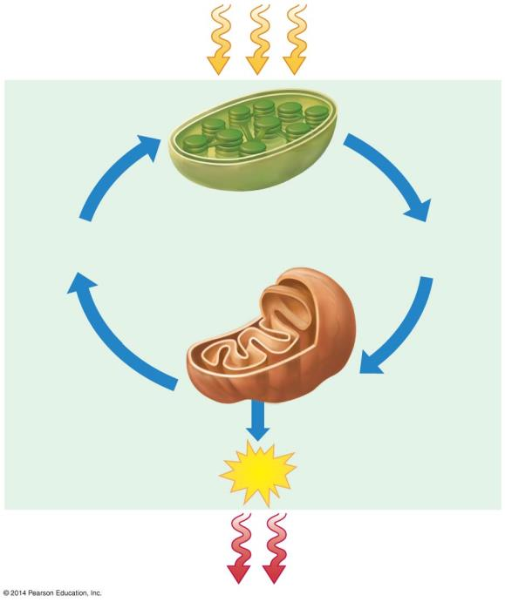
Figure 6.1
Sunlight energy
ECOSYSTEM
Photosynthesis in chloroplasts
CO₂ + H₂O
Organic molecules
+ O₂
Cellular respiration in mitochondria
ATP powers most cellular work
ATP
Heat energy
Notes:
Figure 6.1 The connection between photosynthesis and cellular respiration

Slide 9
5.12 ATP drives cellular work by coupling exergonic and endergonic reactions
ATP, adenosine triphosphate, powers nearly all forms of cellular work.
ATP consists of
adenosine
a triphosphate tail of three phosphate groups.
Notes:
9
Student Misconceptions and Concerns
• Students with limited exposure to physics may have never understood the concepts of energy and the conservation of energy. They also may not have distinguished between potential and kinetic energy. Understanding such broad and new abstract concepts requires time and concrete examples.
• Energy coupling at the cellular level may be new to many students, but it is a familiar concept when related to the use of money in our society. Students might be discouraged if the only benefit of work was the ability to make purchases from the employer. (We all might soon tire of a fast-food job that only paid its employees in food!) Money permits the coupling of a generation of value (a paycheck, analogous to an energy-releasing reaction) to an energy-consuming reaction (money, which allows us to make purchases in distant locations). This idea of earning and spending is a common concept we all know well.
Teaching Tips
• The amount of energy each adult human needs to generate the ATP required in a day is tremendous. Here is a calculation that has impressed many students. Depending upon the size and activity of a person, a human might burn 2,000 dietary calories (kilocalories) a day. This is enough energy to raise the temperature of 20 liters of liquid water from 0° to 100°C. This is something to think about the next time you heat water on the stove! If you can bring in ten 2-liter bottles, you can help students visualize how much liquid water can be raised from 0° to 100°C. (Note: 100 calories raises about 1 liter of water 100°C, but it takes much more energy to melt ice or to convert boiling water into steam.)
• When introducing ATP and ADP, consider asking your students to think of the terms as A-3-P and A-2-P, noting that the word roots “tri” = 3 and “di” = 2. It might help students to keep track of the number of phosphates more easily.
• Recycling is essential in cell biology. Damaged organelles are broken down intracellularly, and chemical components, the monomers of the cytoskeleton, and ADP are routinely recycled. There are several advantages common to human recycling of garbage and cellular recycling. Both save energy by avoiding the need to remanufacture the basic units, and both avoid an accumulation of waste products that could interfere with other “environmental” chemistry (the environment of the cell or the environment of the human population).

Slide 10
5.12 ATP drives cellular work by coupling exergonic and endergonic reactions
Hydrolysis of ATP releases energy by transferring its third phosphate from ATP to some other molecule in a process called phosphorylation.
Most cellular work depends on ATP energizing molecules by phosphorylating them.
Notes:
10
Student Misconceptions and Concerns
• Students with limited exposure to physics may have never understood the concepts of energy and the conservation of energy. They also may not have distinguished between potential and kinetic energy. Understanding such broad and new abstract concepts requires time and concrete examples.
• Energy coupling at the cellular level may be new to many students, but it is a familiar concept when related to the use of money in our society. Students might be discouraged if the only benefit of work was the ability to make purchases from the employer. (We all might soon tire of a fast-food job that only paid its employees in food!) Money permits the coupling of a generation of value (a paycheck, analogous to an energy-releasing reaction) to an energy-consuming reaction (money, which allows us to make purchases in distant locations). This idea of earning and spending is a common concept we all know well.
Teaching Tips
• The amount of energy each adult human needs to generate the ATP required in a day is tremendous. Here is a calculation that has impressed many students. Depending upon the size and activity of a person, a human might burn 2,000 dietary calories (kilocalories) a day. This is enough energy to raise the temperature of 20 liters of liquid water from 0° to 100°C. This is something to think about the next time you heat water on the stove! If you can bring in ten 2-liter bottles, you can help students visualize how much liquid water can be raised from 0° to 100°C. (Note: 100 calories raises about 1 liter of water 100°C, but it takes much more energy to melt ice or to convert boiling water into steam.)
• When introducing ATP and ADP, consider asking your students to think of the terms as A-3-P and A-2-P, noting that the word roots “tri” = 3 and “di” = 2. It might help students to keep track of the number of phosphates more easily.
• Recycling is essential in cell biology. Damaged organelles are broken down intracellularly, and chemical components, the monomers of the cytoskeleton, and ADP are routinely recycled. There are several advantages common to human recycling of garbage and cellular recycling. Both save energy by avoiding the need to remanufacture the basic units, and both avoid an accumulation of waste products that could interfere with other “environmental” chemistry (the environment of the cell or the environment of the human population).

Slide 11
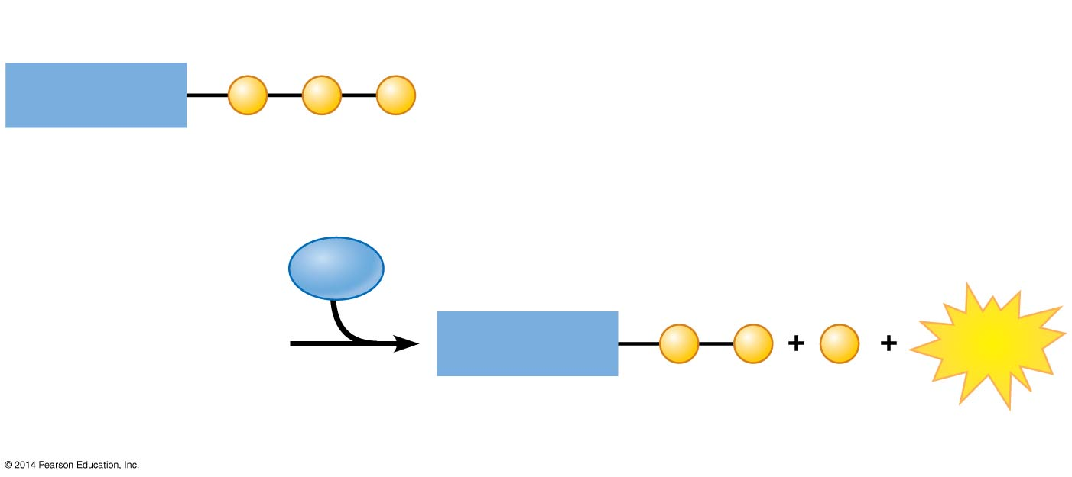
Figure 5.12a-2
Triphosphate
Adenosine
P
P
P
ATP
H₂O
Diphosphate
Adenosine
P
P
P
Energy
ADP
Phosphate
Notes:
Figure 5.12a-2 The hydrolysis of ATP yielding ADP, a phosphate group, and energy (step 2)

Slide 12
Answer in Notebooks:
#3. Explain how ATP release energy.

Slide 13
6.2 Breathing supplies O₂ for use in cellular respiration and removes CO₂ Respiration, as it relates to breathing, and cellular respiration are not the same.
Respiration, in the breathing sense, refers to an exchange of gases.
Usually an organism brings in oxygen from the environment and releases waste CO₂.
Cellular respiration is the aerobic (oxygen-requiring) harvesting of energy from food molecules by cells.
Notes:
13
Student Misconceptions and Concerns
• Students should be cautioned against the assumption that energy is created when it is converted from one form to another. This might be a good time to review the principle of conservation of energy (the first law of thermodynamics, addressed in Module 5.10).
Teaching Tips
• Energy coupling at the cellular level may be new to many students, but it is a familiar concept when related to the use of money in our society. Students might be discouraged if the only benefit of work was the ability to make purchases from the employer. (We all might soon tire of a fast-food job that only paid its employees in food!) Money permits the coupling of a generation of value (a paycheck, analogous to an energy-releasing reaction) to an energy-consuming reaction (money, which allows us to make purchases in distant locations). This idea of earning and spending is a common concept we all know well.
Active Lecture Tips
Ask your students why they feel warm when it is 30°C (86°F) outside, if their core body temperature is about 37°C (98.6°F). Shouldn’t they feel cold? Have students discuss ideas with others seated near them. (The answer is, our bodies are always producing heat. At these higher temperatures, we are producing more heat than we need to maintain a body temperature around 37°C. Thus, we sweat and behave in ways that help us get rid of the extra heat from cellular respiration.)

Slide 14
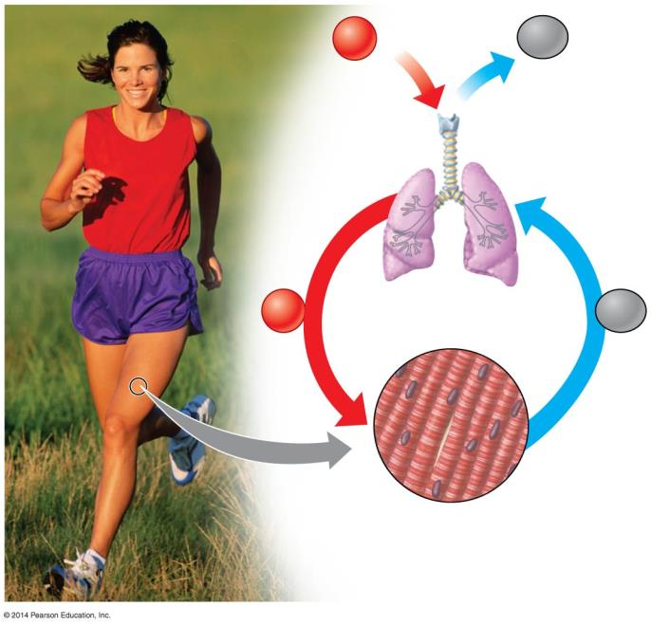
Figure 6.2-0
Breathing
O₂
CO₂
Lungs
O₂
Transported in bloodstream
CO₂
Muscle cells carrying out
Cellular Respiration
Glucose + O₂ ➞ CO₂ + H₂O + ATP
Notes:
Figure 6.2-0 The connection between breathing and cellular respiration

Slide 15
Answer in Notebooks:
#4. What is the difference between breathing respiration and cellular respiration?

Slide 16
6.3 Cellular respiration banks energy in ATP molecules
Cellular respiration is an exergonic (energy- releasing) process that transfers energy from the bonds in glucose to form ATP.
Notes:
16
Student Misconceptions and Concerns
• Students should be cautioned against the assumption that energy is created when it is converted from one form to another. This might be a good time to review the principle of conservation of energy (the first law of thermodynamics, addressed in Module 5.10).
• Students often fail to realize that aerobic metabolism is a process generally similar to the burning of wood or the burning of gasoline in an automobile engine. Noting these general similarities can help students comprehend the overall reaction and heat generation associated with these processes.
Teaching Tips
• Energy coupling at the cellular level may be new to many students, but it is a familiar concept when related to the use of money in our society. Students might be discouraged if the only benefit of work was the ability to make purchases from the employer. (We all might soon tire of a fast-food job that only paid its employees in food!) Money permits the coupling of a generation of value (a paycheck, analogous to an energy-releasing reaction) to an energy-consuming reaction (money, which allows us to make purchases in distant locations). This idea of earning and spending is a common concept we all know well.
• During cellular respiration, our cells convert about 34% of our food energy to useful work (Module 6.3). The other 66% of the energy is released as heat. We use this heat to maintain a relatively steady body temperature near 37°C (98–99°F). This is about the same amount of heat generated by a 75-watt incandescent lightbulb. If you choose to include a discussion of heat generation from aerobic metabolism, consider the following.
• Share this calculation with your students. Depending upon a person’s size and level of activity, a human might burn 2,000 dietary calories (kilocalories) a day. This is enough energy to raise the temperature of 20 liters of liquid water from 0 to 100°C. This is something to think about the next time you heat water on the stove! (Note: Consider bringing a 2-liter bottle as a visual aid, or ten 2-liter bottles to make the point above. It takes 100 calories to raise 1 liter of water 100°C; it takes much more energy to melt ice or evaporate water as steam.)
Active Lecture Tips
• Ask your students why they feel warm when it is 30°C (86°F) outside, if their core body temperature is about 37°C (98.6°F). Shouldn’t they feel cold? Have students discuss ideas with others seated near them. (The answer is, our bodies are always producing heat. At these higher temperatures, we are producing more heat than we need to maintain a body temperature around 37°C. Thus, we sweat and behave in ways that help us get rid of the extra heat from cellular respiration.)

Slide 17
6.3 Cellular respiration banks energy in ATP molecules
Cellular respiration
can produce up to 32 ATP molecules for each glucose molecule
uses about 34% of the energy originally stored in glucose
releases the other 66% as heat.
Notes:
17
Student Misconceptions and Concerns
• Students should be cautioned against the assumption that energy is created when it is converted from one form to another. This might be a good time to review the principle of conservation of energy (the first law of thermodynamics, addressed in Module 5.10).
• Students often fail to realize that aerobic metabolism is a process generally similar to the burning of wood or the burning of gasoline in an automobile engine. Noting these general similarities can help students comprehend the overall reaction and heat generation associated with these processes.
Teaching Tips
• Energy coupling at the cellular level may be new to many students, but it is a familiar concept when related to the use of money in our society. Students might be discouraged if the only benefit of work was the ability to make purchases from the employer. (We all might soon tire of a fast-food job that only paid its employees in food!) Money permits the coupling of a generation of value (a paycheck, analogous to an energy-releasing reaction) to an energy-consuming reaction (money, which allows us to make purchases in distant locations). This idea of earning and spending is a common concept we all know well.
• During cellular respiration, our cells convert about 34% of our food energy to useful work (Module 6.3). The other 66% of the energy is released as heat. We use this heat to maintain a relatively steady body temperature near 37°C (98–99°F). This is about the same amount of heat generated by a 75-watt incandescent lightbulb. If you choose to include a discussion of heat generation from aerobic metabolism, consider the following.
• Share this calculation with your students. Depending upon a person’s size and level of activity, a human might burn 2,000 dietary calories (kilocalories) a day. This is enough energy to raise the temperature of 20 liters of liquid water from 0 to 100°C. This is something to think about the next time you heat water on the stove! (Note: Consider bringing a 2-liter bottle as a visual aid, or ten 2-liter bottles to make the point above. It takes 100 calories to raise 1 liter of water 100°C; it takes much more energy to melt ice or evaporate water as steam.)
Active Lecture Tips
• Ask your students why they feel warm when it is 30°C (86°F) outside, if their core body temperature is about 37°C (98.6°F). Shouldn’t they feel cold? Have students discuss ideas with others seated near them. (The answer is, our bodies are always producing heat. At these higher temperatures, we are producing more heat than we need to maintain a body temperature around 37°C. Thus, we sweat and behave in ways that help us get rid of the extra heat from cellular respiration.)

Slide 18
6.3 Cellular respiration banks energy in ATP molecules
This energy conversion efficiency is better than most energy conversion systems.
Only about 25% of the energy in gasoline produces the kinetic energy of movement.

Slide 19
Figure 6.3
C₆H₁₂O₆
6
O₂
6
CO₂
6
H₂O
ATP
Heat
Glucose
Oxygen
Carbon dioxide
Water
Notes:
Figure 6.3 Summary equation for cellular respiration

Slide 20
6.4 CONNECTION: The human body uses energy from ATP for all its activities
A kilocalorie (kcal) is
the quantity of heat required to raise the temperature of 1 kilogram (kg) of water by 1°C
the same as a food Calorie
used to measure the nutritional values indicated on food labels.
Notes:
20
Student Misconceptions and Concerns
• Students should be cautioned against the assumption that energy is created when it is converted from one form to another. This might be a good time to review the principle of conservation of energy (the first law of thermodynamics, addressed in Module 5.10).
Teaching Tips
• You might share with your students that it takes about 10 million ATP molecules per second to power one active muscle cell.
Active Lecture Tips
• Ask your students why they feel warm when it is 30°C (86°F) outside, if their core body temperature is about 37°C (98.6°F). Shouldn’t they feel cold? Have students discuss ideas with others seated near them. (The answer is, our bodies are always producing heat. At these higher temperatures, we are producing more heat than we need to maintain a body temperature around 37°C. Thus, we sweat and behave in ways that help us get rid of the extra heat from cellular respiration.)

Slide 21
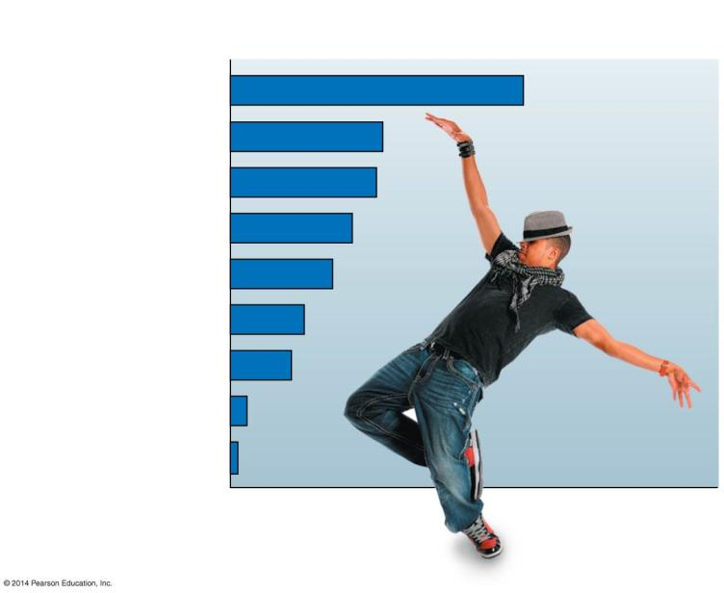
Figure 6.4-0
Activity
kcal consumed per hour by a 67.5-kg (150-lb) person*
Running (8–9 mph)
979
Dancing (fast)
510
Bicycling (10 mph)
490
Swimming (2 mph)
408
Walking (4 mph)
341
Walking (3 mph)
245
Dancing (slow)
204
Driving a car
61
Sitting (writing)
28
*Not including kcal needed for body maintenance
Notes:
Figure 6.4-0 Energy consumed by various activities

Slide 22
6.5 Cells capture energy from electrons “falling” from organic fuels to oxygen
How do your cells extract energy from glucose?
The answer involves the transfer of electrons during chemical reactions.
Notes:
22
Student Misconceptions and Concerns
• Students should be cautioned against the assumption that energy is created when it is converted from one form to another. This might be a good time to review the principle of conservation of energy (the first law of thermodynamics, addressed in Module 5.10).
• The advantage of the gradual degradation of glucose may not be obvious to some students. Many analogies exist that reveal the advantages of a gradual process. Fuel in an automobile is burned slowly to best utilize the energy released from the fuel. A few fireplace logs release gradual heat to keep a room’s temperature steady. In both situations, excessive use of fuel becomes wasteful, reducing the efficiencies of the systems.
Teaching Tips
• The use of the word “falling” when discussing the movement of electrons in a redox reaction can be confusing. Consider explaining the use of the term falling, in reference to potential energy of a falling object.
Active Lecture Tips
• Ask your students why they feel warm when it is 30°C (86°F) outside, if their core body temperature is about 37°C (98.6°F). Shouldn’t they feel cold? Have students discuss ideas with others seated near them. (The answer is, our bodies are always producing heat. At these higher temperatures, we are producing more heat than we need to maintain a body temperature around 37°C. Thus, we sweat and behave in ways that help us get rid of the extra heat from cellular respiration.)
• See the Activity Demonstration of Electron Transport and ATP Production in Aerobic Respiration Using Students and Balloons on the Instructor Exchange. Visit the Instructor Exchange in the MasteringBiology instructor resource area for a description of this activity.

Slide 23
6.5 Cells capture energy from electrons “falling” from organic fuels to oxygen
During cellular respiration
electrons are transferred from glucose to oxygen
energy is released.
Oxygen attracts electrons very strongly.
An electron loses potential energy when it is transferred to oxygen.
Notes:
23
Student Misconceptions and Concerns
• Students should be cautioned against the assumption that energy is created when it is converted from one form to another. This might be a good time to review the principle of conservation of energy (the first law of thermodynamics, addressed in Module 5.10).
• The advantage of the gradual degradation of glucose may not be obvious to some students. Many analogies exist that reveal the advantages of a gradual process. Fuel in an automobile is burned slowly to best utilize the energy released from the fuel. A few fireplace logs release gradual heat to keep a room’s temperature steady. In both situations, excessive use of fuel becomes wasteful, reducing the efficiencies of the systems.
Teaching Tips
• The use of the word “falling” when discussing the movement of electrons in a redox reaction can be confusing. Consider explaining the use of the term falling, in reference to potential energy of a falling object.
Active Lecture Tips
• Ask your students why they feel warm when it is 30°C (86°F) outside, if their core body temperature is about 37°C (98.6°F). Shouldn’t they feel cold? Have students discuss ideas with others seated near them. (The answer is, our bodies are always producing heat. At these higher temperatures, we are producing more heat than we need to maintain a body temperature around 37°C. Thus, we sweat and behave in ways that help us get rid of the extra heat from cellular respiration.)
• See the Activity Demonstration of Electron Transport and ATP Production in Aerobic Respiration Using Students and Balloons on the Instructor Exchange. Visit the Instructor Exchange in the MasteringBiology instructor resource area for a description of this activity.

Slide 24
6.5 Cells capture energy from electrons “falling” from organic fuels to oxygen
The movement of electrons from one molecule to another is an oxidation-reduction reaction, or redox reaction.
Notes:
24
Student Misconceptions and Concerns
• Students should be cautioned against the assumption that energy is created when it is converted from one form to another. This might be a good time to review the principle of conservation of energy (the first law of thermodynamics, addressed in Module 5.10).
• The advantage of the gradual degradation of glucose may not be obvious to some students. Many analogies exist that reveal the advantages of a gradual process. Fuel in an automobile is burned slowly to best utilize the energy released from the fuel. A few fireplace logs release gradual heat to keep a room’s temperature steady. In both situations, excessive use of fuel becomes wasteful, reducing the efficiencies of the systems.
Teaching Tips
• The use of the word “falling” when discussing the movement of electrons in a redox reaction can be confusing. Consider explaining the use of the term falling, in reference to potential energy of a falling object.
Active Lecture Tips
• Ask your students why they feel warm when it is 30°C (86°F) outside, if their core body temperature is about 37°C (98.6°F). Shouldn’t they feel cold? Have students discuss ideas with others seated near them. (The answer is, our bodies are always producing heat. At these higher temperatures, we are producing more heat than we need to maintain a body temperature around 37°C. Thus, we sweat and behave in ways that help us get rid of the extra heat from cellular respiration.)
• See the Activity Demonstration of Electron Transport and ATP Production in Aerobic Respiration Using Students and Balloons on the Instructor Exchange. Visit the Instructor Exchange in the MasteringBiology instructor resource area for a description of this activity.

Slide 25
6.5 Cells capture energy from electrons “falling” from organic fuels to oxygen
the loss of electrons from one substance is called oxidation
the addition of electrons to another substance is called reduction
a molecule is oxidized when it loses one or more electrons
a molecule is reduced when it gains one or more electrons.

Slide 26
6.5 Cells capture energy from electrons “falling” from organic fuels to oxygen
A cellular respiration equation is helpful to show the changes in hydrogen atom distribution.
Glucose loses its hydrogen atoms and becomes oxidized to CO₂.
Oxygen gains hydrogen atoms and becomes reduced to H₂O.
Notes:
26
Student Misconceptions and Concerns
• Students should be cautioned against the assumption that energy is created when it is converted from one form to another. This might be a good time to review the principle of conservation of energy (the first law of thermodynamics, addressed in Module 5.10).
• The advantage of the gradual degradation of glucose may not be obvious to some students. Many analogies exist that reveal the advantages of a gradual process. Fuel in an automobile is burned slowly to best utilize the energy released from the fuel. A few fireplace logs release gradual heat to keep a room’s temperature steady. In both situations, excessive use of fuel becomes wasteful, reducing the efficiencies of the systems.
Teaching Tips
• The use of the word “falling” when discussing the movement of electrons in a redox reaction can be confusing. Consider explaining the use of the term falling, in reference to potential energy of a falling object.
Active Lecture Tips
• Ask your students why they feel warm when it is 30°C (86°F) outside, if their core body temperature is about 37°C (98.6°F). Shouldn’t they feel cold? Have students discuss ideas with others seated near them. (The answer is, our bodies are always producing heat. At these higher temperatures, we are producing more heat than we need to maintain a body temperature around 37°C. Thus, we sweat and behave in ways that help us get rid of the extra heat from cellular respiration.)
• See the Activity Demonstration of Electron Transport and ATP Production in Aerobic Respiration Using Students and Balloons on the Instructor Exchange. Visit the Instructor Exchange in the MasteringBiology instructor resource area for a description of this activity.

Slide 27
Figure 6.5a
Loss of hydrogen atoms (becomes oxidized)
C₆H₁₂O₆ + 6 O₂
6 CO₂ + 6 H₂O + ATP + Heat
(Glucose)
Gain of hydrogen atoms (becomes reduced)
Notes:
Figure 6.5a Rearrangement of hydrogen atoms (with their electrons) in the redox reactions of cellular respiration

Slide 28
Answer in Notebooks:
#5. What is acronym for remembering oxidation and reduction?

Slide 29
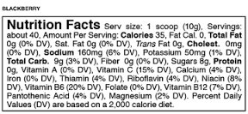
6.5 Cells capture energy from electrons “falling” from organic fuels to oxygen
An important player in the process of oxidizing glucose is a coenzyme called NAD⁺ and FAD
accepts electrons
becomes reduced to NADH and FADH₂.
Notes:
29
Student Misconceptions and Concerns
• Students should be cautioned against the assumption that energy is created when it is converted from one form to another. This might be a good time to review the principle of conservation of energy (the first law of thermodynamics, addressed in Module 5.10).
• The advantage of the gradual degradation of glucose may not be obvious to some students. Many analogies exist that reveal the advantages of a gradual process. Fuel in an automobile is burned slowly to best utilize the energy released from the fuel. A few fireplace logs release gradual heat to keep a room’s temperature steady. In both situations, excessive use of fuel becomes wasteful, reducing the efficiencies of the systems.
Teaching Tips
• The use of the word “falling” when discussing the movement of electrons in a redox reaction can be confusing. Consider explaining the use of the term falling, in reference to potential energy of a falling object.
Active Lecture Tips
• Ask your students why they feel warm when it is 30°C (86°F) outside, if their core body temperature is about 37°C (98.6°F). Shouldn’t they feel cold? Have students discuss ideas with others seated near them. (The answer is, our bodies are always producing heat. At these higher temperatures, we are producing more heat than we need to maintain a body temperature around 37°C. Thus, we sweat and behave in ways that help us get rid of the extra heat from cellular respiration.)
• See the Activity Demonstration of Electron Transport and ATP Production in Aerobic Respiration Using Students and Balloons on the Instructor Exchange. Visit the Instructor Exchange in the MasteringBiology instructor resource area for a description of this activity.

Slide 30
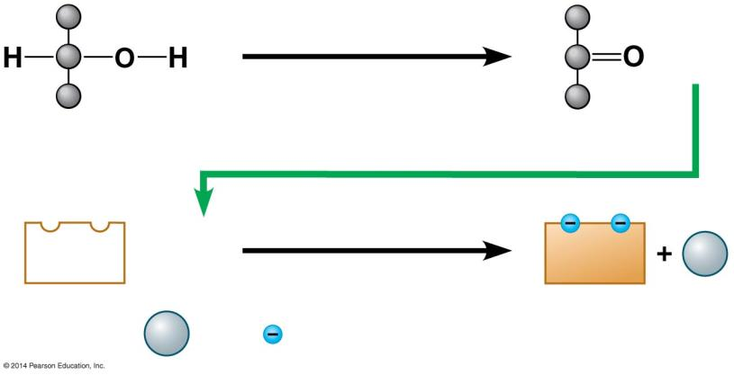
Figure 6.5b
Becomes oxidized
+ 2 H
Becomes reduced
NAD⁺
+ 2 H
NADH
H⁺
(carries) 2 electrons)
2
H⁺
+
2
Notes:
Figure 6.5b A pair of redox reactions occurring simultaneously

Slide 31
Figure 6.1
Sunlight energy
ECOSYSTEM
Photosynthesis in chloroplasts
CO₂ + H₂O
Organic molecules
+ O₂
Cellular respiration in mitochondria
ATP powers most cellular work
ATP
Heat energy
Notes:
Figure 6.1 The connection between photosynthesis and cellular respiration

Slide 32
Stages of Cellular Respiration
Notes:
32

Slide 33
Glycolysis
REDOX in Cell Respiration
Intro to Cell Respiration
Kreb's Cycle
Oxidative Phosphorylation

Slide 34
6.6 Overview: Cellular respiration occurs in three main stages
Cellular respiration consists of a sequence of steps that can be divided into three stages.
Stage 1: Glycolysis
Stage 2: Pyruvate oxidation and the citric acid cycle
Stage 3: Oxidative phosphorylation
Notes:
34
Student Misconceptions and Concerns
• Perhaps more than anywhere else in general biology, students studying aerobic metabolism may fail to see the forest for the trees. Students may focus on the details of each stage of aerobic metabolism and devote little attention to the overall process and products. Consider emphasizing the products and energy yields associated with glycolysis, the citric acid cycle, and oxidative phosphorylation before detailing the specifics of each reaction.
• The location within a cell in which each reaction takes place is often forgotten in the details of the chemical processes, but it is important to emphasize. Consider using Figure 6.12 as a common reference to locate each stage as you discuss the details of cellular respiration.
• Students frequently think that plants have chloroplasts instead of mitochondria. Take care to point out the need for mitochondria in plants when photosynthesis is not efficient or possible (such as during the night).
Active Lecture Tips
• See the Activity Cell Respiration: Pair and Share on the Instructor Exchange. Visit the Instructor Exchange in the MasteringBiology instructor resource area for a description of this activity.

Slide 35
6.6 Overview: Cellular respiration occurs in three main stages
Stage 1: Glycolysis
occurs in the cytosol
begins cellular respiration
breaks down glucose into two molecules of a three-carbon compound called pyruvate.
Notes:
35
Student Misconceptions and Concerns
• Perhaps more than anywhere else in general biology, students studying aerobic metabolism may fail to see the forest for the trees. Students may focus on the details of each stage of aerobic metabolism and devote little attention to the overall process and products. Consider emphasizing the products and energy yields associated with glycolysis, the citric acid cycle, and oxidative phosphorylation before detailing the specifics of each reaction.
• The location within a cell in which each reaction takes place is often forgotten in the details of the chemical processes, but it is important to emphasize. Consider using Figure 6.12 as a common reference to locate each stage as you discuss the details of cellular respiration.
• Students frequently think that plants have chloroplasts instead of mitochondria. Take care to point out the need for mitochondria in plants when photosynthesis is not efficient or possible (such as during the night).
Active Lecture Tips
• See the Activity Cell Respiration: Pair and Share on the Instructor Exchange. Visit the Instructor Exchange in the MasteringBiology instructor resource area for a description of this activity.

Slide 36
6.7 Glycolysis harvests chemical energy by oxidizing glucose to pyruvate
In glycolysis
a single molecule of glucose is enzymatically cut in half through a series of steps
two molecules of pyruvate are produced
two molecules of NAD⁺ are reduced to two molecules of NADH
there is a net gain of two molecules of ATP.
Notes:
36
Student Misconceptions and Concerns
• Perhaps more than anywhere else in general biology, students studying aerobic metabolism may fail to see the forest for the trees. Students may focus on the details of each stage of aerobic metabolism and devote little attention to the overall process and products. Consider emphasizing the products and energy yields associated with glycolysis, the citric acid cycle, and oxidative phosphorylation before detailing the specifics of each reaction.
• The location within a cell in which each reaction takes place is often forgotten in the details of the chemical processes, but it is important to emphasize. Consider using Figure 6.12 as a common reference to locate each stage as you discuss the details of cellular respiration.
• Students frequently think that plants have chloroplasts instead of mitochondria. Take care to point out the need for mitochondria in plants when photosynthesis is not efficient or possible (such as during the night).
Teaching Tips
• The production of NADH through glycolysis and the citric acid cycle, as compared to the direct production of ATP, can get confusing for students. Help students understand that NADH molecules have value to be cashed in by the electron transport chain. The NADH can therefore be thought of as casino chips, accumulated along the way to be cashed in at the electron transport cashier.
Active Lecture Tips
• See the Activity Cell Respiration: Pair and Share on the Instructor Exchange. Visit the Instructor Exchange in the MasteringBiology instructor resource area for a description of this activity.

Slide 37
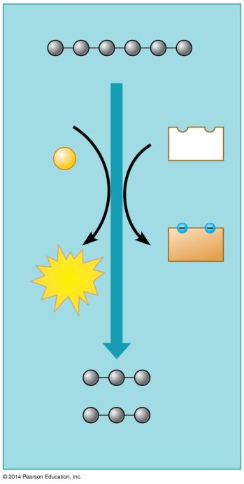
Figure 6.7a
Glucose
2 ADP
2
NAD⁺
+2
P
2
NADH
2
ATP
+2 H⁺
2 Pyruvate
Notes:
Figure 6.7a An overview of glycolysis

Slide 38
6.7 Glycolysis harvests chemical energy by oxidizing glucose to pyruvate
ATP is formed in glycolysis by substrate-level phosphorylation during which
an enzyme transfers a phosphate group from a substrate molecule to ADP
ATP is formed.
Notes:
38
Student Misconceptions and Concerns
• Perhaps more than anywhere else in general biology, students studying aerobic metabolism may fail to see the forest for the trees. Students may focus on the details of each stage of aerobic metabolism and devote little attention to the overall process and products. Consider emphasizing the products and energy yields associated with glycolysis, the citric acid cycle, and oxidative phosphorylation before detailing the specifics of each reaction.
• The location within a cell in which each reaction takes place is often forgotten in the details of the chemical processes, but it is important to emphasize. Consider using Figure 6.12 as a common reference to locate each stage as you discuss the details of cellular respiration.
• Students frequently think that plants have chloroplasts instead of mitochondria. Take care to point out the need for mitochondria in plants when photosynthesis is not efficient or possible (such as during the night).
Teaching Tips
• The production of NADH through glycolysis and the citric acid cycle, as compared to the direct production of ATP, can get confusing for students. Help students understand that NADH molecules have value to be cashed in by the electron transport chain. The NADH can therefore be thought of as casino chips, accumulated along the way to be cashed in at the electron transport cashier.
Active Lecture Tips
• See the Activity Cell Respiration: Pair and Share on the Instructor Exchange. Visit the Instructor Exchange in the MasteringBiology instructor resource area for a description of this activity.

Slide 39
6.7 Glycolysis harvests chemical energy by oxidizing glucose to pyruvate
The compounds that form between the initial reactant, glucose, and the final product, pyruvate, are known as intermediates.

Slide 40
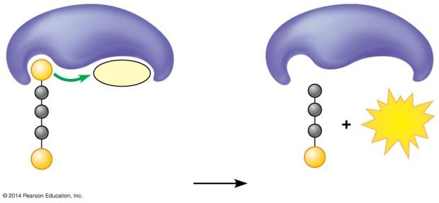
Figure 6.7b
Enzyme
Enzyme
P
ADP
ATP
P
P
Substrate
Product
Notes:
Figure 6.7b Substrate-level phosphorylation: transfer of a phosphate group from a substrate to ADP, producing ATP

Slide 41
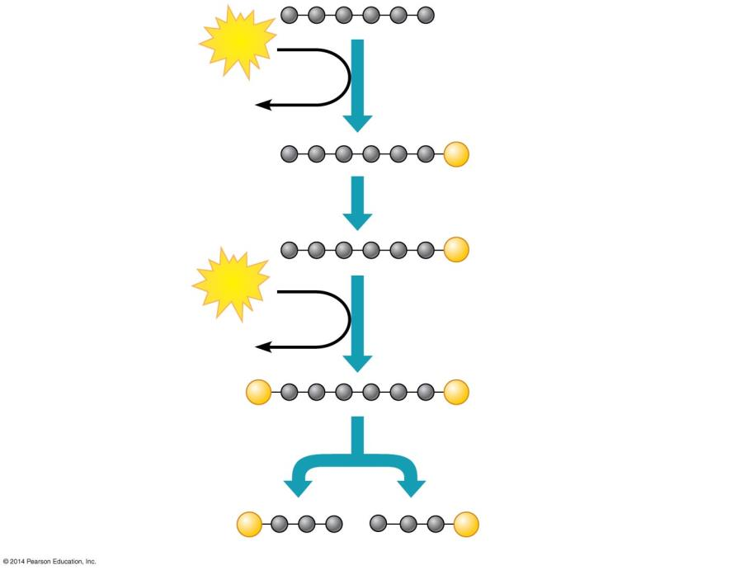
Figure 6.7c-1-2
Glucose
ENERGY INVESTMENT PHASE
ATP
Steps – Glucose is energized, using ATP.
Step
1
3
1
ADP
P
Glucose 6-phosphate
2
P
Fructose 6-phosphate
ATP
3
ADP
Step A six-carbon intermediate splits into two three-carbon intermediates.
4
P
P
Fructose 1,6-bisphosphate
4
P
P
Glyceraldehyde 3-phosphate (G3P)
Notes:
Figure 6.7c-1-2 Details of glycolysis: energy investment phase (part 1, step 2)

Slide 42
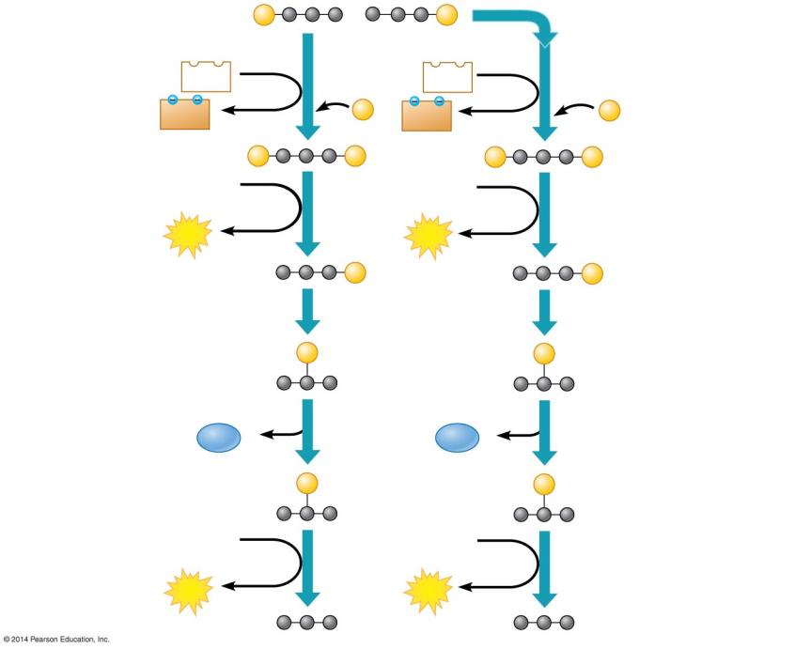
Figure 6.7c-2-2
P
P
Glyceraldehyde 3-phosphate (G3P)
Step A redox reaction generates NADH.
NAD⁺
NAD⁺
ENERGY PAYOFF PHASE
5
5
5
NADH
P
NADH
P
+ H⁺
+ H⁺
P
P
P
P
1,3-Bisphosphoglycerate
ADP
ADP
Steps – ATP and pyruvate are produced.
6
6
6
9
ATP
ATP
P
P
3-Phosphoglycerate
7
7
P
P
2-Phosphoglycerate
H₂O
8
H₂O
8
P
P
Phosphoenolpyruvate (PEP)
ADP
ADP
9
9
ATP
ATP
Pyruvate
Notes:
Figure 6.7c-2-2 Details of glycolysis: energy payoff phase (part 2, step 2)

Slide 43
Answer in Notebooks:
#7. What molecule does Glycolysis Start with?
What are the intermediates produced in Glycolysis?
What is the final product of Glycolysis?

Slide 44
6.6 Overview: Cellular respiration occurs in three main stages
Stage 2: Pyruvate oxidation and the citric acid cycle
take place in mitochondria
oxidize pyruvate to a two-carbon compound
supply the third stage with electrons.
The cell makes a small amount of ATP during glycolysis and the citric acid cycle.
Notes:
44
Student Misconceptions and Concerns
• Perhaps more than anywhere else in general biology, students studying aerobic metabolism may fail to see the forest for the trees. Students may focus on the details of each stage of aerobic metabolism and devote little attention to the overall process and products. Consider emphasizing the products and energy yields associated with glycolysis, the citric acid cycle, and oxidative phosphorylation before detailing the specifics of each reaction.
• The location within a cell in which each reaction takes place is often forgotten in the details of the chemical processes, but it is important to emphasize. Consider using Figure 6.12 as a common reference to locate each stage as you discuss the details of cellular respiration.
• Students frequently think that plants have chloroplasts instead of mitochondria. Take care to point out the need for mitochondria in plants when photosynthesis is not efficient or possible (such as during the night).
Active Lecture Tips
• See the Activity Cell Respiration: Pair and Share on the Instructor Exchange. Visit the Instructor Exchange in the MasteringBiology instructor resource area for a description of this activity.

Slide 45
6.8 Pyruvate is oxidized in preparation for the citric acid cycle
The pyruvate formed in glycolysis is transported from the cytosol into a mitochondrion where the citric acid cycle and oxidative phosphorylation will occur.
Two molecules of pyruvate are produced for each molecule of glucose that enters glycolysis.
Notes:
45
Student Misconceptions and Concerns
• Perhaps more than anywhere else in general biology, students studying aerobic metabolism may fail to see the forest for the trees. Students may focus on the details of each stage of aerobic metabolism and devote little attention to the overall process and products. Consider emphasizing the products and energy yields associated with glycolysis, the citric acid cycle, and oxidative phosphorylation before detailing the specifics of each reaction.
• The location within a cell in which each reaction takes place is often forgotten in the details of the chemical processes, but it is important to emphasize. Consider using Figure 6.12 as a common reference to locate each stage as you discuss the details of cellular respiration.
• Students frequently think that plants have chloroplasts instead of mitochondria. Take care to point out the need for mitochondria in plants when photosynthesis is not efficient or possible (such as during the night).
Teaching Tips
• The production of NADH through glycolysis and the citric acid cycle, as compared to the direct production of ATP, can get confusing for students. Help students understand that NADH molecules have value to be cashed in by the electron transport chain. The NADH can therefore be thought of as casino chips, accumulated along the way to be cashed in at the electron transport cashier.
Active Lecture Tips
• See the Activity Cell Respiration: Pair and Share on the Instructor Exchange. Visit the Instructor Exchange in the MasteringBiology instructor resource area for a description of this activity.

Slide 46
6.8 Pyruvate is oxidized in preparation for the citric acid cycle
Pyruvate does not enter the citric acid cycle but undergoes some chemical grooming in which
a carboxyl group is removed and given off as CO₂
the two-carbon compound remaining is oxidized while a molecule of NAD⁺ is reduced to NADH
coenzyme A joins with the two-carbon group to form acetyl coenzyme A, abbreviated as acetyl CoA.
Notes:
46
Student Misconceptions and Concerns
• Perhaps more than anywhere else in general biology, students studying aerobic metabolism may fail to see the forest for the trees. Students may focus on the details of each stage of aerobic metabolism and devote little attention to the overall process and products. Consider emphasizing the products and energy yields associated with glycolysis, the citric acid cycle, and oxidative phosphorylation before detailing the specifics of each reaction.
• The location within a cell in which each reaction takes place is often forgotten in the details of the chemical processes, but it is important to emphasize. Consider using Figure 6.12 as a common reference to locate each stage as you discuss the details of cellular respiration.
• Students frequently think that plants have chloroplasts instead of mitochondria. Take care to point out the need for mitochondria in plants when photosynthesis is not efficient or possible (such as during the night).
Teaching Tips
• The production of NADH through glycolysis and the citric acid cycle, as compared to the direct production of ATP, can get confusing for students. Help students understand that NADH molecules have value to be cashed in by the electron transport chain. The NADH can therefore be thought of as casino chips, accumulated along the way to be cashed in at the electron transport cashier.
Active Lecture Tips
• See the Activity Cell Respiration: Pair and Share on the Instructor Exchange. Visit the Instructor Exchange in the MasteringBiology instructor resource area for a description of this activity.

Slide 47
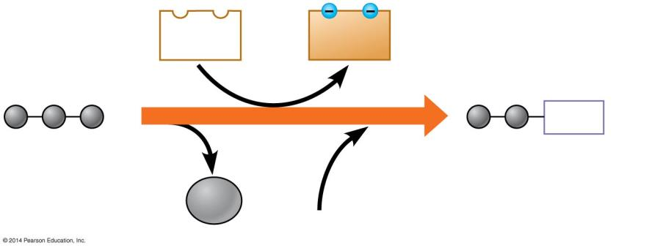
Figure 6.8
NAD⁺
NADH
+ H⁺
2
CoA
Pyruvate
1
Acetyl coenzyme A
3
CO₂
Coenzyme A
Notes:
Figure 6.8 The link between glycolysis and the citric acid cycle

Slide 48
6.8 Pyruvate is oxidized in preparation for the citric acid cycle
Then two molecules of acetyl CoA enter the citric acid cycle.

Slide 49
Answer in Notebooks:
#8.What molecule does pyruvate oxidation start with?
What are the intermediates that are produced in pyruvate oxidation?
What is the final product of pyruvate oxidation?

Slide 50
6.9 The citric acid cycle completes the oxidation of organic molecules, generating many NADH and FADH₂ molecules
The citric acid cycle
is also called the Krebs cycle (after the German-British researcher Hans Krebs, who worked out much of this pathway in the 1930s)
completes the oxidation of organic molecules
generates many NADH and FADH₂ molecules.
Notes:
50
Student Misconceptions and Concerns
• Perhaps more than anywhere else in general biology, students studying aerobic metabolism may fail to see the forest for the trees. Students may focus on the details of each stage of aerobic metabolism and devote little attention to the overall process and products. Consider emphasizing the products and energy yields associated with glycolysis, the citric acid cycle, and oxidative phosphorylation before detailing the specifics of each reaction.
• The location within a cell in which each reaction takes place is often forgotten in the details of the chemical processes, but it is important to emphasize. Consider using Figure 6.12 as a common reference to locate each stage as you discuss the details of cellular respiration.
• Students frequently think that plants have chloroplasts instead of mitochondria. Take care to point out the need for mitochondria in plants when photosynthesis is not efficient or possible (such as during the night).
Teaching Tips
• The production of NADH through glycolysis and the citric acid cycle, as compared to the direct production of ATP, can get confusing for students. Help students understand that NADH molecules have value to be cashed in by the electron transport chain. The NADH can therefore be thought of as casino chips, accumulated along the way to be cashed in at the electron transport cashier.
Active Lecture Tips
• See the Activity Cell Respiration: Pair and Share on the Instructor Exchange. Visit the Instructor Exchange in the MasteringBiology instructor resource area for a description of this activity.

Slide 51
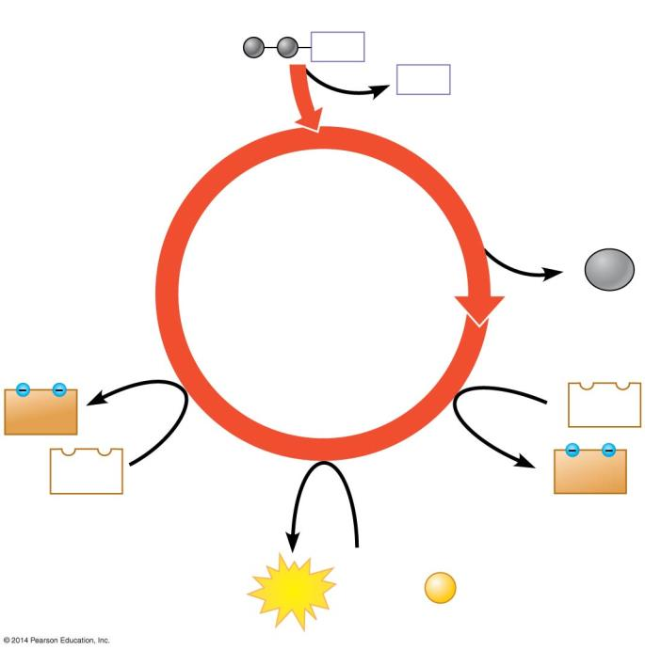
Figure 6.9a
Acetyl CoA
CoA
CoA
2
CO₂
Citric Acid Cycle
FADH₂
3
NAD⁺
FAD
3
NADH
+ 3 H⁺
ATP
ADP +
P
Notes:
Figure 6.9a An overview of the citric acid cycle

Slide 52
6.9 The citric acid cycle completes the oxidation of organic molecules, generating many NADH and FADH₂ molecules
During the citric acid cycle
the two-carbon group of acetyl CoA is joined to a four-carbon compound, forming citrate
citrate is degraded back to the four-carbon compound
two CO₂ are released
one ATP, three NADH, and one FADH₂ are produced.
Notes:
52
Student Misconceptions and Concerns
• Perhaps more than anywhere else in general biology, students studying aerobic metabolism may fail to see the forest for the trees. Students may focus on the details of each stage of aerobic metabolism and devote little attention to the overall process and products. Consider emphasizing the products and energy yields associated with glycolysis, the citric acid cycle, and oxidative phosphorylation before detailing the specifics of each reaction.
• The location within a cell in which each reaction takes place is often forgotten in the details of the chemical processes, but it is important to emphasize. Consider using Figure 6.12 as a common reference to locate each stage as you discuss the details of cellular respiration.
• Students frequently think that plants have chloroplasts instead of mitochondria. Take care to point out the need for mitochondria in plants when photosynthesis is not efficient or possible (such as during the night).
Teaching Tips
• The production of NADH through glycolysis and the citric acid cycle, as compared to the direct production of ATP, can get confusing for students. Help students understand that NADH molecules have value to be cashed in by the electron transport chain. The NADH can therefore be thought of as casino chips, accumulated along the way to be cashed in at the electron transport cashier.
Active Lecture Tips
• See the Activity Cell Respiration: Pair and Share on the Instructor Exchange. Visit the Instructor Exchange in the MasteringBiology instructor resource area for a description of this activity.

Slide 53
6.9 The citric acid cycle completes the oxidation of organic molecules, generating many NADH and FADH₂ molecules
Remember that the citric acid cycle processes two molecules of acetyl CoA for each initial glucose.
Thus, after two turns of the citric acid cycle, the overall yield per glucose molecule is
2 ATP
6 NADH
2 FADH₂.
Notes:
53
Student Misconceptions and Concerns
• Perhaps more than anywhere else in general biology, students studying aerobic metabolism may fail to see the forest for the trees. Students may focus on the details of each stage of aerobic metabolism and devote little attention to the overall process and products. Consider emphasizing the products and energy yields associated with glycolysis, the citric acid cycle, and oxidative phosphorylation before detailing the specifics of each reaction.
• The location within a cell in which each reaction takes place is often forgotten in the details of the chemical processes, but it is important to emphasize. Consider using Figure 6.12 as a common reference to locate each stage as you discuss the details of cellular respiration.
• Students frequently think that plants have chloroplasts instead of mitochondria. Take care to point out the need for mitochondria in plants when photosynthesis is not efficient or possible (such as during the night).
Teaching Tips
• The production of NADH through glycolysis and the citric acid cycle, as compared to the direct production of ATP, can get confusing for students. Help students understand that NADH molecules have value to be cashed in by the electron transport chain. The NADH can therefore be thought of as casino chips, accumulated along the way to be cashed in at the electron transport cashier.
Active Lecture Tips
• See the Activity Cell Respiration: Pair and Share on the Instructor Exchange. Visit the Instructor Exchange in the MasteringBiology instructor resource area for a description of this activity.

Slide 54
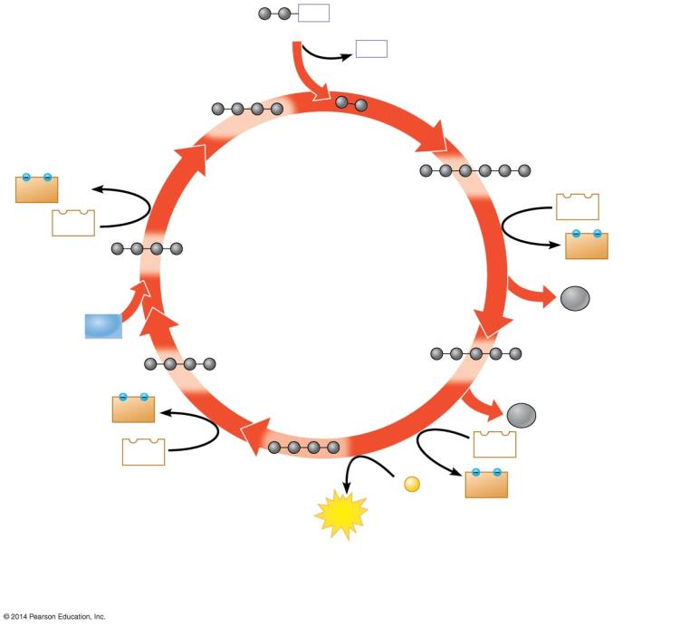
Figure 6.9b-3
CoA
Acetyl CoA
CoA
2 carbons enter cycle
Oxaloacetate
1
NADH
+ H⁺
Citrate
6
NAD⁺
NAD⁺
2
NADH
+ H⁺
Malate
Citric Acid Cycle
CO₂
leaves cycle
H₂O
5
Fumarate
Alpha-ketoglutarate
FADH₂
4
CO₂
leaves cycle
3
NAD⁺
FAD
Succinate
ADP +
P
NADH
+ H⁺
ATP
1
2
Step
Acetyl CoA stokes the furnace.
Steps –
NADH, ATP, and CO₂ are generated during redox reactions.
Steps –
Further redox reactions
generate FADH₂ and more NADH.
3
4
6
Notes:
Figure 6.9b-3 A closer look at the citric acid cycle (step 3)

Slide 55
Answer in Notebooks:
#9. What molecule does the Citric Acid Cycle start with?
What are the intermediates from the Citric Acid Cycle?
What is the final product of the Citric Acid Cycle?

Slide 56
6.9 The citric acid cycle completes the oxidation of organic molecules, generating many NADH and FADH₂ molecules
Thus, after glycolysis and the citric acid cycle, the cell has gained
4 ATP
10 NADH
2 FADH₂.
To harvest the energy banked in NADH and FADH₂, these molecules must shuttle their high-energy electrons to an electron transport chain.
Notes:
56
Student Misconceptions and Concerns
• Perhaps more than anywhere else in general biology, students studying aerobic metabolism may fail to see the forest for the trees. Students may focus on the details of each stage of aerobic metabolism and devote little attention to the overall process and products. Consider emphasizing the products and energy yields associated with glycolysis, the citric acid cycle, and oxidative phosphorylation before detailing the specifics of each reaction.
• The location within a cell in which each reaction takes place is often forgotten in the details of the chemical processes, but it is important to emphasize. Consider using Figure 6.12 as a common reference to locate each stage as you discuss the details of cellular respiration.
• Students frequently think that plants have chloroplasts instead of mitochondria. Take care to point out the need for mitochondria in plants when photosynthesis is not efficient or possible (such as during the night).
Teaching Tips
• The production of NADH through glycolysis and the citric acid cycle, as compared to the direct production of ATP, can get confusing for students. Help students understand that NADH molecules have value to be cashed in by the electron transport chain. The NADH can therefore be thought of as casino chips, accumulated along the way to be cashed in at the electron transport cashier.
Active Lecture Tips
• See the Activity Cell Respiration: Pair and Share on the Instructor Exchange. Visit the Instructor Exchange in the MasteringBiology instructor resource area for a description of this activity.

Slide 57
6.6 Overview: Cellular respiration occurs in three main stages
Stage 3: Oxidative phosphorylation
NADH and a related electron carrier, FADH₂, shuttle electrons to an electron transport chain embedded in the inner mitochondrial membrane.
Most ATP produced by cellular respiration is generated by oxidative phosphorylation
uses the energy released by the downhill fall of electrons from NADH and FADH₂ to oxygen to phosphorylate ADP.
Notes:
57
Student Misconceptions and Concerns
• Perhaps more than anywhere else in general biology, students studying aerobic metabolism may fail to see the forest for the trees. Students may focus on the details of each stage of aerobic metabolism and devote little attention to the overall process and products. Consider emphasizing the products and energy yields associated with glycolysis, the citric acid cycle, and oxidative phosphorylation before detailing the specifics of each reaction.
• The location within a cell in which each reaction takes place is often forgotten in the details of the chemical processes, but it is important to emphasize. Consider using Figure 6.12 as a common reference to locate each stage as you discuss the details of cellular respiration.
• Students frequently think that plants have chloroplasts instead of mitochondria. Take care to point out the need for mitochondria in plants when photosynthesis is not efficient or possible (such as during the night).
Active Lecture Tips
• See the Activity Cell Respiration: Pair and Share on the Instructor Exchange. Visit the Instructor Exchange in the MasteringBiology instructor resource area for a description of this activity.

Slide 58
6.6 Overview: Cellular respiration occurs in three main stages
Stage 3: Oxidative phosphorylation
As the electron transport chain passes electrons down the energy hill, it also pumps hydrogen ions (H⁺) across the inner mitochondrial membrane, into the narrow intermembrane space, and produces a concentration gradient of H⁺ across the membrane.
Notes:
58
Student Misconceptions and Concerns
• Perhaps more than anywhere else in general biology, students studying aerobic metabolism may fail to see the forest for the trees. Students may focus on the details of each stage of aerobic metabolism and devote little attention to the overall process and products. Consider emphasizing the products and energy yields associated with glycolysis, the citric acid cycle, and oxidative phosphorylation before detailing the specifics of each reaction.
• The location within a cell in which each reaction takes place is often forgotten in the details of the chemical processes, but it is important to emphasize. Consider using Figure 6.12 as a common reference to locate each stage as you discuss the details of cellular respiration.
• Students frequently think that plants have chloroplasts instead of mitochondria. Take care to point out the need for mitochondria in plants when photosynthesis is not efficient or possible (such as during the night).
Active Lecture Tips
• See the Activity Cell Respiration: Pair and Share on the Instructor Exchange. Visit the Instructor Exchange in the MasteringBiology instructor resource area for a description of this activity.

Slide 59
6.10 Most ATP production occurs by oxidative phosphorylation
The arrangement of electron carriers built into a membrane makes it possible to
create an H⁺ concentration gradient across the membrane
use the energy of that gradient to drive ATP synthesis.

Slide 60
6.10 Most ATP production occurs by oxidative phosphorylation
Electrons from NADH and FADH₂ travel down the electron transport chain to O₂, the final electron acceptor.
Oxygen picks up H⁺, which forms water.
Energy released by these redox reactions is used to pump H⁺ from the mitochondrial matrix into the intermembrane space.
Notes:
60
Student Misconceptions and Concerns
• Perhaps more than anywhere else in general biology, students studying aerobic metabolism may fail to see the forest for the trees. Students may focus on the details of each stage of aerobic metabolism and devote little attention to the overall process and products. Consider emphasizing the products and energy yields associated with glycolysis, the citric acid cycle, and oxidative phosphorylation before detailing the specifics of each reaction.
• The location within a cell in which each reaction takes place is often forgotten in the details of the chemical processes, but it is important to emphasize. Consider using Figure 6.12 as a common reference to locate each stage as you discuss the details of cellular respiration.
• Students frequently think that plants have chloroplasts instead of mitochondria. Take care to point out the need for mitochondria in plants when photosynthesis is not efficient or possible (such as during the night).
Teaching Tips
• The authors develop an analogy between the function of the inner mitochondrial membrane and a dam. A reservoir of hydrogen ions is built up between the inner and outer mitochondrial membranes, like a dam holding water. As the hydrogen ions move down their concentration gradient, they “spin” the ATP synthase, which helps generate ATP. In a dam, water rushing downhill turns giant turbines, which generate electricity.
• The production of NADH through glycolysis and the citric acid cycle, as compared to the direct production of ATP, can get confusing for students. Help students understand that NADH molecules have value to be cashed in by the electron transport chain. The NADH can therefore be thought of as casino chips, accumulated along the way to be cashed in at the electron transport cashier.
Active Lecture Tips
• As you relate the structure of the inner mitochondrial membrane to its functions, challenge students to explain the adaptive advantage of the many folds of this inner membrane (see Figure 6.6). (These folds greatly increase the surface area available for the associated reactions.)
• See the Activity Cell Respiration: Pair and Share on the Instructor Exchange. Visit the Instructor Exchange in the MasteringBiology instructor resource area for a description of this activity.

Slide 61
6.10 Most ATP production occurs by oxidative phosphorylation
In chemiosmosis, the H⁺ diffuses back across the inner membrane, through ATP synthase complexes, driving the synthesis of ATP.
Notes:
61
Student Misconceptions and Concerns
• Perhaps more than anywhere else in general biology, students studying aerobic metabolism may fail to see the forest for the trees. Students may focus on the details of each stage of aerobic metabolism and devote little attention to the overall process and products. Consider emphasizing the products and energy yields associated with glycolysis, the citric acid cycle, and oxidative phosphorylation before detailing the specifics of each reaction.
• The location within a cell in which each reaction takes place is often forgotten in the details of the chemical processes, but it is important to emphasize. Consider using Figure 6.12 as a common reference to locate each stage as you discuss the details of cellular respiration.
• Students frequently think that plants have chloroplasts instead of mitochondria. Take care to point out the need for mitochondria in plants when photosynthesis is not efficient or possible (such as during the night).
Teaching Tips
• The authors develop an analogy between the function of the inner mitochondrial membrane and a dam. A reservoir of hydrogen ions is built up between the inner and outer mitochondrial membranes, like a dam holding water. As the hydrogen ions move down their concentration gradient, they “spin” the ATP synthase, which helps generate ATP. In a dam, water rushing downhill turns giant turbines, which generate electricity.
• The production of NADH through glycolysis and the citric acid cycle, as compared to the direct production of ATP, can get confusing for students. Help students understand that NADH molecules have value to be cashed in by the electron transport chain. The NADH can therefore be thought of as casino chips, accumulated along the way to be cashed in at the electron transport cashier.
Active Lecture Tips
• As you relate the structure of the inner mitochondrial membrane to its functions, challenge students to explain the adaptive advantage of the many folds of this inner membrane (see Figure 6.6). (These folds greatly increase the surface area available for the associated reactions.)
• See the Activity Cell Respiration: Pair and Share on the Instructor Exchange. Visit the Instructor Exchange in the MasteringBiology instructor resource area for a description of this activity.

Slide 62
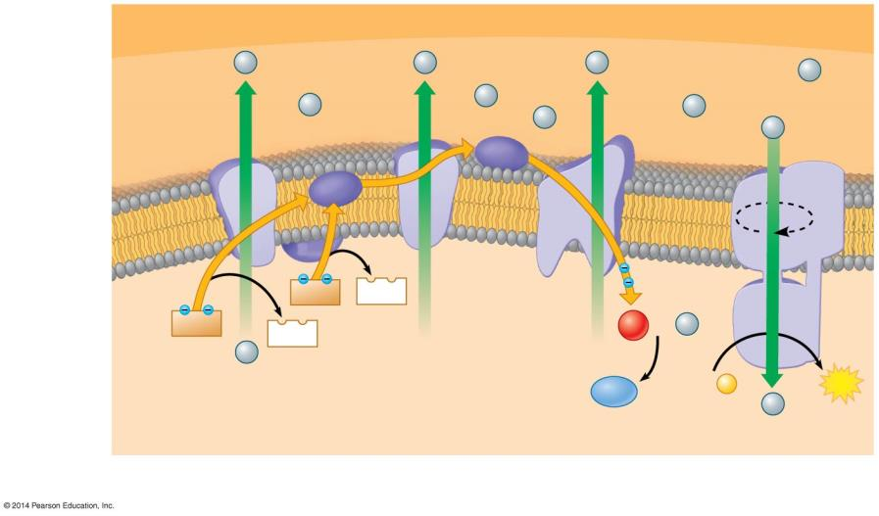
Figure 6.10a
OUTER MITOCHONDRIAL MEMBRANE
Protein
complex of electron carriers
H⁺
Mobile electron carriers
H⁺
H⁺
H⁺
Intermem- brane space
H⁺
H⁺
H⁺
H⁺
H⁺
ATP synthase
III
Cyt c
I
Q
IV
Inner mito- chondrial membrane
II
Electron flow
FADH₂
FAD
NADH
1
O₂
H⁺
NAD⁺
−
+ 2
Mito- chondrial matrix
2
H⁺
H₂O
ADP +
P
ATP
H⁺
Electron Transport Chain
Chemiosmosis
Oxidative Phosphorylation
Notes:
Figure 6.10a Oxidative phosphorylation: electron transport and chemiosmosis in a mitochondrion

Slide 63
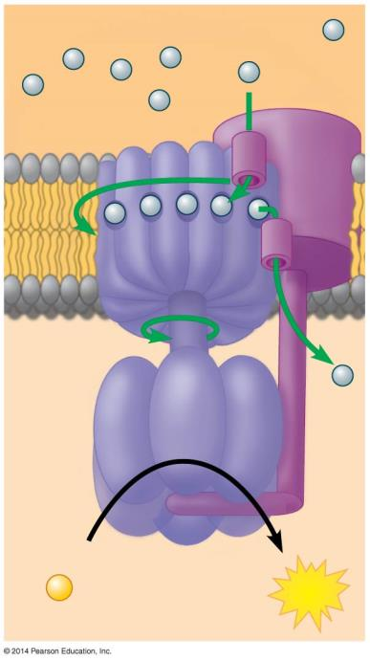
Figure 6.10b
INTERMEMBRANE SPACE
H⁺
Rotor
Internal rod
Catalytic knob
ADP
+
P
ATP
MITOCHONDRIAL MATRIX
Notes:
Figure 6.10b ATP synthase—a molecular rotary motor

Slide 64
Answer in Notebooks:
#10. What is the importance of the H+ concentration gradient across the mitochondrial membrane?

Slide 65
Answer in Notebooks:
#11. What are the 2 parts of oxidative phosphorylation?
What does the process of oxidative phosphorylation need to start?
What are the intermediates from oxidative phosphorylation?
What is the final product of oxidative phosphorylation?

Slide 66
6.12 Review: Each molecule of glucose yields many molecules of ATP
The total yield is about 32 ATP molecules per glucose molecule.
Notes:
66
Student Misconceptions and Concerns
• Perhaps more than anywhere else in general biology, students studying aerobic metabolism may fail to see the forest for the trees. Students may focus on the details of each stage of aerobic metabolism and devote little attention to the overall process and products. Consider emphasizing the products and energy yields associated with glycolysis, the citric acid cycle, and oxidative phosphorylation before detailing the specifics of each reaction.
• The location within a cell in which each reaction takes place is often forgotten in the details of the chemical processes, but it is important to emphasize. Consider using Figure 6.12 as a common reference to locate each stage as you discuss the details of cellular respiration.
• Students frequently think that plants have chloroplasts instead of mitochondria. Take care to point out the need for mitochondria in plants when photosynthesis is not efficient or possible (such as during the night).
Teaching Tips
• Students should be reminded that the ATP yield of up to 32 ATP per glucose molecule is only a potential. The complex chemistry of aerobic metabolism can yield this amount only under ideal conditions, when every substrate and enzyme is immediately available. Such circumstances may occur only rarely in a working cell.
Active Lecture Tips
• See the Activity Cell Respiration: Pair and Share on the Instructor Exchange. Visit the Instructor Exchange in the MasteringBiology instructor resource area for a description of this activity.

Slide 67
6.12 Review: Each molecule of glucose yields many molecules of ATP
The number of ATP molecules cannot be stated exactly for several reasons.
The NADH produced in glycolysis passes its electrons across the mitochondrial membrane to either NAD⁺ or FAD. Because FADH₂ adds its electrons farther along the electron transport chain, it contributes less to the H⁺ gradient and thus generates less ATP.
Some of the energy of the H⁺ gradient may be used for work other than ATP production, such as the active transport of pyruvate into the mitochondrion.

Slide 68
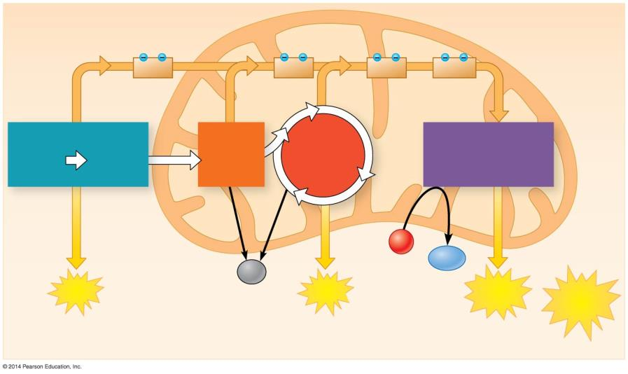
Figure 6.12
CYTOSOL
MITOCHONDRION
2
NADH
2
NADH
6
NADH
+ 2
FADH₂
Glycolysis
Pyruvate Oxidation 2 Acetyl CoA
Oxidative Phosphorylation (electron transport and chemiosmosis)
2 Pyruvate
Citric Acid Cycle
Glucose
O₂
Maximum per glucose:
H₂O
CO₂
+ 2
ATP
+ 2
ATP
+ about 28 ATP
About 32 ATP
by substrate-level phosphorylation
by substrate-level phosphorylation
by oxidative phosphorylation
Notes:
Figure 6.12 An estimated tally of the ATP produced by substrate-level and oxidative phosphorylation in cellular respiration

Slide 69
Fermentation: Anaerobic Harvesting of Energy
Notes:
69

Slide 70
6.13 Fermentation enables cells to produce ATP without oxygen
Fermentation is a way of harvesting chemical energy that does not require oxygen. Fermentation
uses glycolysis
produces two ATP molecules per glucose
reduces NAD⁺ to NADH.
Fermentation also provides an anaerobic path for recycling NADH back to NAD⁺.
Notes:
70
Student Misconceptions and Concerns
• Students may expect that fermentation will produce alcohol and maybe even carbon dioxide. Take the time to clarify the different possible products of fermentation and correct this general misconception.
Teaching Tips
• The text notes that some microbes are useful in the dairy industry because they produce lactic acid. However, the impact of acids on milk may not be obvious to many students. Consider a simple demonstration mixing about equal portions of milk (skim or 2%) with some acid (vinegar will work). Notice the accumulation of strands of milk curd (protein) on the side of the container and stirring device.
• Dry wines are produced when the yeast cells use up all or most of the sugar available. Sweet wines result when the alcohol accumulates enough to inhibit fermentation before the sugar is depleted.
• Exposing fermenting yeast to oxygen will slow or stop the process, because the yeast will switch back to aerobic respiration. When fermentation is rapid, the carbon dioxide produced drives away the oxygen immediately above the wine. However, as fermentation slows down, the wine must be sealed to prevent oxygen exposure and permit the fermentation process to finish.

Slide 71
Answer in Notebooks:
#12. Differentiate between aerobic and anaerobic.

Slide 72
6.13 Fermentation enables cells to produce ATP without oxygen
Your muscle cells and certain bacteria can regenerate NAD⁺ through lactic acid fermentation
NADH is oxidized back to NAD⁺
pyruvate is reduced to lactate.
Notes:
72
Student Misconceptions and Concerns
• Students may expect that fermentation will produce alcohol and maybe even carbon dioxide. Take the time to clarify the different possible products of fermentation and correct this general misconception.
Teaching Tips
• The text notes that some microbes are useful in the dairy industry because they produce lactic acid. However, the impact of acids on milk may not be obvious to many students. Consider a simple demonstration mixing about equal portions of milk (skim or 2%) with some acid (vinegar will work). Notice the accumulation of strands of milk curd (protein) on the side of the container and stirring device.
• Dry wines are produced when the yeast cells use up all or most of the sugar available. Sweet wines result when the alcohol accumulates enough to inhibit fermentation before the sugar is depleted.
• Exposing fermenting yeast to oxygen will slow or stop the process, because the yeast will switch back to aerobic respiration. When fermentation is rapid, the carbon dioxide produced drives away the oxygen immediately above the wine. However, as fermentation slows down, the wine must be sealed to prevent oxygen exposure and permit the fermentation process to finish.

Slide 73
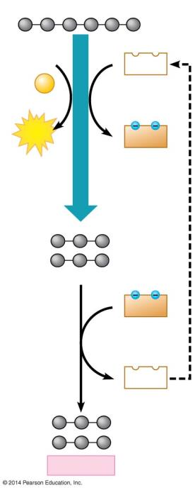
Figure 6.13a
Glucose
2 ADP
2 NAD⁺
+ 2 P
Glycolysis
2 ATP
2 NADH
2 Pyruvate
2 NADH
2 NAD⁺
2 Lactate
Notes:
Figure 6.13a Lactic acid fermentation: NAD⁺ is generated as pyruvate is reduced to lactate.

Slide 74
Answer in Notebooks:
#13. What is different about the production of lactic acid in glycolysis compared to cellular respiration?

Slide 75
6.13 Fermentation enables cells to produce ATP without oxygen
Lactate is carried by the blood to the liver, where it is converted back to pyruvate and oxidized in the mitochondria of liver cells.
The dairy industry uses lactic acid fermentation by bacteria to make cheese and yogurt.
Other types of microbial fermentation turn soybeans into soy sauce and cabbage into sauerkraut.
Notes:
75
Student Misconceptions and Concerns
• Students may expect that fermentation will produce alcohol and maybe even carbon dioxide. Take the time to clarify the different possible products of fermentation and correct this general misconception.
Teaching Tips
• The text notes that some microbes are useful in the dairy industry because they produce lactic acid. However, the impact of acids on milk may not be obvious to many students. Consider a simple demonstration mixing about equal portions of milk (skim or 2%) with some acid (vinegar will work). Notice the accumulation of strands of milk curd (protein) on the side of the container and stirring device.
• Dry wines are produced when the yeast cells use up all or most of the sugar available. Sweet wines result when the alcohol accumulates enough to inhibit fermentation before the sugar is depleted.
• Exposing fermenting yeast to oxygen will slow or stop the process, because the yeast will switch back to aerobic respiration. When fermentation is rapid, the carbon dioxide produced drives away the oxygen immediately above the wine. However, as fermentation slows down, the wine must be sealed to prevent oxygen exposure and permit the fermentation process to finish.

Slide 76
6.13 Fermentation enables cells to produce ATP without oxygen
The baking and winemaking industries have used alcohol fermentation for thousands of years.
In this process, yeast (single-celled fungi)
oxidize NADH back to NAD⁺
convert pyruvate to CO₂ and ethanol.
Notes:
76
Student Misconceptions and Concerns
• Students may expect that fermentation will produce alcohol and maybe even carbon dioxide. Take the time to clarify the different possible products of fermentation and correct this general misconception.
Teaching Tips
• The text notes that some microbes are useful in the dairy industry because they produce lactic acid. However, the impact of acids on milk may not be obvious to many students. Consider a simple demonstration mixing about equal portions of milk (skim or 2%) with some acid (vinegar will work). Notice the accumulation of strands of milk curd (protein) on the side of the container and stirring device.
• Dry wines are produced when the yeast cells use up all or most of the sugar available. Sweet wines result when the alcohol accumulates enough to inhibit fermentation before the sugar is depleted.
• Exposing fermenting yeast to oxygen will slow or stop the process, because the yeast will switch back to aerobic respiration. When fermentation is rapid, the carbon dioxide produced drives away the oxygen immediately above the wine. However, as fermentation slows down, the wine must be sealed to prevent oxygen exposure and permit the fermentation process to finish.

Slide 77
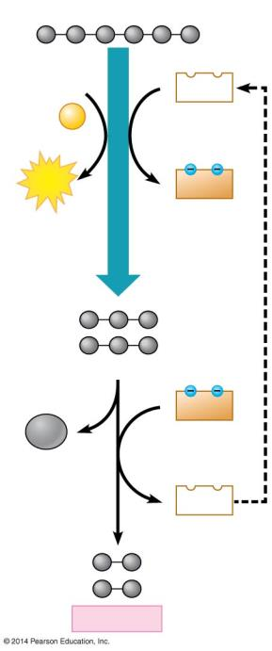
Figure 6.13b
Glucose
2 ADP
2 NAD⁺
+ 2 P
Glycolysis
2 ATP
2 NADH
2 Pyruvate
2 NADH
2 CO₂
2 NAD⁺
2 Ethanol
Notes:
Figure 6.13b Alcohol fermentation: NAD⁺ is regenerated as pyruvate is broken down to CO₂ and ethanol.

Slide 78
Answer in Notebooks:
#14. What is different about the production of ethanol in glycolysis compared to cellular respiration?

Slide 79
6.13 Fermentation enables cells to produce ATP without oxygen
Obligate anaerobes
require anaerobic conditions
are poisoned by oxygen
live in stagnant ponds and deep soils
Notes:
79
Student Misconceptions and Concerns
• Students may expect that fermentation will produce alcohol and maybe even carbon dioxide. Take the time to clarify the different possible products of fermentation and correct this general misconception.
Teaching Tips
• The text notes that some microbes are useful in the dairy industry because they produce lactic acid. However, the impact of acids on milk may not be obvious to many students. Consider a simple demonstration mixing about equal portions of milk (skim or 2%) with some acid (vinegar will work). Notice the accumulation of strands of milk curd (protein) on the side of the container and stirring device.
• Dry wines are produced when the yeast cells use up all or most of the sugar available. Sweet wines result when the alcohol accumulates enough to inhibit fermentation before the sugar is depleted.
• Exposing fermenting yeast to oxygen will slow or stop the process, because the yeast will switch back to aerobic respiration. When fermentation is rapid, the carbon dioxide produced drives away the oxygen immediately above the wine. However, as fermentation slows down, the wine must be sealed to prevent oxygen exposure and permit the fermentation process to finish.

Slide 80
6.13 Fermentation enables cells to produce ATP without oxygen
Facultative anaerobes
can make ATP by fermentation or oxidative phosphorylation
include yeasts and many bacteria.

