Slide 1
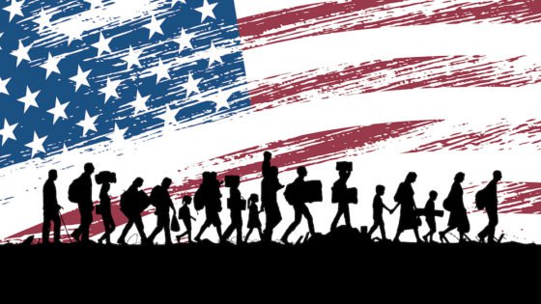
Module 4
Immigration and Urbanization

Slide 2
Lesson 1: The New Immigrants
The Big Idea: Immigration from Europe, Asia, the Caribbean, and Mexico reached a new high in the late 19th and early 20th centuries.
Why It Matters Now: This wave of immigration helped make the United States the diverse society it is today.
Key Terms and People: Ellis Island / Angel Island / Melting Pot / Nativism / Chinese Exclusion Act / Gentlemen’s Agreement

Slide 3
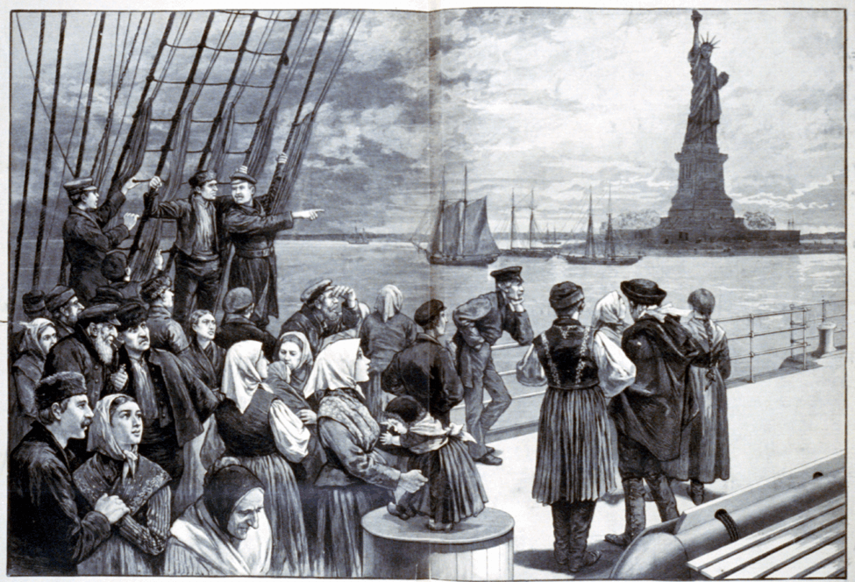
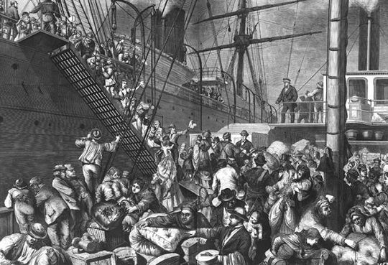
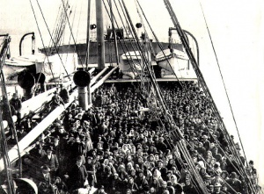
I. Through the Golden Door
Influenced by push / pull factors
Some were “birds of passage”
A. Europeans
20 million between 1870 & 1920
Mostly from southern / eastern Europe
Persecution of the Jews
Overpopulation
Scarcity of land and jobs
A spirit of revolt and reform

Slide 4
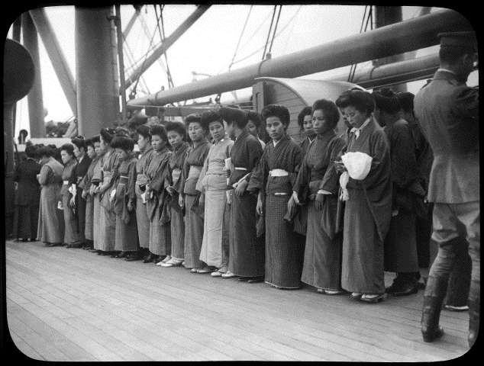
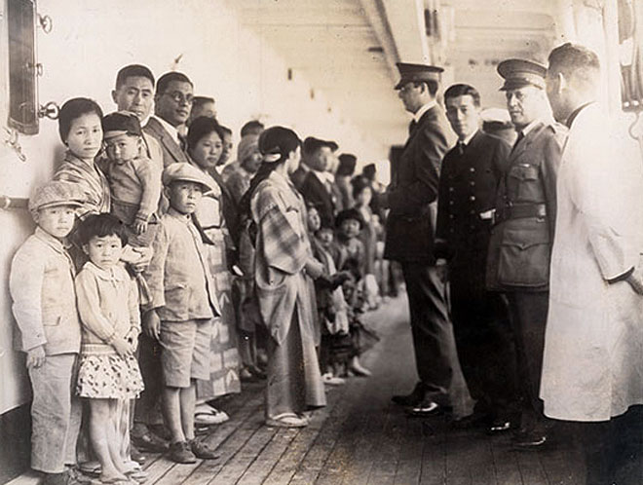
B. Chinese and Japanese
Chinese
Smaller in number
Many sought gold in California
Helped in building railroads
Then took to farming, mining, & domestic service
Limited by Congress in 1882
Japanese
Increased after Hawaii was annexed
Sought high American wages
Mostly on the West Coast

Slide 5
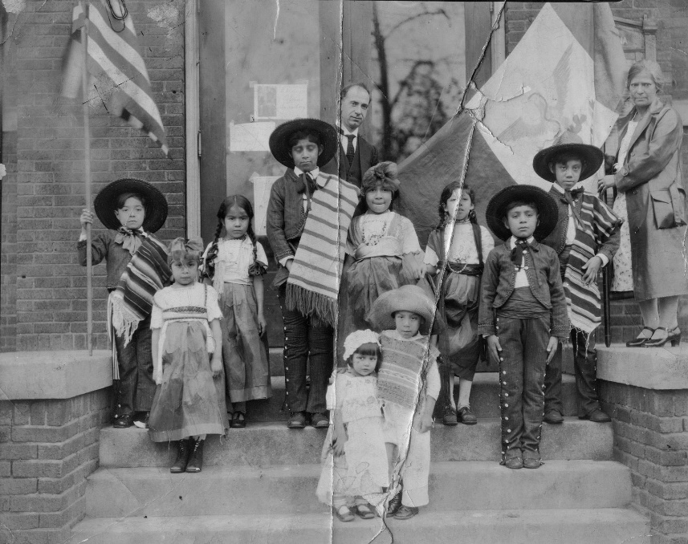
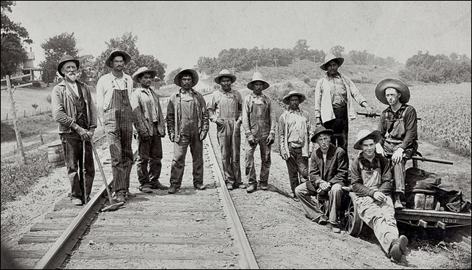
C. The West Indies and Mexico
Mostly in the east and southeast
Left home because jobs were scarce
US industry promised work
Mexico faced political turmoil
1902 Nat’l Reclamation Act - irrigated land
From 1910-1930, 7% of Mexico immigrated

Slide 6
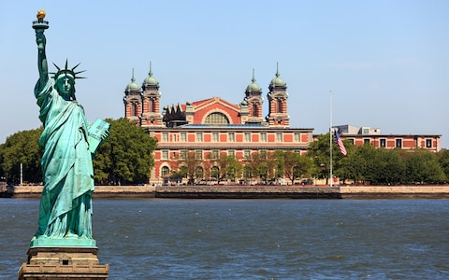
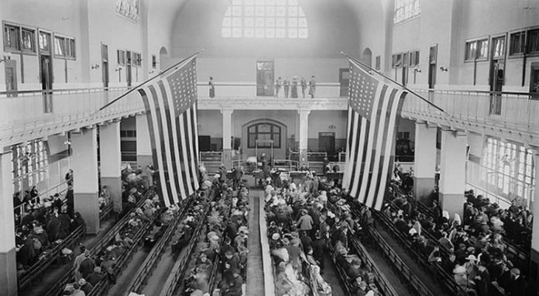
II. A Difficult Journey
A. Ellis Island
Immigration and inspection station
East coast
1892-1924 saw 17 million immigrants
Could take a whole day
Health inspection
Document checks
Questioning
Financial requirement ($25 after 1909)
Women had to be picked up by a man
Often denied – officials felt they would require public assistance

Slide 7
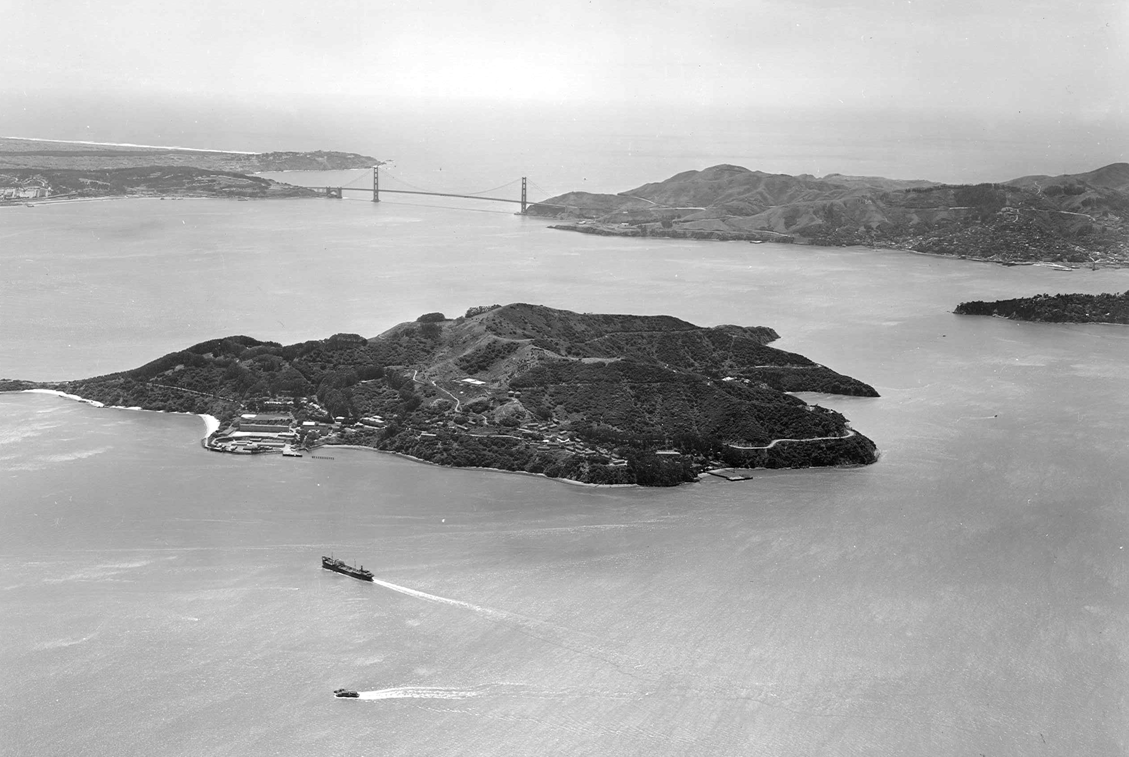
B. Angel Island
Asian Immigrants
San Francisco
Different than NYC
Harsh questioning
Buildings were run-down / dirty

Slide 8
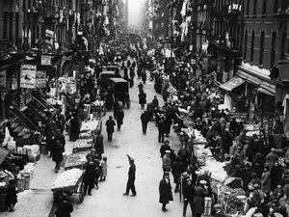
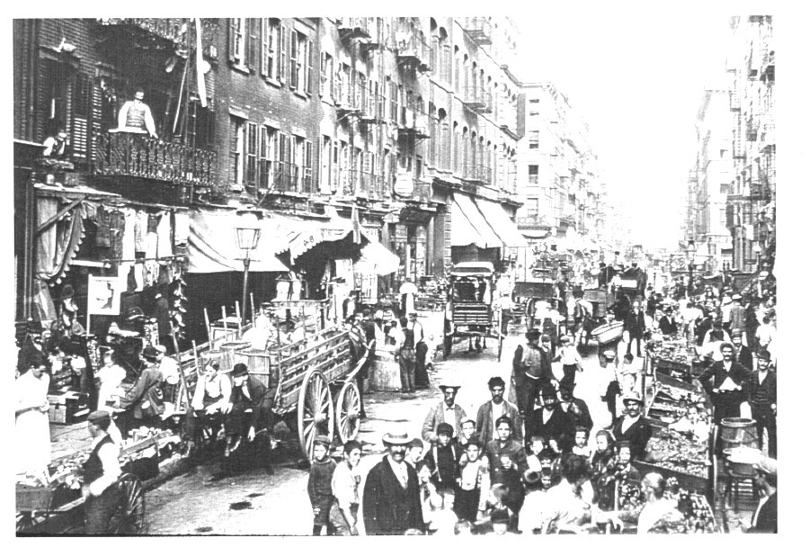
III. Life in the New Land
A. Cooperation for Survival
Immigrants faced many challenges after arrival
Lodging and employment were scarce
Lack of similar culture
Ghettos offered familiarity
Eventually opened shops, restaurants, churches and businesses
Hyphenated Americans
Struggled against nativists

Slide 9
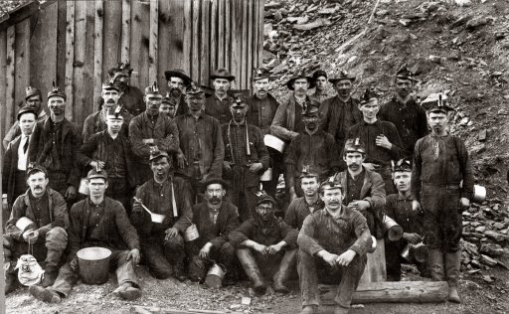
B. Seeking Opportunities
Most settled in cities
Some also turned to mining
Same pay but much more dangerous
30% would die per year
1886 – the majority of farm workers were immigrants
Suffered terrible working conditions, 16 hour days, low wages, and unsanitary conditions

Slide 10
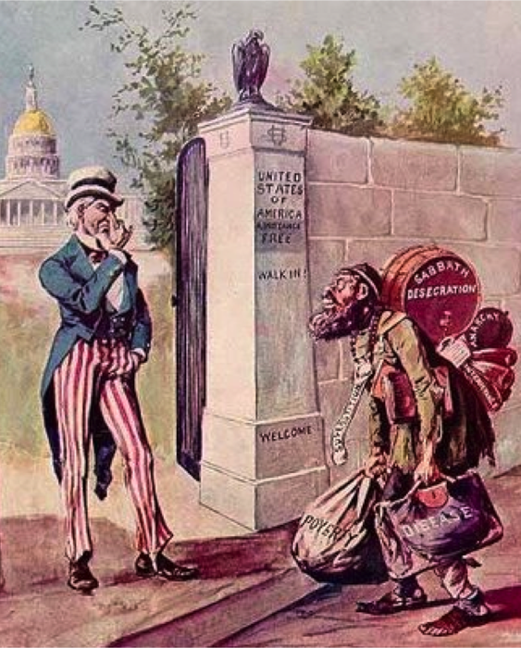
IV. Immigration Restrictions
Is the US a melting pot or a mixing bowl?
A. The Rise of Nativism
Nativists favored native born Americans
They also promoted anti-immigrant groups
Some accepted immigrants from the “right” countries
Prescott Hall – founded the Immigration Restriction League
Attacked religions before ethnicities
1897 Congressional Rules
Read 40 words in English
Vetoed

Slide 11
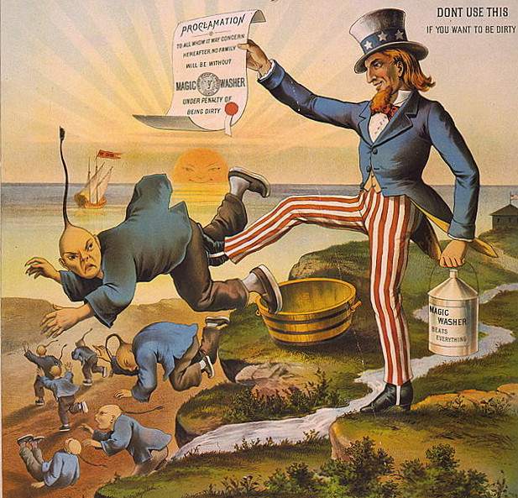
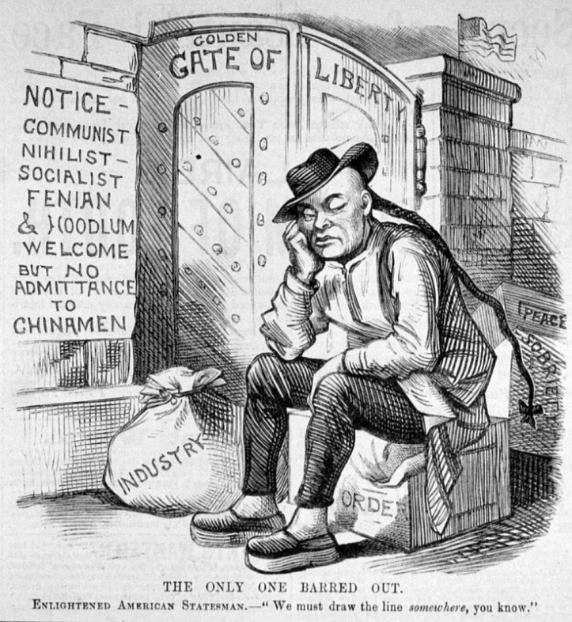
B. Anti-Asian Sentiment
Nativism built in labor movements
Chinese immigrants would accept low wages
1873 Depression increased nativism
1882: Chinese Exclusion Act
Banned all except students, teachers, merchants, tourists, and government officials
Lasted until 1943

Slide 12
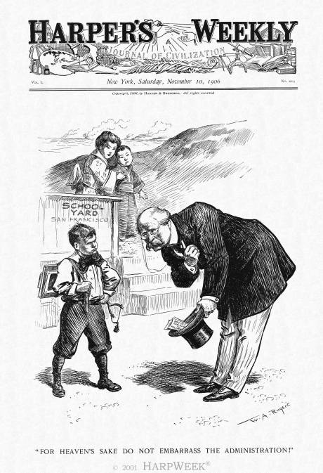
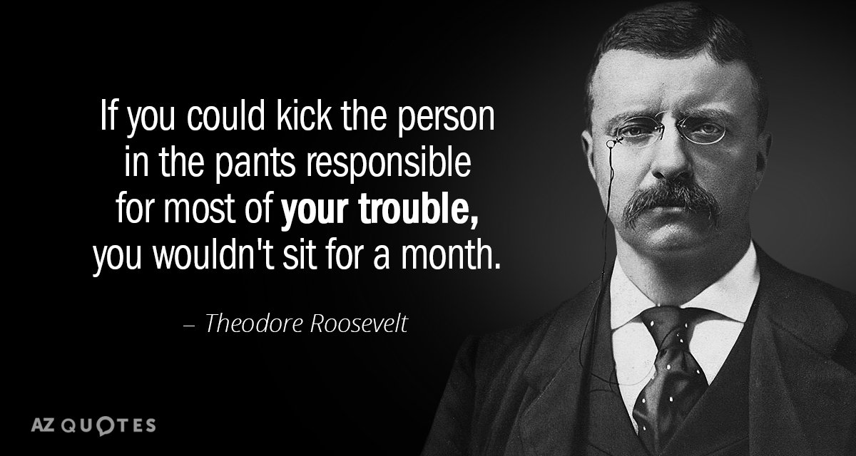
C. The Gentlemen’s Agreement
Japanese and other Asian groups were also targeted
1906: San Francisco segregated schools
Japan protested
Theodore Roosevelt: 1907 – Gentlemen’s Agreement
Japan would limit emigration
San Francisco would end segregation
Kept Western immigration behind the East

