Slide 2
Introduction
Dinosaurs were the first feathered animals on Earth.
Thousands of fossils of feathered dinosaurs have been found and classified into more than 30 different species.
Macroevolution: the major changes recorded in the history of life over vast tracts of time.
Big Bang

Slide 3
Big Bang
Big Bang 1
Big Bang Crash Course
Origins of Life Crash Course
Human Evolution
Human Evolution Facts
Dr. Garvin

Slide 4
Early Earth and the Origin of Life

Slide 5
15.1 Conditions on early Earth made the origin of life possible
The Earth formed about 4.6 billion years ago.
As the Earth cooled and the bombardment slowed about 3.9 billion years ago, the conditions on the planet were extremely different from those today.
The first atmosphere was probably thick with water vapor and various compounds released by volcanic eruptions, including nitrogen and its oxides, carbon dioxide, methane, ammonia, hydrogen, and hydrogen sulfide.
Lightning, volcanic activity, and ultraviolet radiation were much more intense than today.
Notes:
Student Misconceptions and Concerns
• Students might not have considered that cells today are not created from scratch. Unlike baking a cake or constructing an automobile, where components are assembled to create something new, the reproduction of cells does not currently involve anything other than cells.
• Some students might think that scientists have answers for all of life’s questions. Other students might rely upon supernatural explanations when faced with scientific uncertainty. The material in this chapter provides a good opportunity to further distinguish between the process of science and other ways of knowing.
• Most of us are unable to comprehend the lengths of time considered by geologists. Exercises and examples can increase this comprehension. Consider (a) the number of seconds in a year = 60 × 60 × 24 × 365.25 = 31,557,600, or (b) vast that you would live your 1 billionth second of life at age 31 and 8 months of age, or (c) how much money you could spend each day if you spent $1 million dollars a year ($1,000,000/365 = $2,739.73/day).
• Students may need to be reminded that 1 billion is 1,000 million. Many students (and some politicians) easily confuse million and billion without realizing the scale of the error. Challenge students to translate either of the examples above to illustrate 1 billion. (For example, 1 billion seconds equals about 31.7 years. If you were to spend 1 billion dollars in a year, you would need to spend $2,739,730 each day of that year!)
Teaching Tips
• Students who have studied cell theory might wonder how the first cells formed. Furthermore, they might wonder if spontaneous generation of cells could occur today. Module 15.1 describes how conditions on the surface of Earth when life first formed were dramatically different from today. Furthermore, if new life were evolving on Earth today, it would face competition from the vast amount of life already present.
• Consider pointing out the logic of the theory of spontaneous generation, given the state of scientific knowledge during that period in history. Piles of manure and rotting flesh left in the open would apparently produce flies out of nowhere. At that time, so little was understood about eggs, sperm, and fertilization that spontaneous generation was a logical conclusion.
• The four-stage hypothesis for the origin of life is a little like a recipe for building cells from the bottom up. If your students do not remember details about biological molecules and basic cell structure, you may need to review them before addressing these stages.
Active Lecture Tips
• At some point in the presentation of the four-stage hypothesis for the origin of life, students should be challenged to work in pairs or small groups to consider at what point “life” exists. Are self-replicating, RNA-based, membrane-bound structures alive? Discussing the evolution of the first cells helps clarify definitions of life.

Slide 6
In Notebooks:
#11) Most of us are unable to comprehend the vast lengths of time considered by geologists. Calculate the following in your notebooks:
(a) the number of seconds in a year ?
(b) that you would live your 1 billionth second of life at age of?
(c) how much money you could spend each day if you spent $1 million dollars a year ?
Notes:
Most of us are unable to comprehend the lengths of time considered by geologists. Exercises and examples can increase this comprehension. Consider (a) the number of seconds in a year = 60 × 60 × 24 × 365.25 = 31,557,600, or (b) vast that you would live your 1 billionth second of life at age 31 and 8 months of age, or (c) how much money you could spend each day if you spent $1 million dollars a year ($1,000,000/365 = $2,739.73/day).

Slide 7
15.1 Conditions on early Earth made the origin of life possible
The earliest evidence for life on Earth comes from 3.5-billion-year-old fossils of stromatolites, rocks built by ancient photosynthetic prokaryotes still alive today.
Because these 3.5-billion-year-old prokaryotes used photosynthesis, it suggests that life first evolved earlier, perhaps as much as 3.9 billion years ago.
Notes:
Student Misconceptions and Concerns
• Students might not have considered that cells today are not created from scratch. Unlike baking a cake or constructing an automobile, where components are assembled to create something new, the reproduction of cells does not currently involve anything other than cells.
• Some students might think that scientists have answers for all of life’s questions. Other students might rely upon supernatural explanations when faced with scientific uncertainty. The material in this chapter provides a good opportunity to further distinguish between the process of science and other ways of knowing.
• Most of us are unable to comprehend the vast lengths of time considered by geologists. Exercises and examples can increase this comprehension. Consider (a) the number of seconds in a year = 60 × 60 × 24 × 365.25 = 31,557,600, or (b) that you would live your 1 billionth second of life at age 31 and 8 months of age, or (c) how much money you could spend each day if you spent $1 million dollars a year ($1,000,000/365 = $2,739.73/day).
• Students may need to be reminded that 1 billion is 1,000 million. Many students (and some politicians) easily confuse million and billion without realizing the scale of the error. Challenge students to translate either of the examples above to illustrate 1 billion. (For example, 1 billion seconds equals about 31.7 years. If you were to spend 1 billion dollars in a year, you would need to spend $2,739,730 each day of that year!)
Teaching Tips
• Students who have studied cell theory might wonder how the first cells formed. Furthermore, they might wonder if spontaneous generation of cells could occur today. Module 15.1 describes how conditions on the surface of Earth when life first formed were dramatically different from today. Furthermore, if new life were evolving on Earth today, it would face competition from the vast amount of life already present.
• Consider pointing out the logic of the theory of spontaneous generation, given the state of scientific knowledge during that period in history. Piles of manure and rotting flesh left in the open would apparently produce flies out of nowhere. At that time, so little was understood about eggs, sperm, and fertilization that spontaneous generation was a logical conclusion.
• The four-stage hypothesis for the origin of life is a little like a recipe for building cells from the bottom up. If your students do not remember details about biological molecules and basic cell structure, you may need to review them before addressing these stages.
Active Lecture Tips
• At some point in the presentation of the four-stage hypothesis for the origin of life, students should be challenged to work in pairs or small groups to consider at what point “life” exists. Are self-replicating, RNA-based, membrane-bound structures alive? Discussing the evolution of the first cells helps clarify definitions of life.

Slide 8
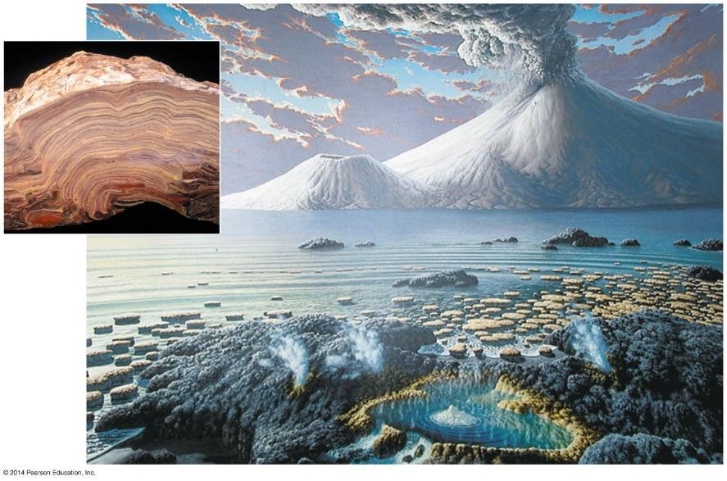
Figure 15.1-0
Notes:
Figure 15.1-0 A depiction of Earth about 3 billion years ago

Slide 9
In Notebooks:
#12) Work in pairs or small groups to consider the following:
At what point “life” exists?

Slide 10
15.1 Conditions on early Earth made the origin of life possible
The first life may have evolved through four stages.
The abiotic (nonliving) synthesis of small organic molecules, such as amino acids and nitrogenous bases.
The joining of these small molecules into polymers, such as proteins and nucleic acids.
The packaging of these molecules into “protocells,” membrane-enclosed droplets that maintained an internal chemistry different from that of their surroundings.
The origin of self-replicating molecules that eventually made inheritance possible.
Notes:
Student Misconceptions and Concerns
• Students might not have considered that cells today are not created from scratch. Unlike baking a cake or constructing an automobile, where components are assembled to create something new, the reproduction of cells does not currently involve anything other than cells.
• Some students might think that scientists have answers for all of life’s questions. Other students might rely upon supernatural explanations when faced with scientific uncertainty. The material in this chapter provides a good opportunity to further distinguish between the process of science and other ways of knowing.
• Most of us are unable to comprehend the vast lengths of time considered by geologists. Exercises and examples can increase this comprehension. Consider (a) the number of seconds in a year = 60 × 60 × 24 × 365.25 = 31,557,600, or (b) that you would live your 1 billionth second of life at age 31 and 8 months of age, or (c) how much money you could spend each day if you spent $1 million dollars a year ($1,000,000/365 = $2,739.73/day).
• Students may need to be reminded that 1 billion is 1,000 million. Many students (and some politicians) easily confuse million and billion without realizing the scale of the error. Challenge students to translate either of the examples above to illustrate 1 billion. (For example, 1 billion seconds equals about 31.7 years. If you were to spend 1 billion dollars in a year, you would need to spend $2,739,730 each day of that year!)
Teaching Tips
• Students who have studied cell theory might wonder how the first cells formed. Furthermore, they might wonder if spontaneous generation of cells could occur today. Module 15.1 describes how conditions on the surface of Earth when life first formed were dramatically different from today. Furthermore, if new life were evolving on Earth today, it would face competition from the vast amount of life already present.
• Consider pointing out the logic of the theory of spontaneous generation, given the state of scientific knowledge during that period in history. Piles of manure and rotting flesh left in the open would apparently produce flies out of nowhere. At that time, so little was understood about eggs, sperm, and fertilization that spontaneous generation was a logical conclusion.
• The four-stage hypothesis for the origin of life is a little like a recipe for building cells from the bottom up. If your students do not remember details about biological molecules and basic cell structure, you may need to review them before addressing these stages.
Active Lecture Tips
• At some point in the presentation of the four-stage hypothesis for the origin of life, students should be challenged to work in pairs or small groups to consider at what point “life” exists. Are self-replicating, RNA-based, membrane-bound structures alive? Discussing the evolution of the first cells helps clarify definitions of life.

Slide 11
Abiotic synthesis of organic molecules is possible
In the 1920s, the Russian chemist A. I. Oparin and the British scientist J. B. S. Haldane independently proposed that conditions on early Earth could have generated organic molecules.
Our modern atmosphere is rich in O₂, which disrupts chemical bonds.
The early Earth likely had a reducing atmosphere.
Notes:
Student Misconceptions and Concerns
• Students might not have considered that cells today are not created from scratch. Unlike baking a cake or constructing an automobile, where components are assembled to create something new, the reproduction of cells does not currently involve anything other than cells.
• Some students might think that scientists have answers for all of life’s questions. Other students might rely upon supernatural explanations when faced with scientific uncertainty. The material in this chapter provides a good opportunity to further distinguish between the process of science and other ways of knowing.
• Most of us are unable to comprehend the vast lengths of time considered by geologists. Exercises and examples can increase this comprehension. Consider (a) the number of seconds in a year = 60 × 60 × 24 × 365.25 = 31,557,600, or (b) that you would live your 1 billionth second of life at age 31 and 8 months of age, or (c) how much money you could spend each day if you spent $1 million dollars a year ($1,000,000/365 = $2,739.73/day).
• Students may need to be reminded that 1 billion is 1,000 million. Many students (and some politicians) easily confuse million and billion without realizing the scale of the error. Challenge students to translate either of the examples above to illustrate 1 billion. (For example, 1 billion seconds equals about 31.7 years. If you were to spend 1 billion dollars in a year, you would need to spend $2,739,730 each day of that year!)
Teaching Tips
• Some scientists distinguish between biological evolution and chemical evolution. Biological evolution addresses changes in life once it existed on Earth. Chemical evolution includes the origin of the first forms of life. The word evolution, if strictly defined as “a change over time,” also applies to changes in the universe.
• The experiments and hypotheses discussed in Module 15.2 demonstrate the tentative nature of science. As evidence is collected, old hypotheses are tested and new hypotheses arise.

Slide 12
In 1953, graduate student Stanley Miller, working under Harold Urey, tested the Oparin-Haldane hypothesis.
Notes:
Student Misconceptions and Concerns
• Students might not have considered that cells today are not created from scratch. Unlike baking a cake or constructing an automobile, where components are assembled to create something new, the reproduction of cells does not currently involve anything other than cells.
• Some students might think that scientists have answers for all of life’s questions. Other students might rely upon supernatural explanations when faced with scientific uncertainty. The material in this chapter provides a good opportunity to further distinguish between the process of science and other ways of knowing.
• Most of us are unable to comprehend the vast lengths of time considered by geologists. Exercises and examples can increase this comprehension. Consider (a) the number of seconds in a year = 60 × 60 × 24 × 365.25 = 31,557,600, or (b) that you would live your 1 billionth second of life at age 31 and 8 months of age, or (c) how much money you could spend each day if you spent $1 million dollars a year ($1,000,000/365 = $2,739.73/day).
• Students may need to be reminded that 1 billion is 1,000 million. Many students (and some politicians) easily confuse million and billion without realizing the scale of the error. Challenge students to translate either of the examples above to illustrate 1 billion. (For example, 1 billion seconds equals about 31.7 years. If you were to spend 1 billion dollars in a year, you would need to spend $2,739,730 each day of that year!)
Teaching Tips
• Some scientists distinguish between biological evolution and chemical evolution. Biological evolution addresses changes in life once it existed on Earth. Chemical evolution includes the origin of the first forms of life. The word evolution, if strictly defined as “a change over time," also applies to changes in the universe.
• The experiments and hypotheses discussed in Module 15.2 demonstrate the tentative nature of science. As evidence is collected, old hypotheses are tested and new hypotheses arise.

Slide 13
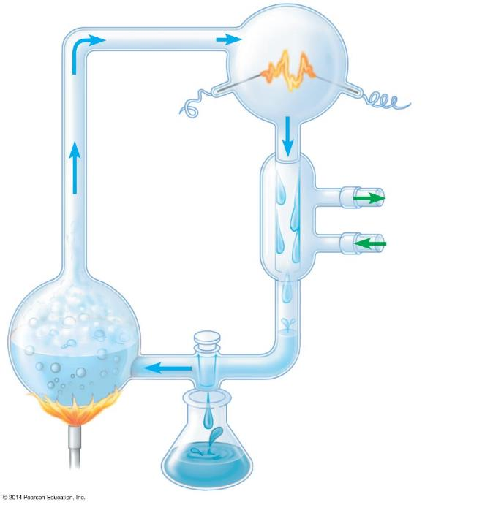
Figure 15.2
Sparks simulating lightning
CH₄
“Atmosphere”
Water vapor
NH₃
H₂
2
Electrode
Condenser
3
Cold water
1
H₂O
“Sea”
4
Sample for chemical analysis
Notes:
Figure 15.2 Diagram showing the synthesis of organic compounds in Miller’s 1953 experiment
Water was heated so that some vaporized and moved intro a second, higher flask
The atmosphere in the higher flask consisted of water vapor, hydrogen gas, methane, and ammonia the gases that scientists at the time though prevailed in the ancient world. Electrodes discharged sparks into the flask to mimic lightening.
A condenser with circulating cold water cooled the atmosphere, raining water and any dissolved compounds back down into the miniature sea.
As material cycled through the apparatus, Miller periodically collected samples for chemical analysis
First evidence that molecules of life could have arisen spontaneously from inorganic precursors because samples contained hydrocarbons (carbon and hydrogen) and amino acids

Slide 14
In Notebooks:
#13) Briefly summarize how the four stages in which life is thought to have evolved.

Slide 15
Mechanisms of Macroevolution

Slide 16
15.7 Continental drift has played a major role in macroevolution
Pangaea
Plate tectonics
Continental drift
Notes:
Student Misconceptions and Concerns
• Student backgrounds in the earth sciences may be uneven based upon their specific high school and college coursework. An emphasis on chemistry, physics, and biology may leave large gaps in basic content regarding geology and Earth’s history.
Teaching Tips
• Consider this analogy to help students understand the biological consequences of speciation as continents drifted apart. As your students left high school and entered the workforce or continued their education, their high school social groups lost contact and drifted apart. Your students, in their new circumstances, adapted and changed in different ways, separate from the members of their old social groups. A note of caution: This analogy to individual social changes is not an example of biological evolution, which occurs over generations.

Slide 17
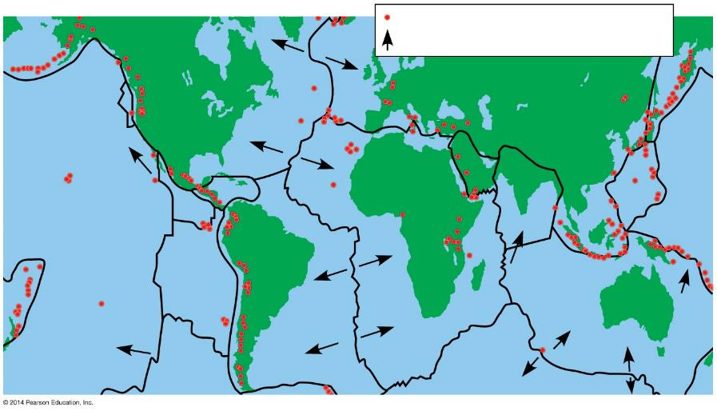
Figure 15.7b
Zones of violent tectonic activity
Direction of movement
North American Plate
Eurasian Plate
Juan de Fuca Plate
Caribbean Plate
Philippine Plate
Arabian Plate
Indian Plate
Cocos Plate
Pacific Plate
South American Plate
Nazca Plate
African Plate
Australian Plate
Scotia Plate
Antarctic Plate
Notes:
Figure 15.7b Earth’s tectonic plates

Slide 18
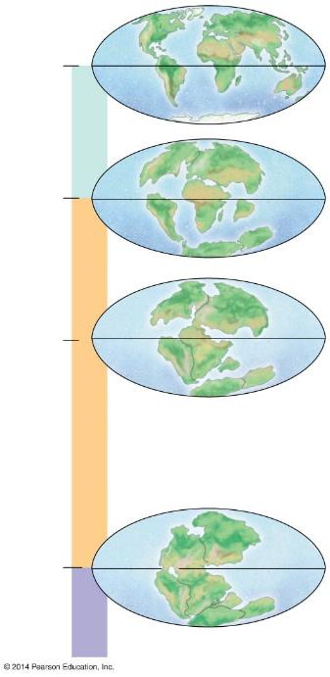
Figure 15.7c-4
Present
4
Cenozoic
North America
Eurasia
65.5
3
Africa
South America
India
Madagascar
Australia
Antarctica
Laurasia
135
2
Millions of years ago
Gondwana
Mesozoic
251
1
Pangaea
Paleozoic
Notes:
Figure 15.7c-4 Continental drift during the Phanerozoic eon (step 4)

Slide 19
15.9 During mass extinctions, large numbers of species are lost
Extinction is inevitable in a changing world.
The fossil record shows that the vast majority of species that have ever lived are now extinct.
Over the last 500 million years, five mass extinctions have occurred and in each event, more than 50% of the Earth’s species went extinct.
Notes:
Student Misconceptions and Concerns
• Student backgrounds in the earth sciences may be uneven based upon their specific high school and college coursework. An emphasis on chemistry, physics, and biology may leave large gaps in basic content regarding geology and Earth’s history.
• The slow speed at which life can evolve in response to human damage of natural systems may not be appreciated by our students. As noted in Module 15.9, it may take millions of years for the planet to recover from the ongoing human-induced loss of biological diversity.
Teaching Tips
• The consequences of an asteroid impact, large or small, reveal the role of random events in evolution. Like throwing a dart at a spinning globe, where the asteroid hits and what continents and forms of life are most affected can change greatly if the impact occurs even a few hours earlier or later. An asteroid delayed by 12 hours, in what might be a journey of millions or billions of years, will land on the opposite side of the Earth!
• Students might not realize that entire categories of animals have come and gone. The once abundant trilobites, ostracoderm and placoderm fish, and nonavian dinosaurs are now extinct. Birds and mammals are relatively recent additions. Such examples of macroevolution are apparent in the fossil record.

Slide 20
15.9 During mass extinctions, large numbers of species are lost
Mass extinctions affect biological diversity profoundly.
It took 100 million years for the number of marine families to recover after the Permian mass extinction.
Is a sixth extinction under way?
The current extinction rate is 100–1,000 times the normal background rate.
It may take millions of years for life on Earth to recover.
Notes:
Student Misconceptions and Concerns
• Student backgrounds in the earth sciences may be uneven based upon their specific high school and college coursework. An emphasis on chemistry, physics, and biology may leave large gaps in basic content regarding geology and Earth’s history.
• The slow speed at which life can evolve in response to human damage of natural systems may not be appreciated by our students. As noted in Module 15.9, it may take millions of years for the planet to recover from the ongoing human-induced loss of biological diversity.
Teaching Tips
• The consequences of an asteroid impact, large or small, reveal the role of random events in evolution. Like throwing a dart at a spinning globe, where the asteroid hits and what continents and forms of life are most affected can change greatly if the impact occurs even a few hours earlier or later. An asteroid delayed by 12 hours, in what might be a journey of millions or billions of years, will land on the opposite side of the Earth!
• Students might not realize that entire categories of animals have come and gone. The once abundant trilobites, ostracoderm and placoderm fish, and nonavian dinosaurs are now extinct. Birds and mammals are relatively recent additions. Such examples of macroevolution are apparent in the fossil record.

Slide 21
15.10 Adaptive radiations have increased the diversity of life
Adaptive radiations are periods of evolutionary change in which many new species evolve from a common ancestor, often following the colonization of new, unexploited areas.
The divergent evolution and adaptation of species to different roles in new habitats
Notes:
Student Misconceptions and Concerns
• Student backgrounds in the earth sciences may be uneven based upon their specific high school and college coursework. An emphasis on chemistry, physics, and biology may leave large gaps in basic content regarding geology and Earth’s history.
Active Lecture Tips
• Many analogies can be made to adaptive radiations. Challenge your students to work in pairs to come up with such an analogy drawn from modern human society. Computers of all types and sizes represent a type of technological radiation. The abundance of Internet websites is an ongoing radiation that has changed the way we communicate with each other, learn, and make purchases. Many other analogies can be developed as they relate to culture and commercialism.

Slide 22
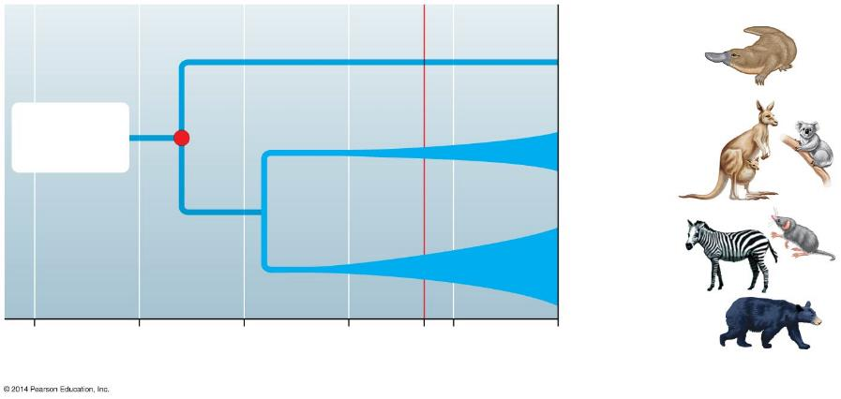
Figure 15.10
Extinction of dinosaurs
Ancestral mammal
Monotremes (5 species)
Reptilian ancestor
Marsupials (324 species)
Eutherians (placental mammals; 5,010 species)
250
200
150
100
65
50
0
Time (millions of years ago)
Notes:
Figure 15.10 Adaptive radiation of mammals (width of line reflects numbers of species)

Slide 23
15.11 Genes that control development play a major role in evolution
Many striking evolutionary transformations are the result of a change in the rate or timing of developmental events.
Paedomorphosis
is the retention in the adult of body structures that were juvenile features in an ancestral species
occurs in the axolotl salamander, in which sexually mature adults retain gills and other larval features.
Notes:
Student Misconceptions and Concerns
• Student backgrounds in the earth sciences may be uneven based upon their specific high school and college coursework. An emphasis on chemistry, physics, and biology may leave large gaps in basic content regarding geology and Earth’s history.
Teaching Tips
• Students may not be familiar enough with salamander life histories to appreciate the similarity of a larval salamander to the axolotl form. By analogy, students might be asked to imagine what would result if a caterpillar reproduced and never developed into a winged adult butterfly. The caterpillar stage can then be related to the early larval form of salamanders. Furthermore, students might wonder why paedomorphosis occurs in salamanders but not frogs or butterflies (to the degree that tadpoles and caterpillars reproduce). No clear answer is known.

Slide 24
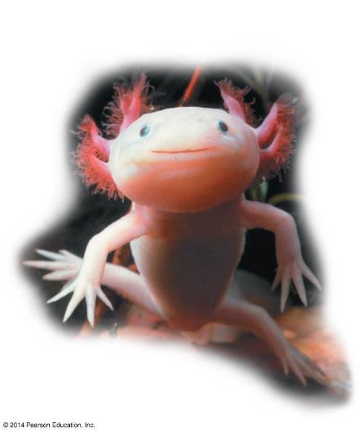
Figure 15.11a
Gills
Notes:
Figure 15.11a An axolotl, a paedomorphic salamander

Slide 25
15.11 Genes that control development play a major role in evolution
Slight changes in the relative growth of different body parts can change an adult form substantially.
Skulls of humans and chimpanzees are more similar as fetuses but quite different as adults, due to different rates of growth.
Notes:
Student Misconceptions and Concerns
• Student backgrounds in the earth sciences may be uneven based upon their specific high school and college coursework. An emphasis on chemistry, physics, and biology may leave large gaps in basic content regarding geology and Earth’s history.
Teaching Tips
• Students may not be familiar enough with salamander life histories to appreciate the similarity of a larval salamander to the axolotl form. By analogy, students might be asked to imagine what would result if a caterpillar reproduced and never developed into a winged adult butterfly. The caterpillar stage can then be related to the early larval form of salamanders. Furthermore, students might wonder why paedomorphosis occurs in salamanders but not frogs or butterflies (to the degree that tadpoles and caterpillars reproduce). No clear answer is known.

Slide 26
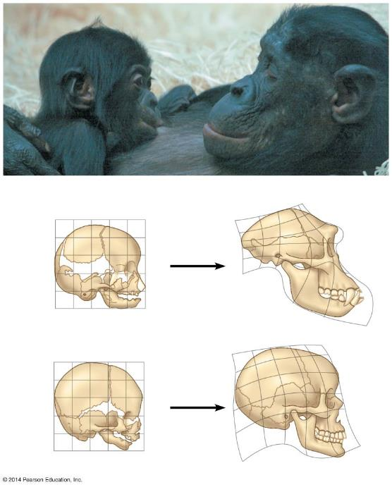
Figure 15.11b-0
Chimpanzee infant
Chimpanzee adult
Chimpanzee fetus
Chimpanzee adult
Human fetus
Human adult
Notes:
Figure 15.11b-0 Chimpanzee and human skull shapes compared

Slide 27
15.11 Genes that control development play a major role in evolution
Homeotic genes
are called master control genes
determine basic features, such as where pairs of wings or legs develop on a fruit fly.
Profound alterations in body form can result from
changes in homeotic genes
how or where homeotic genes are expressed.
Notes:
Student Misconceptions and Concerns
• Student backgrounds in the earth sciences may be uneven based upon their specific high school and college coursework. An emphasis on chemistry, physics, and biology may leave large gaps in basic content regarding geology and Earth’s history.
Teaching Tips
• Students may not be familiar enough with salamander life histories to appreciate the similarity of a larval salamander to the axolotl form. By analogy, students might be asked to imagine what would result if a caterpillar reproduced and never developed into a winged adult butterfly. The caterpillar stage can then be related to the early larval form of salamanders. Furthermore, students might wonder why paedomorphosis occurs in salamanders but not frogs or butterflies (to the degree that tadpoles and caterpillars reproduce). No clear answer is known.

Slide 28
15.11 Genes that control development play a major role in evolution
New developmental genes that arose as a result of gene duplications may have facilitated the origin of new body forms.
For example, a fruit fly has a single cluster of several homeotic genes that direct the development of major body parts.
Two duplications of these gene clusters appear to have occurred in the evolution of vertebrates from invertebrate animals.
Mutations in these duplicated genes may then have led to the origin of novel vertebrate characteristics, such as a backbone, jaws, and limbs.
Notes:
Student Misconceptions and Concerns
• Student backgrounds in the earth sciences may be uneven based upon their specific high school and college coursework. An emphasis on chemistry, physics, and biology may leave large gaps in basic content regarding geology and Earth’s history.
Teaching Tips
• Students may not be familiar enough with salamander life histories to appreciate the similarity of a larval salamander to the axolotl form. By analogy, students might be asked to imagine what would result if a caterpillar reproduced and never developed into a winged adult butterfly. The caterpillar stage can then be related to the early larval form of salamanders. Furthermore, students might wonder why paedomorphosis occurs in salamanders but not frogs or butterflies (to the degree that tadpoles and caterpillars reproduce). No clear answer is known.

Slide 29
Answer in Notebooks:
#14) What are the mechanisms of macroevolution?

