Slide 1
Lesson 3: Politics in the Gilded Age
The Big Idea: Local and national political corruption in the 19th century led to calls for reform.
Why It Matters Now: Political reforms paved the way for a more honest and efficient government in the 20th century and beyond.
Key Terms and People: Political Machines / Graft / Boss Tweed / Patronage / Civil Service / Rutherford B. Hayes / James A. Garfield / Chester A. Arthur / Pendleton Civil Service Act / Grover Cleveland / Benjamin Harrison

Slide 2
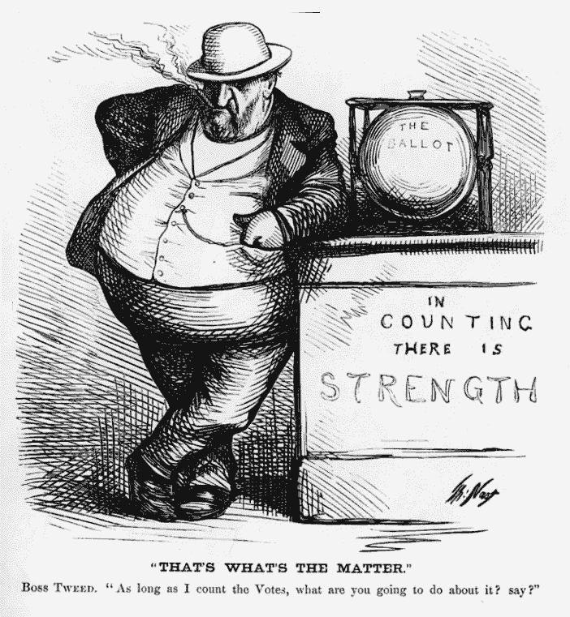
I. The Emergence of Political Machines
A. The Political Machine
Organized groups of that controlled party activities
Exchanged services for political support
Worked as a pyramid
Precinct captains, ward bosses, city bosses.
Worked to get their own candidates elected

Slide 3
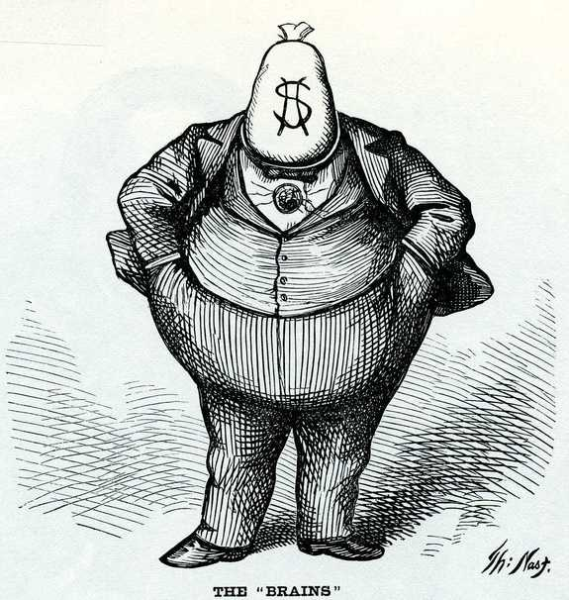
B. The Role of the Political Boss
Controlled municipal jobs & business licenses
Built parks, sewers, plumbing systems
Funded schools, hospitals, orphanages
Reinforced loyalty and profited at the same time

Slide 4
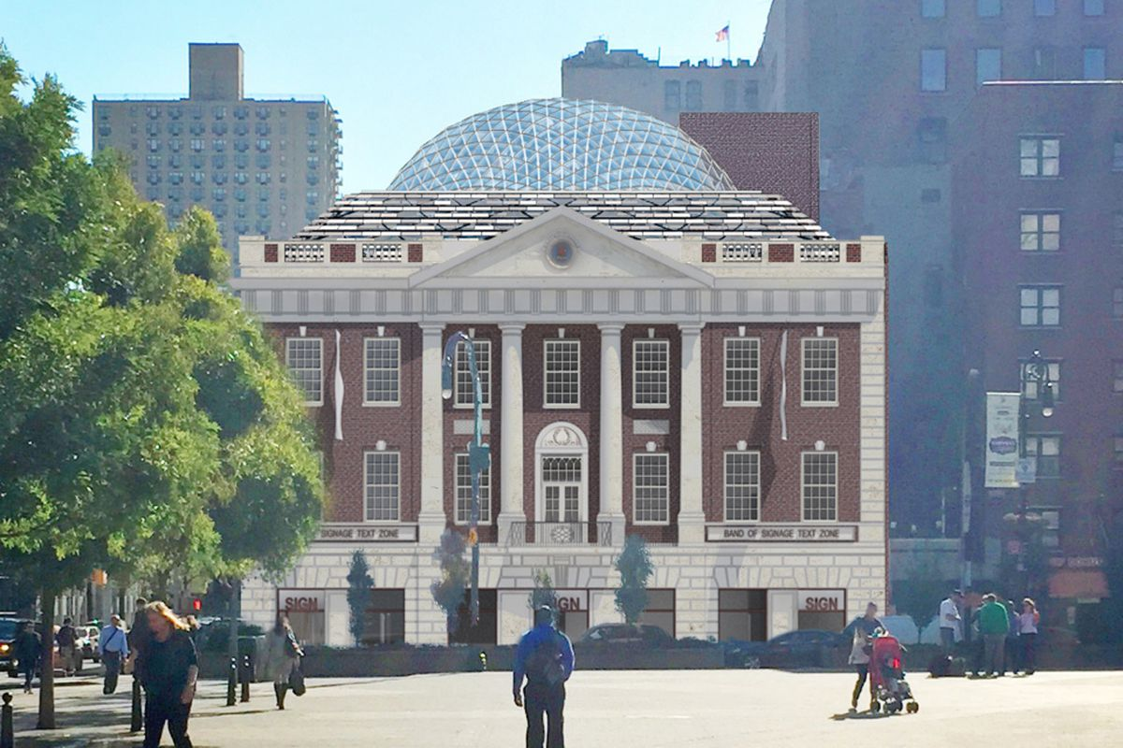
C. Immigrants and the Machine
Captains & bosses were 1st or 2nd generation immigrants
Eased the challenge of language barriers
Provided services (Ex. Tammany Hall – helped with citizenship)
Immigrants provided votes in return
“Big Jim” Pendergast controlled all of Missouri this way

Slide 5
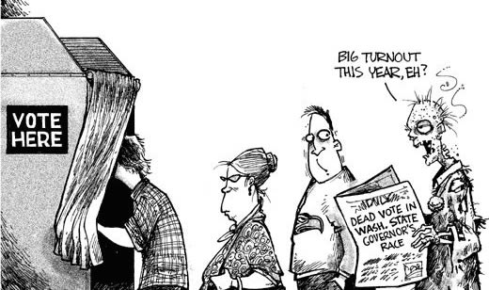
II. Municipal Graft and Scandal
A. Election Fraud and Graft
Sometimes this was not enough
Fake names were used to cast extra votes
Once elected, graft was common in politics
Granted favors to businesses for cash
Police did not interfere. They were hired & fired by bosses

Slide 6
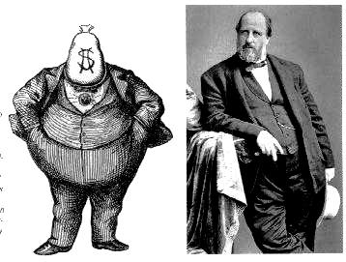
B. The Tweed Ring Scandal
Boss Tweed – Head of Tammany Hall
His politicians were known as the Tweed Ring
Charged NYC $13 million for a $3 million project
Pocketed the rest
Thomas Nast
Political cartoonist
Provoked outrage against the Tweed Ring
Boss Tweed received 12 years in jail
Only served 1…. But was later arrested again.
He then escaped…. But was arrested in Spain shorty after

Slide 7
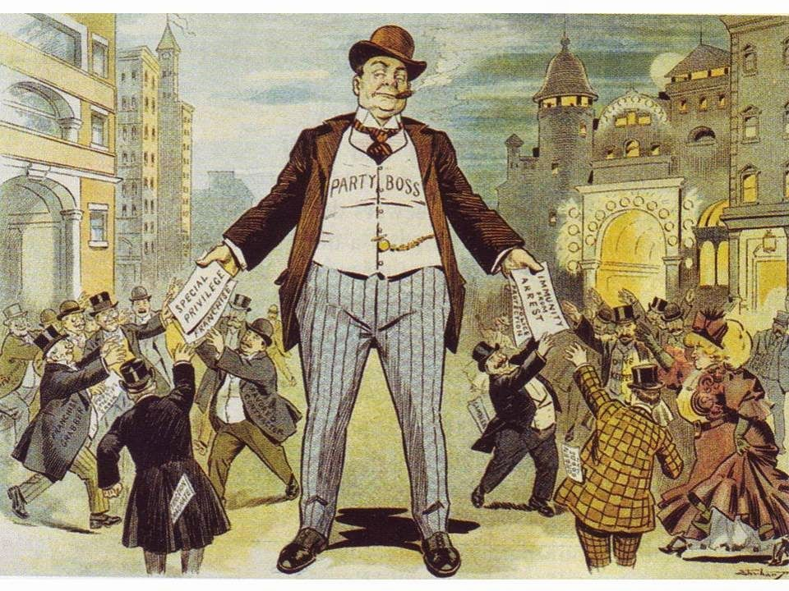
III. Civil Service Replaces Patronage
A. Patronage Spurs Reform
Patronage = gov’t jobs for those who helped someone get elected A.K.A. the Spoils System
This meant many gov’t employees weren’t qualified
Reformers felt civil service jobs should be based on qualification

Slide 8
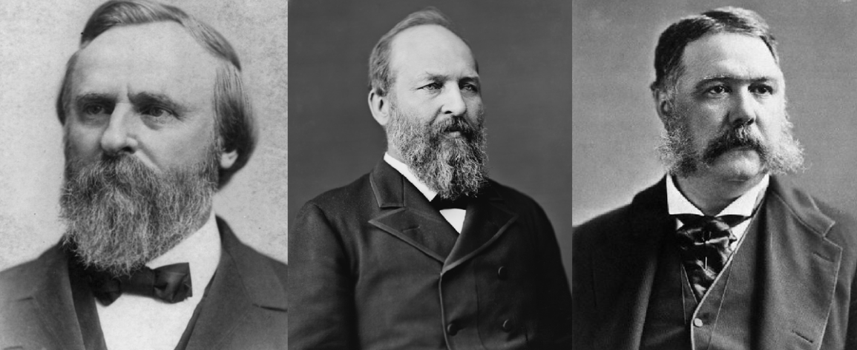
B. Reform Under Hayes, Garfield, and Arthur
Rutherford B. Hayes:
Named independents to his cabinet / investigated custom-houses / fired some top officials
James A. Garfield:
Was expected to follow suit
Gave many jobs through patronage
Assassinated in a DC train station by Charles Guiteau (whom he had refused giving a job to)
Chester A. Arthur
Garfield’s VP
Passed the Pendleton Civil Service Act
Appointed federal jobs on a merit system

Slide 9
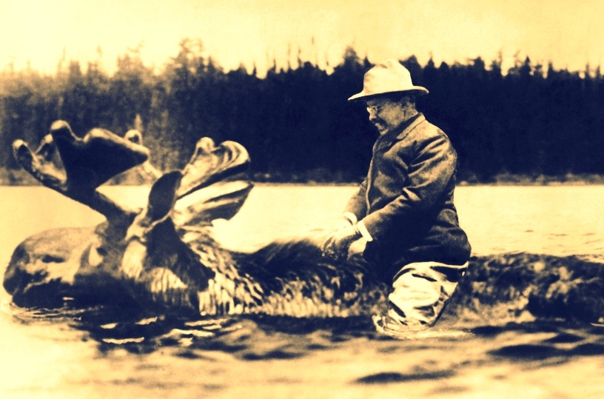
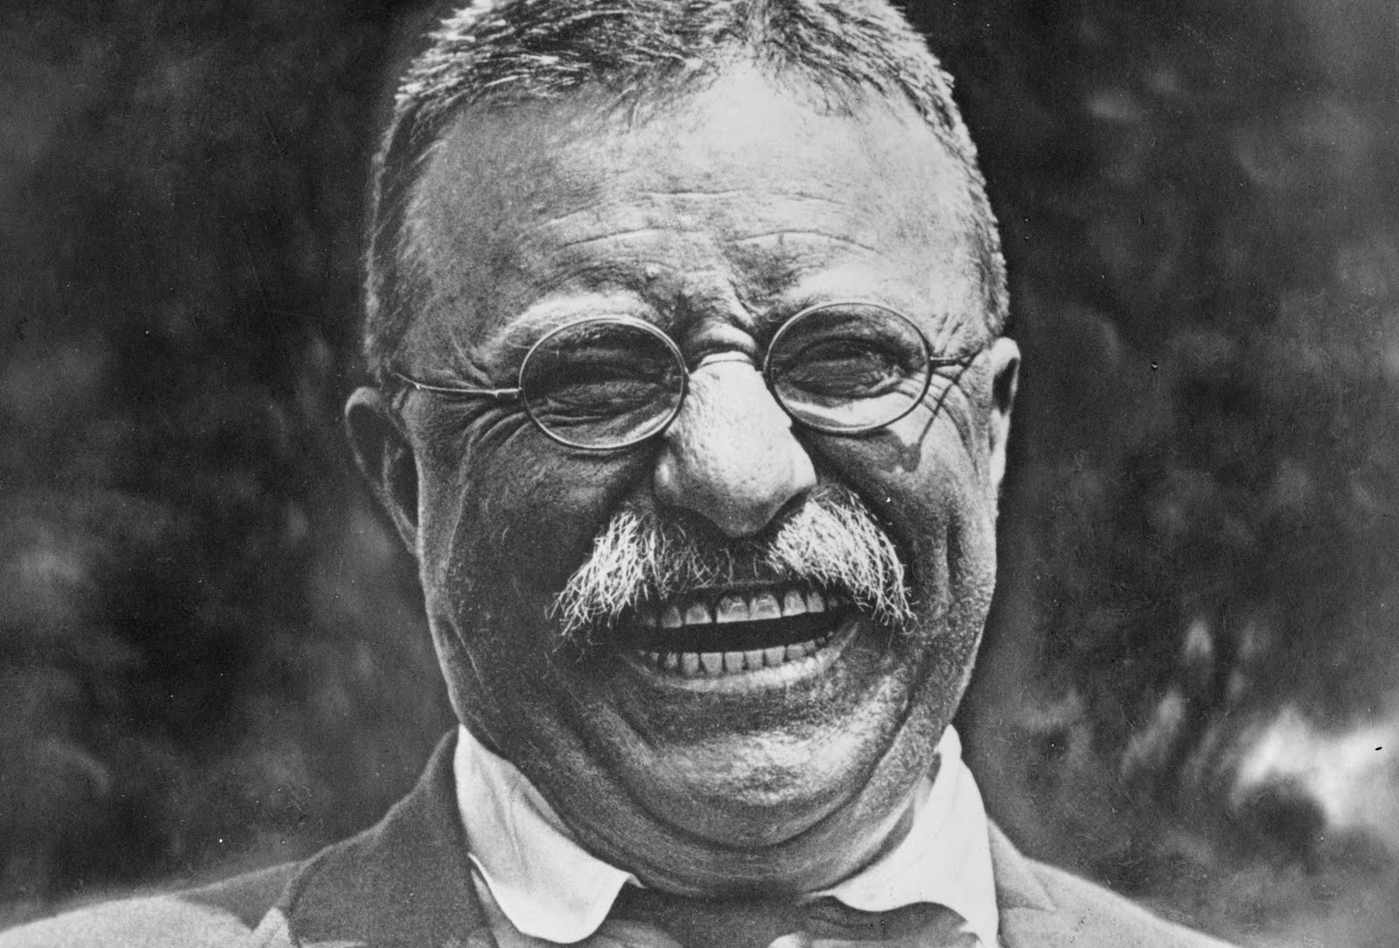
C. Governor Theodore Roosevelt
Gov. of New York
Campaigned for public interest over politics
Ignored the Republic Party’s wishes
Until…
Roosevelt replaced Garret Hobart as VP
Hoped for a presidential run
Left New York in the hands of a machine

Slide 10
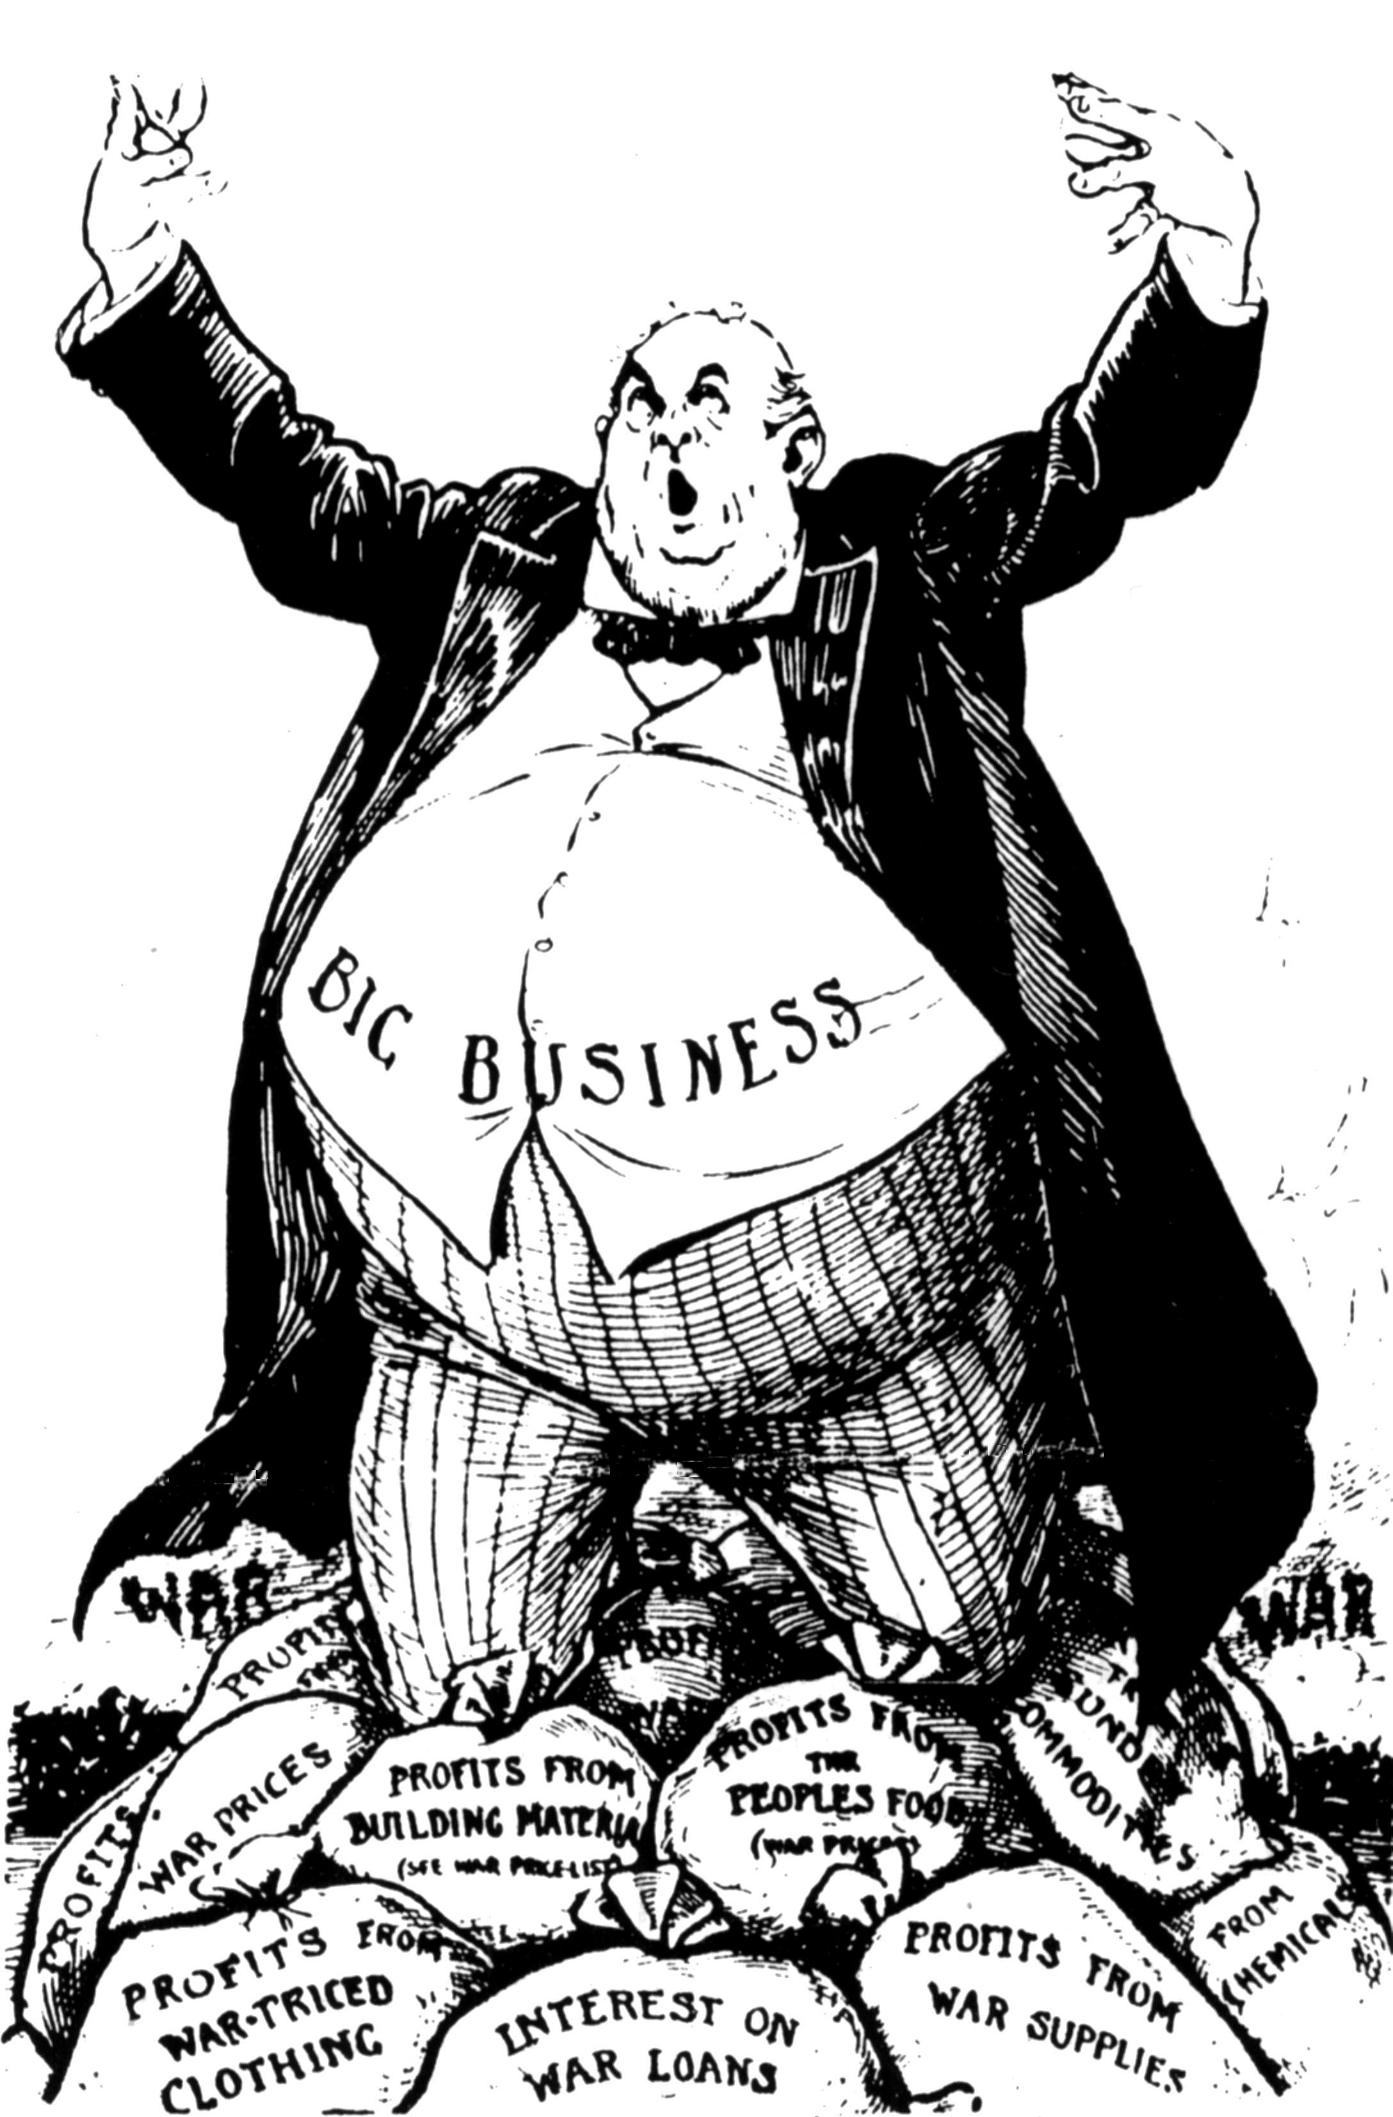
IV. Business Buys Influence
Mixed Consequences of the Pendleton Act
No pressure on employees for campaign help
Politicians turned to businesses for contributions
Grover Cleveland (Part 1)
1st Democrat in 28 years
Hoped to lower tariffs
Shut down by Congress
Benjamin Harrison
Won without the popular vote
Raised tariffs
Grover Cleveland (Part 2)
Wilson-Gorman Tariff is passed (without his support) and it creates a Federal income tax
William McKinley – raises tariffs

Slide 11
