Slide 1
Lesson 3: Segregation & Discrimination
The Big Idea: African Americans led the fight against voting restrictions and Jim Crow Laws.
Why It Matters Now: Today, African Americans have the legacy of a century-long battle for civil rights.
Key Terms and People: Ida B. Wells / Poll Tax / Grandfather Clause / Segregation / Jim Crow Laws / Plessy v. Ferguson / Debt Peonage

Slide 2
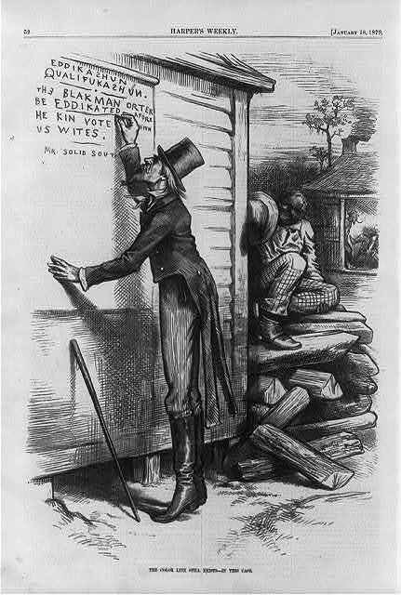
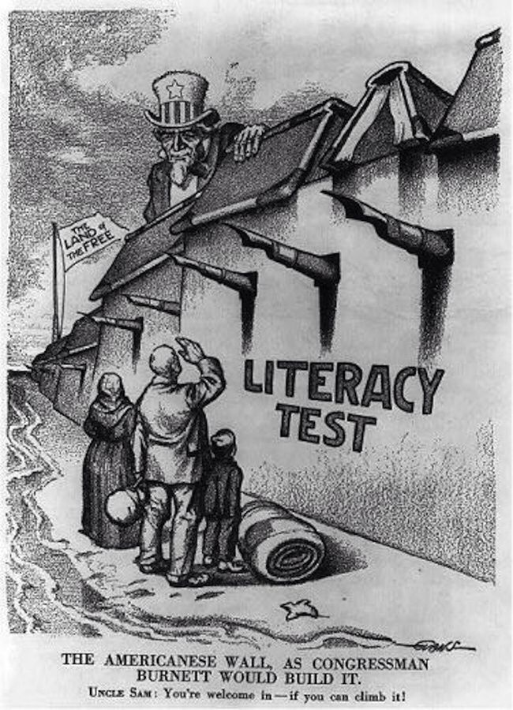
I. Legal Discrimination
The Nadir: worst point from late 1800’s to early 1900’s
A. Voting Restrictions
Literacy Tests
Poll Taxes
Grandfather Clause: Jan 1, 1867

Slide 3
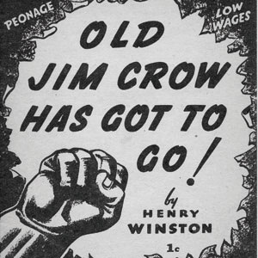
B. Jim Crow Laws
Segregation laws
De jure segregation
De facto segregation
1873: The Slaughterhouse Cases
Used to justify the creation of segregated workplaces
Schooling, housing, transportation, granted by states, not the Federal Government

Slide 4
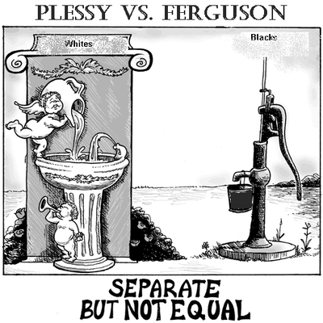
C. Plessy v. Ferguson
1896 Supreme Court Case
Ruled segregation legal
Established a policy of “separate but equal”
Lasted 60 years
Stripped African American & Minority rights
“All men are created equal?”

Slide 5
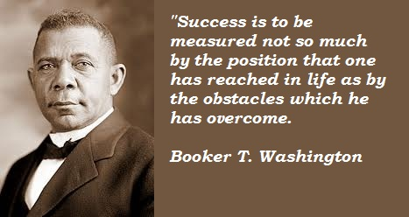
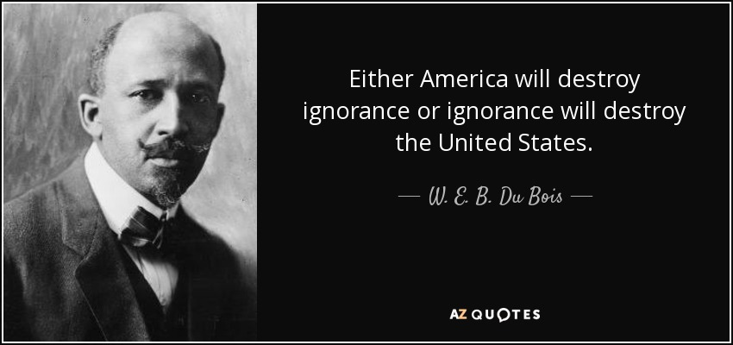
II. Turn-of-the-Century Race Relations
A. Washington Vs. Du Bois
Washington suggested cooperation for progress
Felt improved economic skills would gain equality
Du Bois would not wait
Demanded social and economic equality

Slide 6
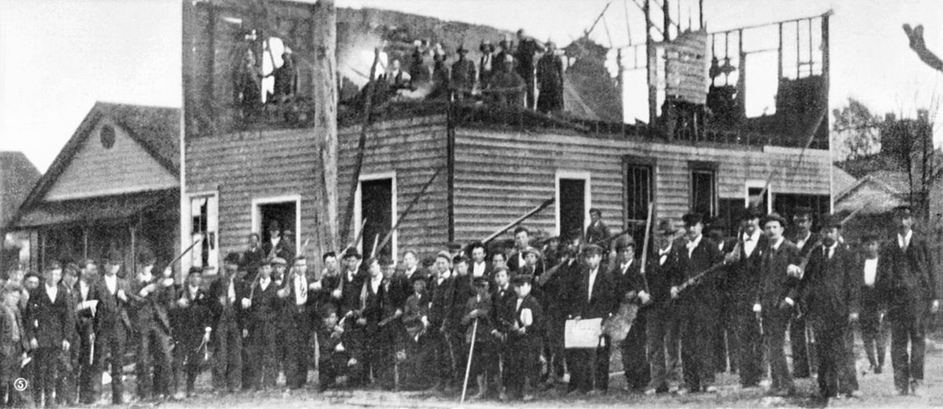
B. Violence
African Americans often faced punishment or death
Often accused of violations
1882-1892: 1,400 executions without trial
1896: Wilmington Race Riots – to gain political power
14 dead (probably many more)
Homes & businesses burned
Many fled

Slide 7
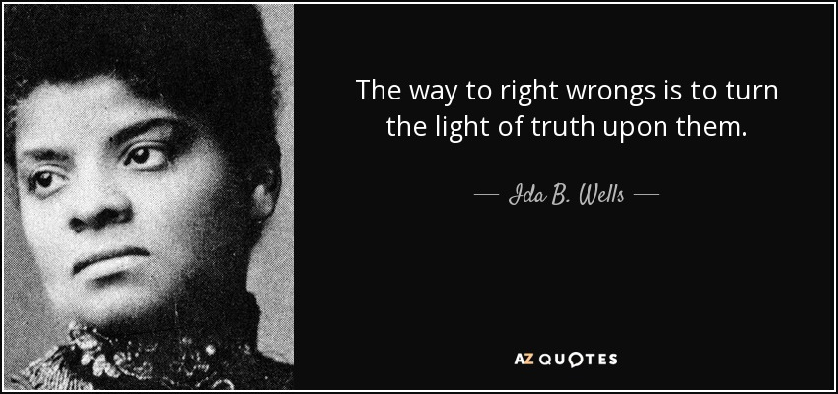
C. African American Press
Used the press to fight back
Documented lynchings and violence
Ida B. Wells
Newspaper company was viciously attacked
Stayed out of the south for the next 30 years

Slide 8
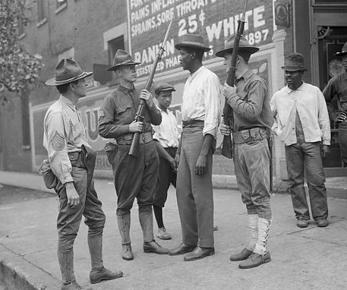
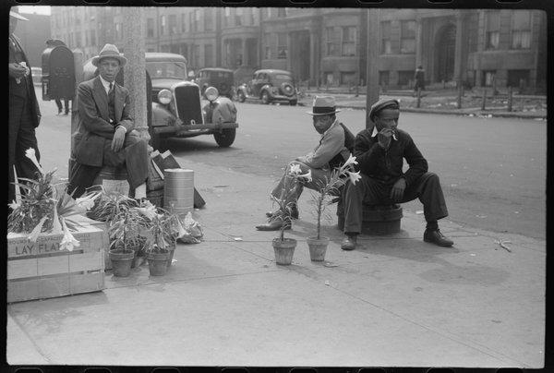
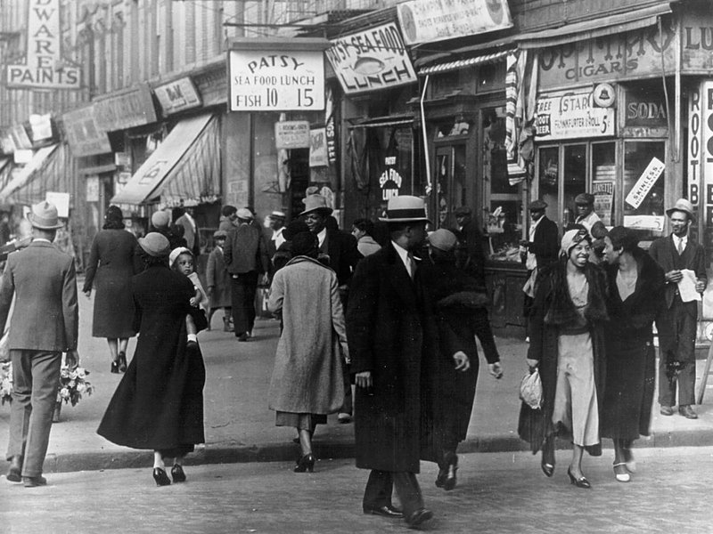
D. Discrimination in the North
Northern cities offered jobs and equality
Much was still segregated (de facto)
Cities
Workplaces
Unions
Workplace competition often became violent
Race Riots were common
New York City 1900

Slide 9
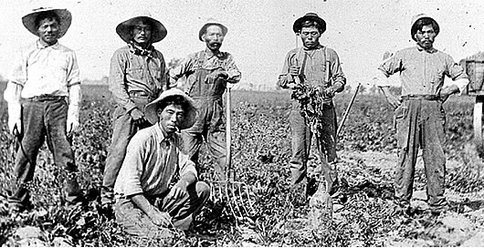
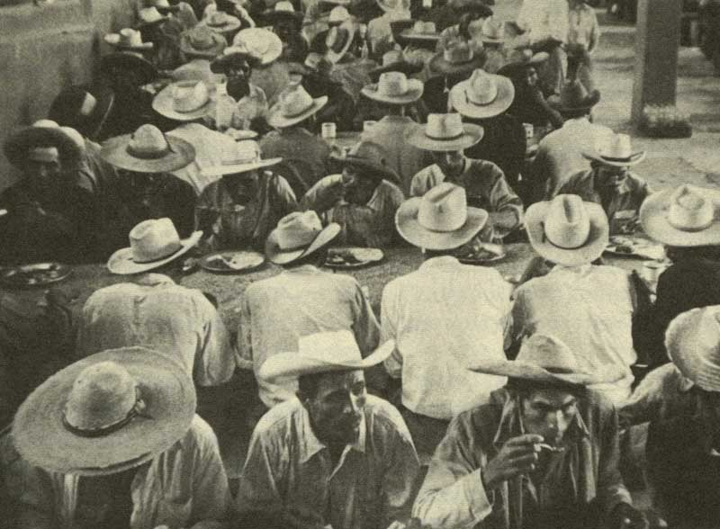
III. Discrimination in the West
A. Mexican Workers
Used in railroad construction
Also in mining & agriculture
Largely due to the 1902 Nat’l Reclamation Act
Faced difficult conditions and low pay
1903: Japanese – Mexican Labor Association
Many employers forced workers into debt peonage
Ended with 1911’s 17th Amendment

Slide 10
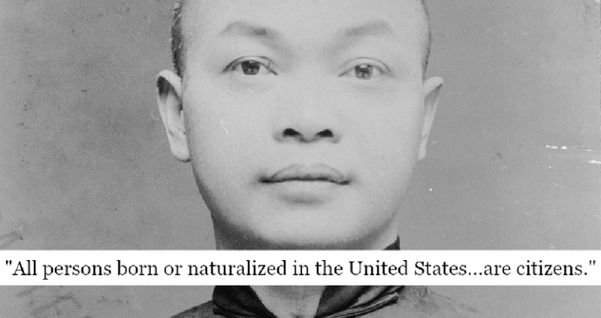
B. Excluding the Chinese
Fear of job competition lead to segregation
Some returned home
Won Kim Ark – denied reentry after visiting his parents.
U.S. Gov’t cited the Chinese Exclusion Act
U.S. v. Wong Kim Ark: 4 year legal battle.
Ruled that anyone born in the United States is a citizen.

Slide 11
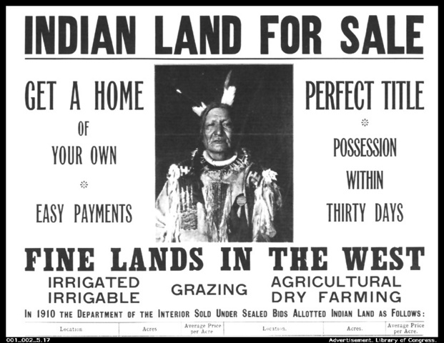
C. Native Americans
Also faced discrimination and violence
Most were not considered US citizens
Many whites opposed naturalization
Courts ruled against citizenship
Those who did have it were still denied suffrage, jury privileges, and public education
Other groups often offered help
Most believed assimilation was their only chance
Natives resisted through the Ghost Dance Movement
They promoted return to cultural roots
The movement was banned because the US Gov’t felt it would inspire an uprising

