Slide 1
SUB-SAHARAN AFRICA
Ben Rothman, Dua Abedeen, John Waldo, Nudhbi Choudhury, Irene Elias, Colleen Fang
Period 9 Garcia H4WX

Slide 2
Sub Saharan Africa
8000-600 BCE
Growth of Civilization

Slide 3
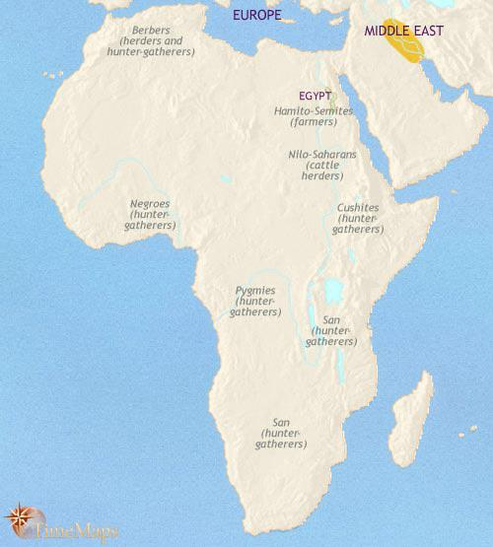
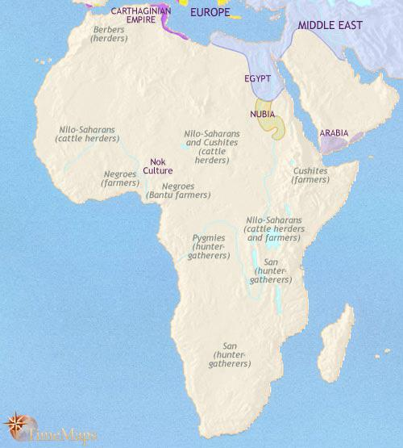
8000 BC 600 BC

Slide 4
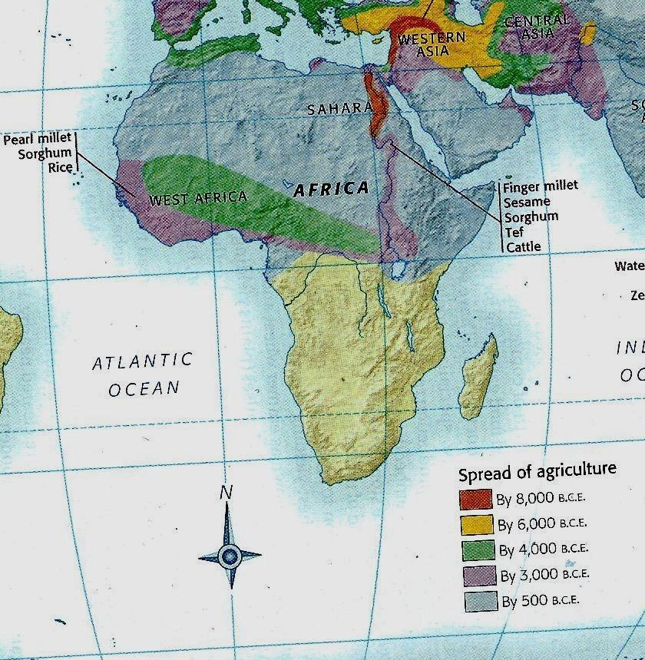
This shows the spread of the use of agriculture from 8000 BC - 500BC.
Most areas in lower Sub-Saharan Africa did not experience Agricultural or societal growth until later
Spread of Agriculture in Sub-Saharan Africa.

Slide 5
Interaction between humans and environment
Beginnings of civilization (Nok culture may have been the first civilization in Sub-Saharan Africa around 1000 BCE)
Agricultural revolution allowed the nomadic lifestyles to finish and allowed people to settle.
Usually people settled near water and built farmland, rerouted water.
This settled lifestyle allowed populations to increase and allowed for a surplus of food, leading to specialization of skills and the formation of cities and civilizations.
Early Africans migrated from the southern Sahara, where desertification was occurring. Thus, they migrated southward to escape the expanding desert.
There was a low population density.

Slide 6
State-building, expansion, and conflict
Northern Nubia- in the 5th millenium B.C.E, people switched from hunting and gathering to a settled life based on agriculture and cattle herding.
Bantu migrations (1500 - 500 BCE) - farmers moving from rivers in West Africa to the South and East, taking the land of nomads
Jenne-Jeno - possibly first city in Sub-Saharan Africa, by the Niger River Valley
Egypt occupied Nubia for a while, then the Nubians took over Egypt in 728 BCE. In between, the kingdom of Meroe developed.
Kush: a kingdom located farther down, eventually destroyed by the Egyptians around 590 BCE.

Slide 7
Development and Interaction of Cultures
Indian Ocean trade linked Eastern Coast (Swahili Coast) of Africa with India and Southeast Asia
Wealth supplied by this trade led to the building of great cities and kingdoms (Kush, Axum)
Elites of Eastern African kingdoms often converted to Islam to help with their political and economic interactions, so Islam spread through most of East Africa

Slide 8
Creation, Expansion, and Interaction of Economic Systems
Ivory, ebony, wood, and gold was supplied to Egypt by Nubia during their occupation.
Nubians brought back with them manufactured goods when they went to Egypt.
Swahilis traded with Muslims for gold, slaves, and ivory
Gold and salt trade in Ghana, which had previously been kept secluded by the Sahara

Slide 9
Development and Transformations of Social Structures
Egyptian Occupation in Nubia
Nubians were heavily affected by the Egyptian occupation for 500 years.
The natives were forced to adopt the Egyptian culture
Children of respectable households were taken to Egypt and immersed in Egyptian culture, religion and language. They came back and spread their knowledge.
Nubians served in the Egyptian army.
Hunter-gather societies lived with mostly the men looking for food. Polygamy was big (Women were secondary to men and took care of the children) and they didn't settle anywhere.
The Nok people worked collectively in society. Women were not as below men as in other societies.

Slide 10
Sub-Saharan Africa
600 B.C.E. – 600 C.E.
Expansion and
Development of Cities

Slide 11
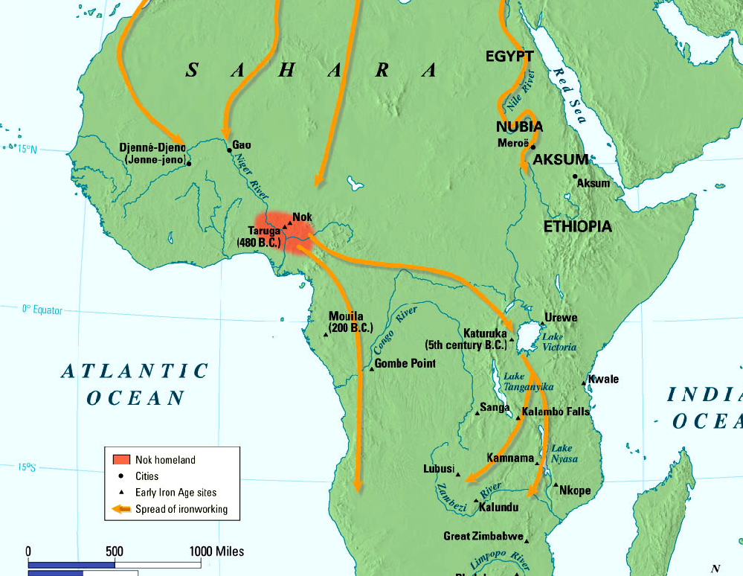

Slide 12
Interaction Between Humans and Environment
African societies began to depend less on hunting and gathering due to advancements in agriculture especially in Egypt, Ethiopia and the rainforests of Western Africa
Agriculture supplied a surplus of food which led to a population increase throughout Africa
This large growth in the population led to massive migrations south into Sub-Saharan Africa

Slide 13
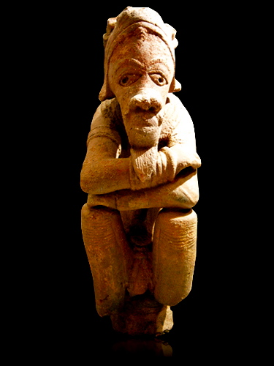
Development and Interaction of Cultures
When the Bantu people migrated southward they spread their language and culture throughout Africa
Bantu languages and culture depended on oral tradition and had many branches and dialects
Sub-Saharan empires such as the Nok made elegant clay sculptures, iron tools and weapons (metallurgy)
The major religious belief of Sub-Saharan Africans was animism, the belief that spirits are present in animals, plants and natural forces
Later in 200 C.E. Christianity was introduced into Sub-Saharan Africa in Axum
Nok Clay sculpture

Slide 14
Creation, Expansion, and Interaction of Economic Systems
The Nok were the first Sub-Saharan people to produce iron in 500 B.C.E.
The mass Bantu migration into southern Africa created large trading networks throughout Africa
Generally, Sub-Saharan states supplied stronger northern empires such as Kush and Axum with materials such as gold
Trade also included rice, fish, pottery, and salt

Slide 15
State-Building, Expansion, and Conflict
Most Africans lived in villages but cities began to develop along rivers sometime between 600 and 200 B.C.E.
As Bantu people migrated southward they often waged territorial wars but due to their superior technology they easily established their position
Empires and boundaries in Sub-Saharan Africa were constantly changing during this time period
Introduction of Christianity and other religions into Sub-Saharan Africa created further tensions

Slide 16
Development and Transformation of Social Structures
Extended families and families that have common ancestors formed family groups or clans
These early societies consisted of a village chief and a council of leaders from different family groups
Stronger societies eventually developed into kingdoms as seen in the city of Djenne-Djeno or the kingdom of Axum

Slide 17
Sub-Saharan Africa
600-1450 CE
The Rise of Large Empires

Slide 18
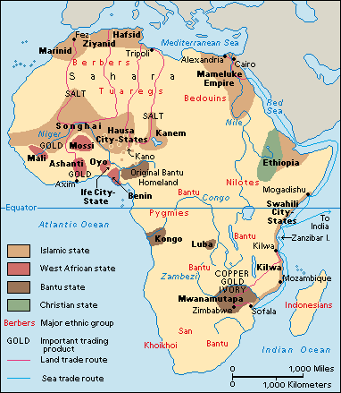

Slide 19
Interactions between humans and the environment
Iron metallurgy: provided the tools to clear and cultivate the fields of Africa, provided weapons like spears and arrowheads.
Earlier Bantu migration had caused the spread of iron smelting as well as a cultural unity of similar tradition
Copper: used to make wire, decorative objects, and as money
stone masonry: along the Swahili coast, it was used to make houses, replaced huts
population growth due to the spread of trade
domestication of the camel allows for the expansion of trade
Great Zimbabwe: people depleted their forest for firewood and their cattle overgrazed, so the empire collapsed
Notes:
magical power associated with iron smelters and blacksmiths

Slide 20
Development and Interaction of Cultures
Sub- Saharan Africa's geography causes it to be very decentralized and so there were many isolate societies,
Animism remained dominant
Ethiopia was the only Christian nation
Islam: began in the 6th century and spread to Africa in this period through trade, conquest because it was tolerant of other religions.
Sufis were Islamic missionaries that spread Islam to different lands including Sub-Saharan Africa
Merchants introduced Islam in West Africa to the kings through trade.
West Africa became a very key cultural center. Mosques and schools were built.
Notes:
Mostly ruler and elitist members of society converted

Slide 21
Creation, expansion, and interaction of economic systems
Development of the Trans-Saharan trade
Expansion of the trade: salt from the Sahara was traded with gold from south of the Sahara
increase in trade led to rise of regional states, Ghana and Mali
Slave Trade: Mali and Bornu sent slaves to North Africa, prisoners of war
Indian Ocean Trade: collapse of the Mongol Empire in the 1300s disrupted overland routes of trade, thus strengthening the Indian Ocean Routes
Swahili Coast (of Eastern Africa): supplied gold from inland Africa to the rest of the world
Notes:
domesticated camels allowed for an increase of trade across the Sahara desert

Slide 22
State-building, expansion, and conflict
Ghana: 500- 1200 king had exclusive right to gold, a divine position. The rulers had converted to Islam. Eventually, Ghana was absorbed by the Mali. Mali: controlled and taxed all trade, in Timbuktu- Muslim scholars studied Islamic law and administration as well as math, science, medicine and technology. Schools and books for education. Mansa Musa,the king of Mali went on a pilgrimage to Mecca, showing off his wealth throughout his journey and establishing Mali as a wealthy nation
Great Zimbabwe: attracted Arab and Iranian merchants, farming cattle herding provided an economic basis, long-distance trade brought wealth
South of West Africa there were villages, with chiefs and councils to rule the people. Witch doctors were of great importance to the people.
Notes:
converted to Christianity to gain favor with the Arab merchants, alliances
the value of gold in cairo was depressed for years
large stone structures

Slide 23
Development and Transformations of Social Structures : Islam
Islam spread literacy, boys were taught Arabic in order to read the Quran
scholars adapted the Arabic alphabet to write local languages
Women held an important role: they did most of the farm work, sold their products in local markets.
Adopting Islam did not lead to the adoption of all the social customs of the Arabs: Muslim women did not cover all of their bodies and did not veil their face, and talked to men freely in Mali
Music was very important to African culture, dancing and wearing masks as well
Kingship legitimized by Islam
Notes:
products: agricultural products, pottery and other craftwork
Mali: muslim women didn't cover all of their bodies and didn't veil their face Ibn Battuta was appalled. women and non family male members were allowed to associate, food preparation

Slide 24
Sub-Saharan Africa
1450-1750 CE
Rising European Influence

Slide 25
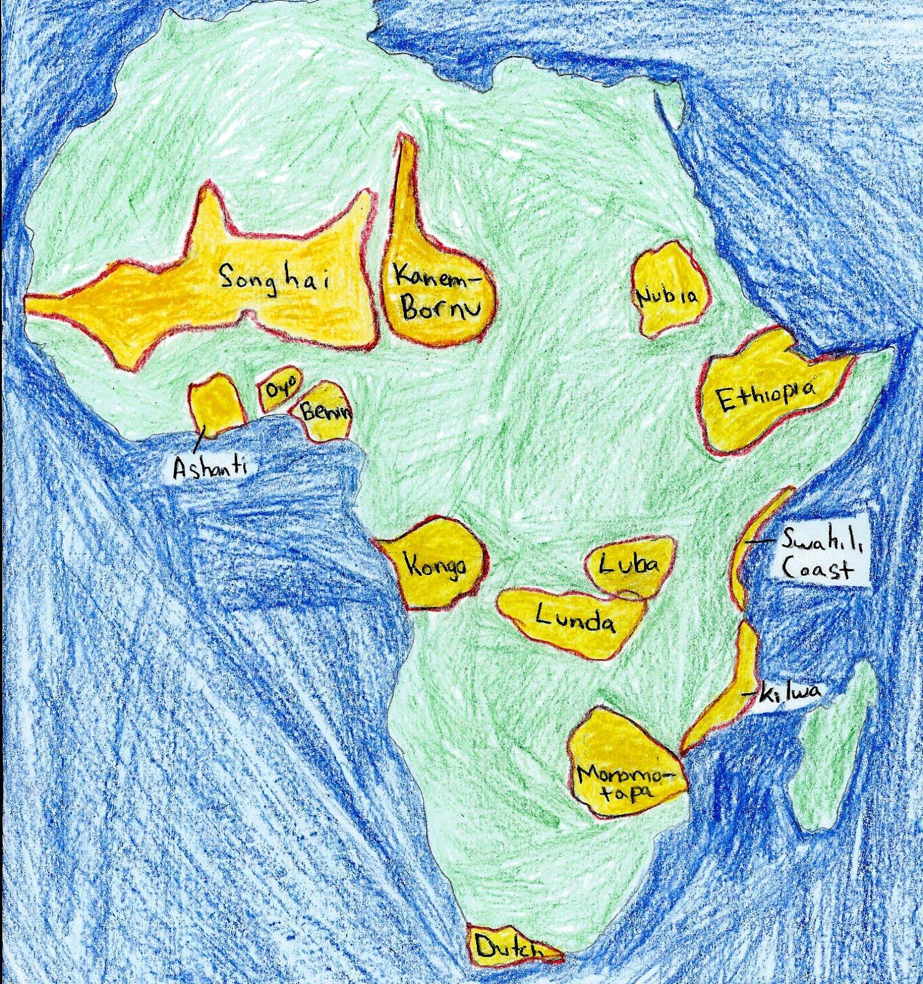
1450s
Empires: Songhai, Kanem-Bornu, Nubia, Ashanti, Oyo, Benin, Ethiopia, Kongo, Lunda, Luba, Swahili Coast, Kilwa, Monomotapa, Dutch Cape Colony.

Slide 26
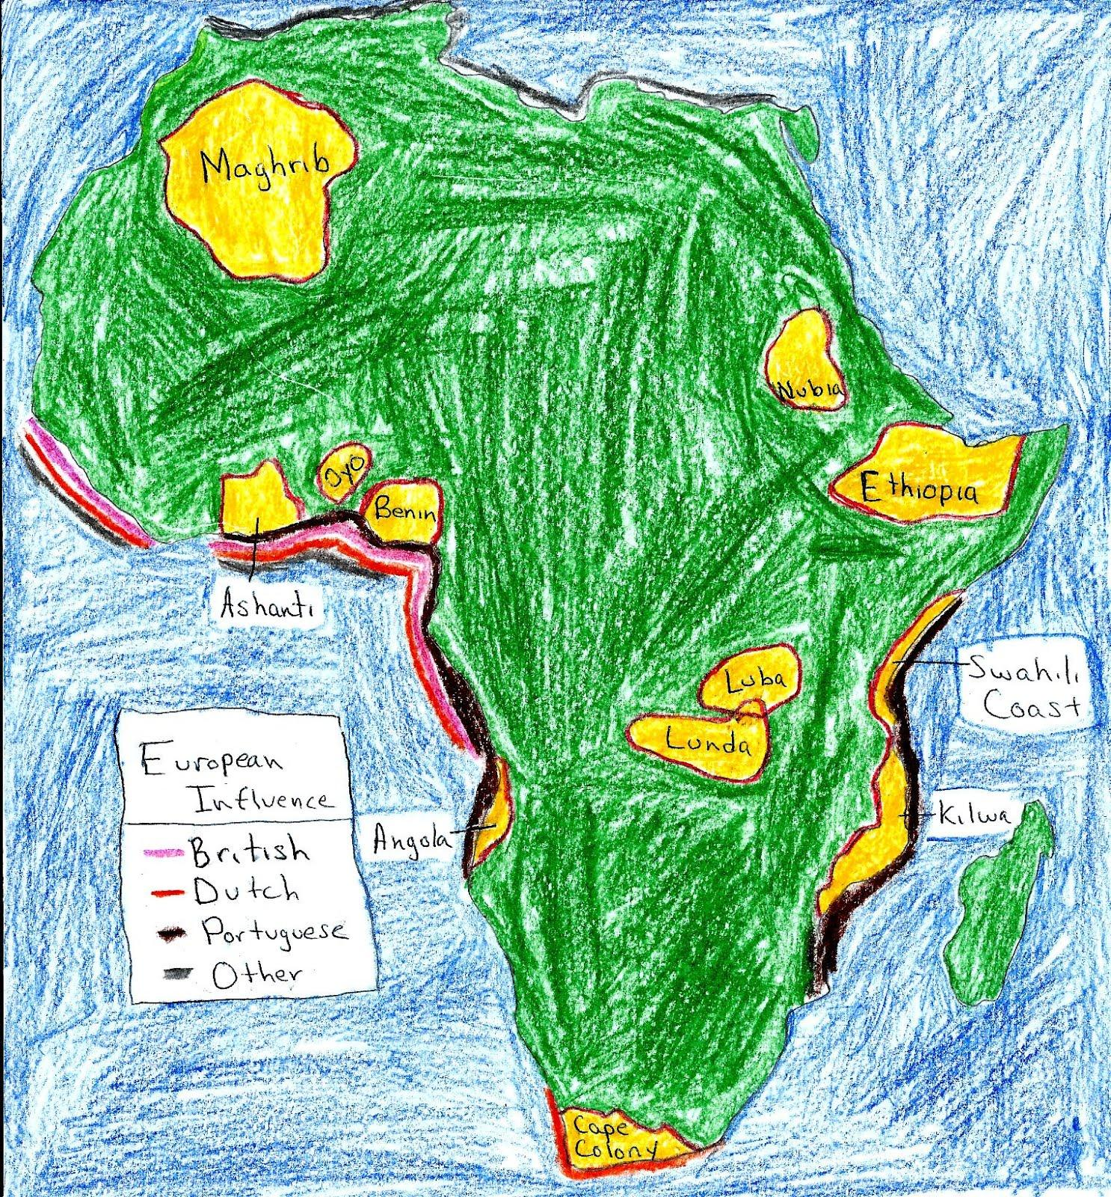
1750s
Maghrib, Nubia, Ashanti, Oyo, Benin, Ethiopia, Luba, Lunda, Swahili Coast, Angola, Kilwa, Cape Colony

Slide 27
Interactions between Humans and their Environment
• During the 1400s, the Portuguese had been looking for a simpler and faster passage to the great trade routes of the Indian Ocean, when they discovered the riches of Sub-Saharan Africa.
•Most Europeans stayed around the coastline in order to stay involved with maritime trade but also due to the lack of protection from diseases and wildlife of inner Africa
•European Migrations to Sub-Saharan Africa increased.
•Africans who were sold to slavery had to travel through the Middle Passage and many died from hunger, overcrowding, torture and also suicide.
•While European diseases did affect Africans, it did not have a great effect due to contact with many of these diseases from North Africa, Middle East, or the Indian Ocean.

Slide 28
Creation, Expansion, and Interaction of Economic Systems:Slavery
•Slavery had been a part of Africa since before the 1400s. However, it was not until European presence grew in Africa and the Americas were beginning to be colonized did the trade grow drastically. •The Portuguese and eventually other Europeans quickly became closely connected with the African people and its trades.
The Slave Trade became an important part of the Trans-Atlantic Trade around the 1500s and expanded until the 1800s
•Portuguese built colonies and forts and used its military power to defeat many African states and defeat many competitors in trade.
•The Dutch first traded firearms to Africans in late 1600s.
•Other trades also grew with European influence such as the gold trade and the ivory trade.
•Trade with the Indian Ocean, North Africa, and the Middle East continued.

Slide 29
Development and Transformation of Social Structures: Effects of Slavery
As the slave trade grew, so did economic and social disparity.
Many families were destroyed by the abduction of people to sell into slavery.
Abductions led to the drastic decline of the population in many states.
Many aristocrats were also abducted leading to political dysfunction and eventually economic decline. However social classes stayed mostly the same.
While there was a decrease in the male to female ratio the status of women did not make great progress. However women did take part in agricultural commerce.

Slide 30
Development and Interactions of Cultures
•There were some African Christian states in the beginning of the period, such as the Kingdom of Ethiopia and the Kingdom of the Kongo.
•In the 1500s Christianity was making a rise due to missionary work. However, by the end of the period many Christian Africans were upset at how Christians can practice something as horrible as slavery such as in Congo, which led to the decline of Christianity in many empires.
•Islam also increased its reach in Africa. In the 1500s and 1600s, the growth of Muslim empires, like the Ottomans, Kingdom of Sennar and the Kingdom of Adal Sultanate led to the spread of Islam. The Swahili Coast also expanded during this period, spreading the mixed language of Bantu and Arabic
•Traditional religions of voodoo, animism, and spiritualism were dominant and would continue to dominate for many centuries.

Slide 31
State Building Expansion and Conflict
•The Songhai Empire grew largely in the beginning of the period, taking over the city of Timbuktu and spreading across the area of the Malian Kingdom. It fell in the late 1500s.
•The Kingdom of Ethiopia in East Africa and Kingdom of Congo in Central Africa had been Christian for a long time.
•The Kingdom of Zimbabwe had fallen around 1450s and was replaced by many smaller kingdoms including Portuguese colonies.
•The Swahili Coast expanded to a large portion of East African Coast. They were a major part of the Indian Ocean trade.
•Civil Wars were common in many of these states and became more bloody with the acquisition of firearms
•Small Portuguese, Dutch, and British colonies tried to increase wealth by utilizing the resources of the continent by building colonies near the coastal areas.

Slide 32
1750-1914 CE
Scramble for Africa

Slide 33
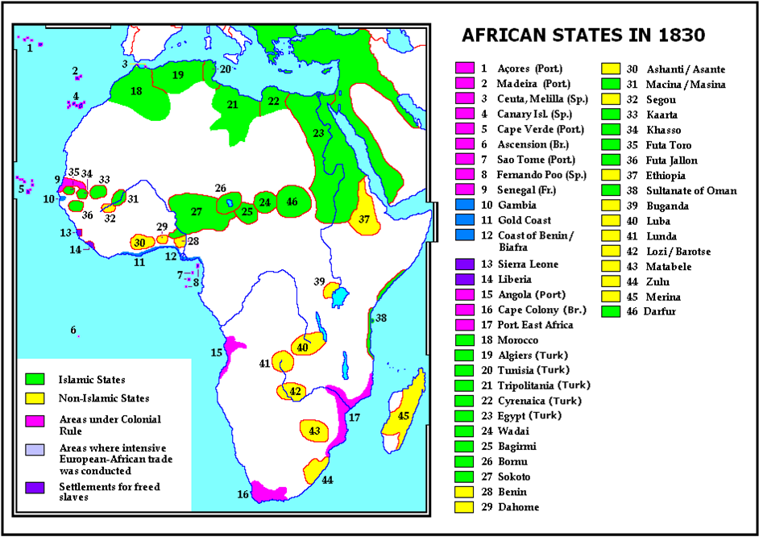

Slide 34
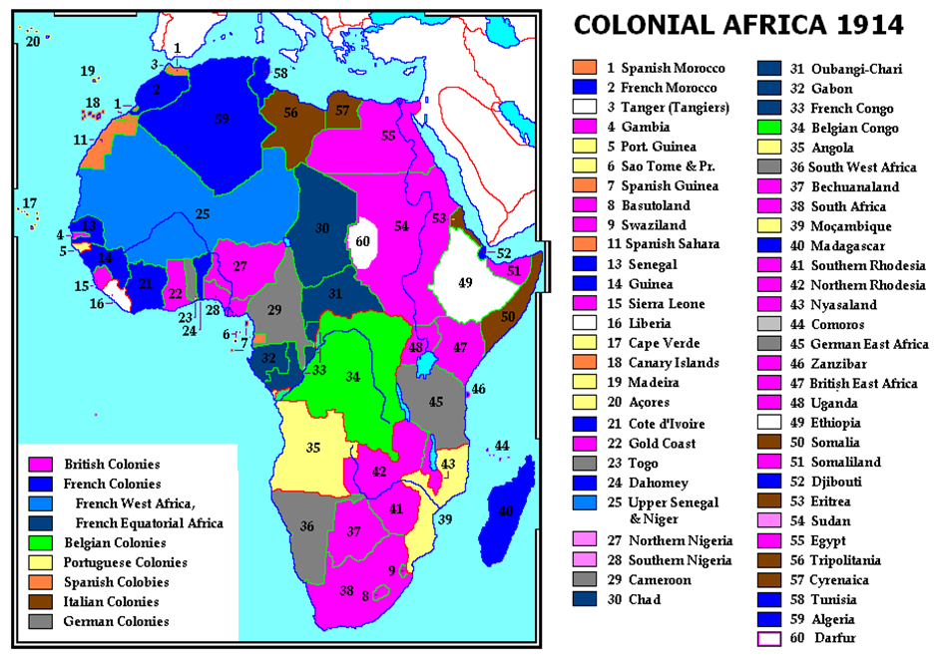
Colonial Boundaries

Slide 35
Statebuilding, expansion and conflict
In 1884 in the Berlin Conference, leaders of many European countries decided that Africa would be divided by "effective occupation" which means colonies would created depending on which country occupied and could control them.
Nguni people were cattle herders and farmers on the coast of southern Africa. When a deadly drought hit in 1818, the Zulu kingdom was formed. Shaka, the leader expanded the Zulu kingdom, causing the displacement of many people.
These refugees formed their own kingdoms called the Swazi kingdom and the Lesotho kingdom.
The Muslim Hausa states of West Africa pushed for reforms of Islamic practices in the 1770s. This led to the conquer of the rural pagans. The Hausa states were then united under the Sokoto Caliphate.
Ethiopia underwent modernization. They bought firearms from Europeans and created highly effective armies. They resisted occupation.
Due to the abolition of slavery, slave traders moved eastward and created Zanzibar.
Secondary Empires were developing in East Africa
Tribes who accepted occupation receive benefits, while those who fought back suffered immense hardships and usually lost.
Many tribes and lingually connected regions were divided by the new borders developed by the Europeans.

Slide 36
Interactions between Humans and Environments
Population increased because of the end of the trans-atlantic trade, colonization and the spread of medical services.
Indentured servants came in and left Sub-Saharan Africa.
Many Africans had to move to cities for jobs.
Resources were starting to be extracted at a greater scale.
Roads and other technology were used.
Colonies were made across all of Africa, even the lands in which many people suffer from diseases.

Slide 37
Development and Interaction of Cultures
Abolition of Trans-Atlantic slavery led to more Western influence. British were adamant abolitionists and freed many people who were taught Christian ideals
Freed blacks returned to their homeland and brought Western culture with them.
Christianity spread through mission schools
European imperialism allowed for Muslims to settle in new places, and so Islam spread peacefully farther.

Slide 38
Creation, Expansion and Interaction of Economic Systems
legitimate trade had grown as a result of the abolition of the Trans-Atlantic slave trade, new exports were created and old exports were revived. The most important coastal export was palm-oil.
Zanzibar: continued the practice of slavery and exported ivory. Imported many European weapons
Industrialization caused the demand for more raw materials & after colonization sub-Saharan Africa became a major supplier
Most colonies became economically dependent because they exported raw materials but built little industry; infrastructure was only built for movement of goods out of the country
Because foreign investors owned & controlled production, all profits went to Western businessmen/companies
Colonies would force taxes with European currency mandating people to get European jobs.
Secondary Empires in East Africa were funded by Europeans and were major part of trading in the area.
industrialization fueled demand for colonies because industry needed money (gold), cheap laborers, markets
Imperialism led to increased global trade and communication

Slide 39
Social Structure: The Effects of Colonization
The Africans under colonial rule were horribly taken advantage of especially in colonies like the Belgian Congo.
Most Africans did not have upward mobility in society.
Governments assigned taxes and in order to pay for these new taxes, Africans had to migrate to cities or mines and had to work under Europeans in order to get money.
While some African women were happy with colonization, most jobs were assigned to men and private land belonged to the head of the household (male).
Missionary schools softened the exploitative nature of colonization. Many converts to Christianity as well as Islam.

Slide 40
Sub-Saharan Africa
1914 - Present
Decolonization and Development

Slide 41
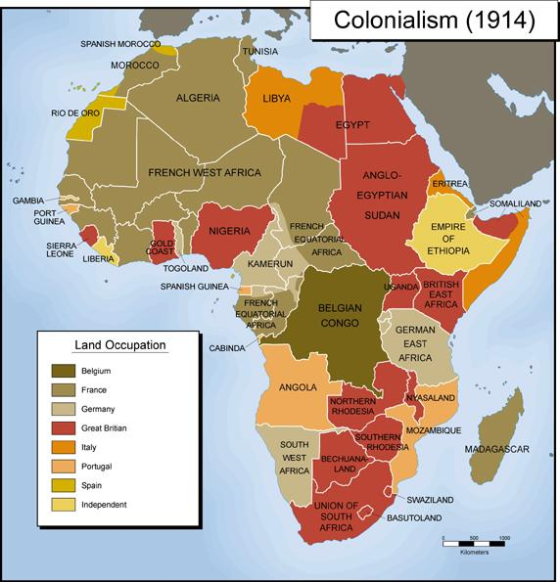
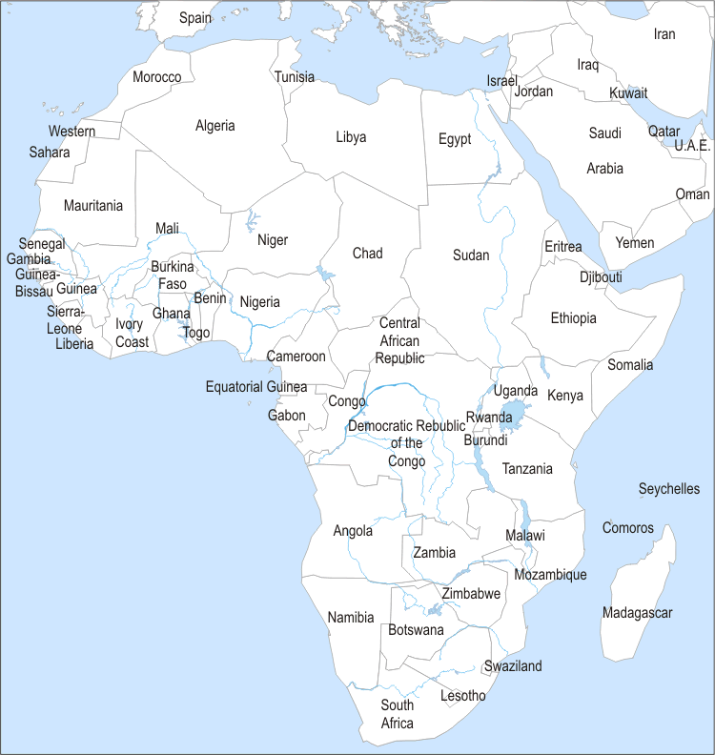
Political Maps
Colonialism and Present Day
1914 Present Day

Slide 42
Interactions between Humans and the Environment
There was a modernization of the country which gave new technology.
They were exposed to many Western ideas and tools and began gaining things like pools, hotels, cars, etc.
During colonialism many new paved roads were being made to connect different places in the country.
Mining was also big as there were many natural resources in Africa.
Vaccines also helped eliminate how many people died from disease in Africa. No longer would people be at so high a risk of dying from things like Malaria and Aids.

Slide 43
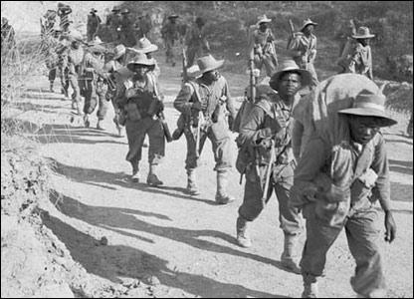
Development and interaction of cultures
Religious beliefs stayed the same.
During WW1 and WW2 Africans supported the Europeans with troops and resources.
An ideology that didn't support the Europeans after WW2 began.
European powers broke promises and showed weakness.
African states united together under nationalism and in belief against the ideologies of the Europeans.
The non-aligned movement some nations took was against war because they couldn't survive on their own if a war broke out and newly developing countries needed stable and peaceful world for growth.

Slide 44
State-building, expansion, and conflict
Anger towards colonialism and the the European powers, led to the birth of Nationalism.
All over Sub-Saharan Africa nations were revolting.
There were different approaches like:
Radical mass movements and violence in Ghana which was the first independent nation.
  Belgium and Portugal held onto their colonies the longest, but eventually had to let them go - Congo, Mozambique, Angola.
In Southern Africa, there was a huge white population. Took the longest for independence, because the white population there ruled the government.

Slide 45
Creation, expansion, and interaction of economic systems
After gaining independence nations wanted to create democratic societies.
Some nations like Ghana, didn't think capitalism would work and leaned towards socialism.
They tried industrializing and increasing their economies, but bad investments led to many nations going bankrupt.
  Other causes were corrupt leaders going into power in almost all of the nations and creating tyrannical governments.

Slide 46
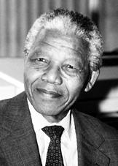
Development and transformation of social structures
White people ruled in southern Africa from the 40's to the 90's.
Apartheid - Used to run the government in a racist style for white supremacy.
Nelson Mandela helped fight for black rights.
A Black Conscious movement was formed with leaders like Steve Biko to change the mentality that the black Africans couldn't/didn't deserve to rule themselves and were inferior to the white man.
Since Europe didn't divide Africa up according to the people, ethnic rivalries can be seen still today between people in nations in Africa since they have different values.
People in Africa remain poor as corruption in the government has ruined their economies.

Slide 47
Works Cited List
Henderson. "Unit II: 600 - 1450 C.E." Henderson's History Haven. Web. 03 May 2012. <http://www.historyhaven.com/>.
Rodriguez, Joel. "Questions of Periodization." A.P. World History Notes. Google. Web. 3 May 2012.
Bulliet, Richard W. The Earth and Its People: A Global History. 5th ed. Boston, MA: Cengage Wadsworth, 2011. Print.
Goman, Daniel. "University High World History." Home. Web. 03 May 2012. <http://universityhigh.webs.com/apreview.htm>.
Beck, Roger B. World History: Patterns of Interaction. Evanston, IL: McDougal Littell, 2005. Print.
"Africa History." - Africa History Map 3500BC. Time Maps Ltd. Web. 04 May 2012. <http://www.timemaps.com/history/africa-3500bc>.
HowStuffWorks. Discovery Communications. Web. 03 May 2012. <http://history.howstuffworks.com/african-history/history-of-africa2.htm>.

Slide 48
Works Cited List (continued)
"Between World Wars." BBC News. BBC. 28 Apr. 2012 <http://www.bbc.co.uk/worldservice/africa/features/storyofafrica/index_section13.shtm>
"White Supremacy." 2006. 28 Apr. 2012 <http://africanholocaust.net/html_ah/Notes%20on%20Understanding%20White%20Supremacy.html>.
Valley, Paul. "Forever In Chains. History of The Congo" The Independent. Independent Digital News and Media. 28 Apr. 2012 <http://www.independent.co.uk/news/world/africa/forever-in-chains-the-tragic-history-of-congo-409586.html>.
"Nile Valley" The Story of Africa BBC News. BBC. http://www.bbc.co.uk/worldservice/africa/features/storyofafrica/3chapter4.shtml
"Nubia" Essential-Humanities. 28 Apr. 2012 http://www.essential-humanities.net/world-history/history-of-sub-saharan-africa/#raquo_Nubia

