Slide 2
9.6 Geneticists can use the testcross to determine unknown genotypes
A testcross is the mating between an individual of unknown genotype and a homozygous recessive individual.
A testcross can show whether the unknown genotype includes a recessive allele.
Mendel used testcrosses to verify that he had true-breeding varieties of plants.
The following figure demonstrates how a testcross can be performed to determine the genotype of a Lab with normal eyes.
Notes:
Student Misconceptions and Concerns
• Students using Punnett squares need to be reminded that the calculations are expected statistical probabilities and not absolutes. Just as we would expect that any six playing cards dealt might be half black and half red, we frequently find that this is not true. This might be a good time to show how larger sample sizes increase the likelihood that sampling will reflect expected ratios.
Teaching Tips
• Consider challenging your students to explain why a testcross of two black Labs of unknown genotypes might not reveal the genotype of each dog. (If both dogs are heterozygous, or homozygous, the results would reveal the genotypes because the offspring would either be three dark and one brown or all dark. But if one black Lab was homozygous and the other heterozygous, we could not determine which Lab has which genotype.)
Active Lecture Tips
• See the Media Review: “Learn.Genetics” Genetic Science Learning Center from the University of Utah on the Instructor Exchange. Visit the Instructor Exchange in the MasteringBiology instructor resource area for a description of this activity.

Slide 3
Answer in Notebooks:
#6. Why do you have to perform a test cross using a homozygous recessive individual?

Slide 4
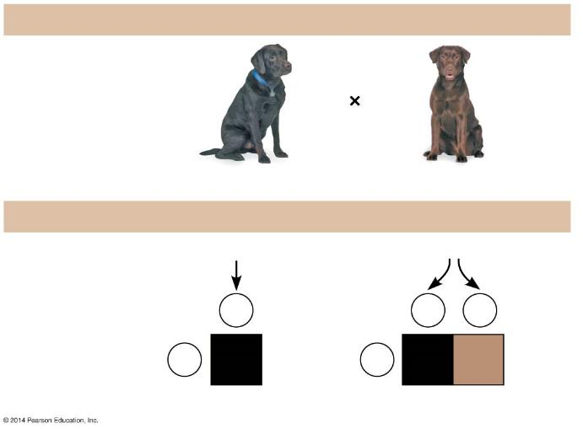
Figure 9.6
What is the genotype of the black dog?
Testcross
Genotypes
B_?
bb
Two possibilities for the black dog:
BB
or
Bb
Gametes
B
B
b
b
Bb
b
Bb
bb
Offspring
All black
1 black : 1 chocolate
Notes:
Figure 9.6 Using a testcross to determine genotype

Slide 7
Answer in Notebooks:
#7.

Slide 8
Variations on Mendel’s Laws

Slide 9
9.11 Incomplete dominance results in intermediate phenotypes
Mendel’s pea crosses always looked like one of the two parental varieties, a situation called complete dominance.
For some characters, the appearance of F₁ hybrids falls between the phenotypes of the two parental varieties. This is called incomplete dominance.
Notes:
Student Misconceptions and Concerns
• As your class size increases, the chances increase that at least one student will have a family member with one of the genetic disorders discussed. Some students may find this embarrassing, but others might have a special interest in learning more about these topics and may even be willing to share some of their family’s experiences with the class.
• After reading the preceding modules, students might expect all traits to be governed by a single gene with two alleles, one dominant over the other. Modules 9.11–9.15 describe deviations from simplistic models of inheritance.
• As these variations of Mendel’s laws are introduced, students are likely to get confused and become uncertain about the prior definitions. Consider keeping a clear definition of these different patterns of inheritance available for the class to refer to as new patterns are discussed (perhaps as a handout for student reference).
Teaching Tips
• Incomplete dominance is analogous to a compromise or a gray shade. The key concept is that both “sides” have input. Complete dominance is analogous to an authoritarian style, overruling others and insisting on things being a certain way. Although these analogies might seem obvious to instructors, many students new to genetics appreciate them.
• Another analogy for cholesterol receptors is fishing poles. The more fishing poles you use at the same time, the more fish you are likely to catch. Heterozygotes for hypercholesterolemia have fewer “fishing poles” for cholesterol. Thus, fewer “fish” are caught and more “fish” remain in the water.
Active Lecture Tips
• See the activity Who Wants to Be a Millionaire? Inheritance on the Instructor Exchange. Visit the Instructor Exchange in the MasteringBiology instructor resource area for a description of this activity.

Slide 10
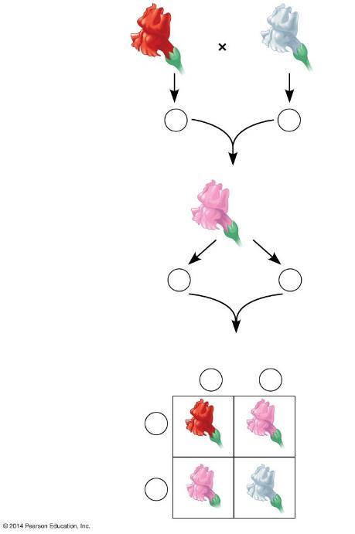
Figure 9.11a-0
P generation
Red
RR
White
rr
Gametes
R
r
F₁ generation
Pink hybrid
Rr
Gametes
1
2
R
1
2
r
F₂ generation
Sperm
1
2
R
1
2
r
1
2
R
RR
rR
Eggs
1
2
r
Rr
rr
Notes:
Figure 9.11a-0 Incomplete dominance in snapdragon flower color

Slide 11
9.11 Incomplete dominance results in intermediate phenotypes
One example of incomplete dominance in humans is hypercholesterolemia, in which
  dangerously high levels of cholesterol occur in the blood
  heterozygotes have intermediately high cholesterol levels.
Notes:
Student Misconceptions and Concerns
• As your class size increases, the chances increase that at least one student will have a family member with one of the genetic disorders discussed. Some students may find this embarrassing, but others might have a special interest in learning more about these topics and may even be willing to share some of their family’s experiences with the class.
• After reading the preceding modules, students might expect all traits to be governed by a single gene with two alleles, one dominant over the other. Modules 9.11–9.15 describe deviations from simplistic models of inheritance.
• As these variations of Mendel’s laws are introduced, students are likely to get confused and become uncertain about the prior definitions. Consider keeping a clear definition of these different patterns of inheritance available for the class to refer to as new patterns are discussed (perhaps as a handout for student reference).
Teaching Tips
• Incomplete dominance is analogous to a compromise or a gray shade. The key concept is that both “sides” have input. Complete dominance is analogous to an authoritarian style, overruling others and insisting on things being a certain way. Although these analogies might seem obvious to instructors, many students new to genetics appreciate them.
• Another analogy for cholesterol receptors is fishing poles. The more fishing poles you use at the same time, the more fish you are likely to catch. Heterozygotes for hypercholesterolemia have fewer “fishing poles” for cholesterol. Thus, fewer “fish” are caught and more “fish” remain in the water.
Active Lecture Tips
• See the activity Who Wants to Be a Millionaire? Inheritance on the Instructor Exchange. Visit the Instructor Exchange in the MasteringBiology instructor resource area for a description of this activity.

Slide 12
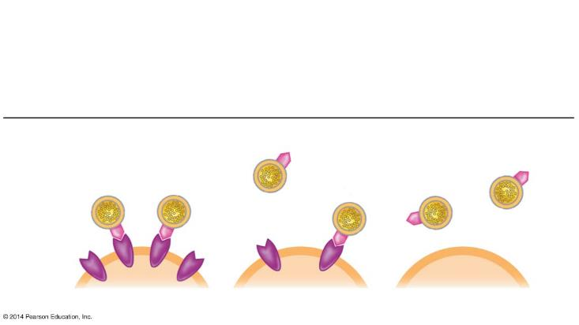
Figure 9.11b
Genotypes
HH
Homozygous
for ability to make
LDL receptors
Hh
Heterozygous
hh
Homozygous
for inability to make
LDL receptors
Phenotypes
LDL
LDL
receptor
Cell
Normal
Mild disease
Severe disease
Notes:
Figure 9.11b Incomplete dominance in human hypercholesterolemia

Slide 13
Incomplete Dominance
In incomplete dominance neither allele for the trait dominates the other so that each allele is in effect. This produces a third phenotype which is an apparent blend of the two parents’ phenotypes. For example; in some flowers, crossing a red (RR) with a Blue (R’R’) will produce a Purple flower (RR’).
1. A gardener crosses a red flower with a blue flower
A. What are the genotypes and phenotypes of the F1 generation?
B. What would be the genotype and phenotype ratios of the offspring if
two of the F1 were crossed?

Slide 14
Answer in Notebooks:
#8. In incomplete dominance neither allele for the trait dominates the other so that each allele is in effect. This produces a third phenotype which is an apparent blend of the two parents’ phenotypes. For example; in some flowers, crossing a red (RR) with a Blue (R’R’) will produce a Purple flower (RR’).
2. A gardener crosses a blue flower with a purple flower
A. What are the genotypes and phenotypes of the flowers produced?

Slide 15
9.12 Many genes have more than two alleles in the population
Although each individual carries, at most, two different alleles for a particular gene, in cases of multiple alleles, more than two possible alleles exist in a population.
Notes:
Student Misconceptions and Concerns
• As your class size increases, the chances increase that at least one student will have a family member with one of the genetic disorders discussed. Some students may find this embarrassing, but others might have a special interest in learning more about these topics and may even be willing to share some of their family’s experiences with the class.
• After reading the preceding modules, students might expect all traits to be governed by a single gene with two alleles, one dominant over the other. Modules 9.11–9.15 describe deviations from simplistic models of inheritance.
• As these variations of Mendel’s laws are introduced, students are likely to get confused and become uncertain about the prior definitions. Consider keeping a clear definition of these different patterns of inheritance available for the class to refer to as new patterns are discussed (perhaps as a handout for student reference).
Teaching Tips
• Students can think of blood types as analogous to socks on their feet. You can have socks that match, a sock on one foot but not the other, you can wear two socks that do not match, or you can even go barefoot (type O blood)! Developed further, think of amber (A) and blue (B) socks. Type A blood can have an amber sock with either another amber sock or a bare foot (or “zero” sock). Blue socks work the same way. One amber and one blue sock represent the AB blood type. Having no socks, as already noted, represents type O.
• Consider specifically comparing the principles of codominance (expression of both alleles) and incomplete dominance (expression of one intermediate trait). Students will likely benefit from this direct comparison.
Active Lecture Tips
• See the activity Who Wants to Be a Millionaire? Inheritance on the Instructor Exchange. Visit the Instructor Exchange in the MasteringBiology instructor resource area for a description of this activity.

Slide 16
9.12 Many genes have more than two alleles in the population
Human ABO blood group phenotypes involve three alleles for a single gene.
The four human blood groups, A, B, AB, and O, result from combinations of these three alleles.
The A and B alleles are both expressed in heterozygous individuals, making both alleles codominant.
Notes:
Student Misconceptions and Concerns
• As your class size increases, the chances increase that at least one student will have a family member with one of the genetic disorders discussed. Some students may find this embarrassing, but others might have a special interest in learning more about these topics and may even be willing to share some of their family’s experiences with the class.
• After reading the preceding modules, students might expect all traits to be governed by a single gene with two alleles, one dominant over the other. Modules 9.11–9.15 describe deviations from simplistic models of inheritance.
• As these variations of Mendel’s laws are introduced, students are likely to get confused and become uncertain about the prior definitions. Consider keeping a clear definition of these different patterns of inheritance available for the class to refer to as new patterns are discussed (perhaps as a handout for student reference).
Teaching Tips
• Students can think of blood types as analogous to socks on their feet. You can have socks that match, a sock on one foot but not the other, you can wear two socks that do not match, or you can even go barefoot (type O blood)! Developed further, think of amber (A) and blue (B) socks. Type A blood can have an amber sock with either another amber sock or a bare foot (or “zero” sock). Blue socks work the same way. One amber and one blue sock represent the AB blood type. Having no socks, as already noted, represents type O.
• Consider specifically comparing the principles of codominance (expression of both alleles) and incomplete dominance (expression of one intermediate trait). Students will likely benefit from this direct comparison.
Active Lecture Tips
• See the activity Who Wants to Be a Millionaire? Inheritance on the Instructor Exchange. Visit the Instructor Exchange in the MasteringBiology instructor resource area for a description of this activity.

Slide 17
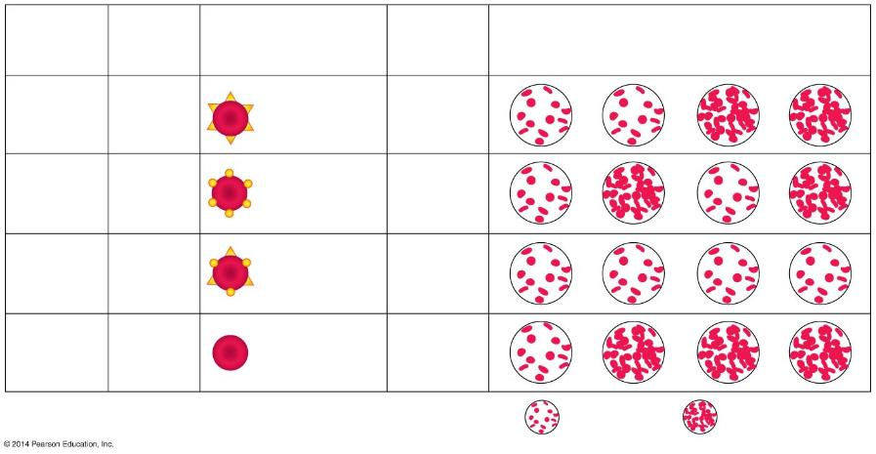
Figure 9.12-0
Blood
Group
(Phenotype)
Antibodies
Present
in Blood
Reaction When Blood from Groups Below Is
Mixed with Antibodies from Groups at Left
Carbohydrates Present
on Red Blood Cells
Genotypes
O
A
B
AB
I^{A}I^{A}
or
I^{A}i
Carbohydrate A
A
Anti-B
I^{B}I^{B}
or
I^{B}i
Carbohydrate B
B
Anti-A
Carbohydrate A
and
Carbohydrate B
AB
I^{A}I^{B}
None
Anti-A
O
ii
Neither
Anti-B
No reaction
Clumping reaction
Notes:
Figure 9.12-0 Multiple alleles for the ABO blood groups

Slide 18
Write the genotype for each person based on the description:
  1. Homozygous for the “B” allele
  2. Heterozygous for the “A” allele
  3. Type O
  4. Type “A” and had a type “O” parent
  5. Type “AB”
  6. Blood can be donated to anybody
  7. Can only get blood from a type “O” donor

Slide 19
Pretend that Brad Pitt is homozygous for the type B allele, and Angelina Jolie is type “O.” What are all the possible blood types of their baby? (show your work)

Slide 20
Answer in Notebooks:
Two parents think their baby was switched at the hospital. Its 1968, so DNA fingerprinting technology does not exist yet. The mother has blood type “O,” the father has blood type “AB,” and the baby has blood type “B.”
  Mother’s genotype: _______
  Father’s genotype: _______
  Baby’s genotype: ______ or ________
  Punnett square showing all possible genotypes for children produced by this couple
  Was the baby switched?

Slide 21
Sex Chromosomes and
Sex-Linked Genes

Slide 22
9.21 Sex-linked genes exhibit a unique pattern of inheritance
Sex-linked genes are located on either of the sex chromosomes.
The X chromosome carries many genes unrelated to sex.
The inheritance of white eye color in the fruit fly illustrates an X-linked recessive trait.
Notes:
Student Misconceptions and Concerns
• The prior discussion of linked genes addresses a relationship different from the similar term sex-linked genes. Consider emphasizing this distinction for your students.
Teaching Tips
• An analogy can be drawn between sex-linked genes and the risk of not having a backup copy of a file on your computer. If you only have one file, and it is damaged, you have to live with the damaged file. Females, who have two X chromosomes, thus have a “backup copy” that can function if one of the sex-linked genes is damaged.

Slide 23
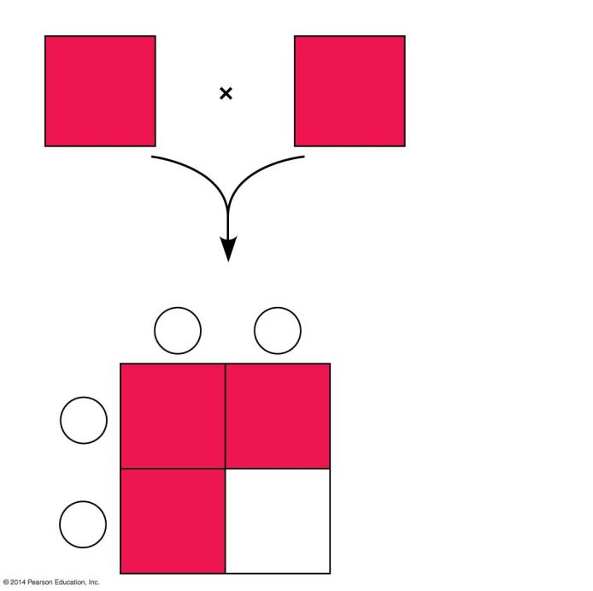
Figure 9.21c
Female
Male
X^{R}X^{r}
X^{R}Y
Sperm
X^{R}
Y
X^{R}
X^{R}X^{R}
X^{R}Y
Eggs
X^{r}
X^{r}X^{R}
X^{r}Y
R = red-eye allele
r = white-eye allele
Notes:
Figure 9.21c A heterozygous female crossed with a red-eyed male

Slide 24
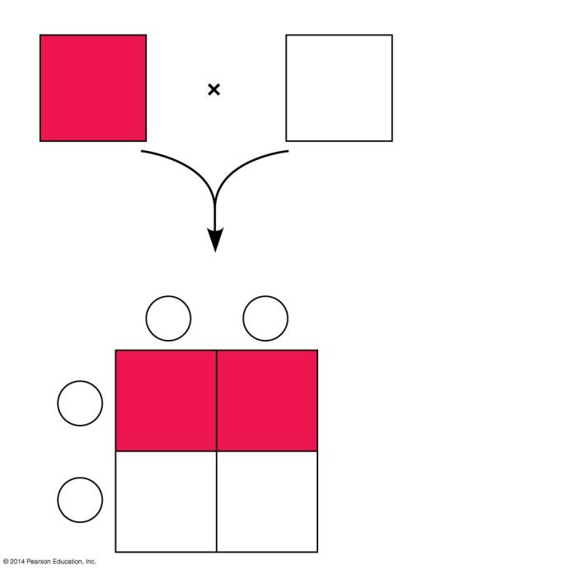
Figure 9.21d
Female
Male
X^{R}X^{r}
X^{r}Y
Sperm
X^{r}
Y
X^{R}
X^{R}X^{r}
X^{R}Y
Eggs
X^{r}
X^{r}X^{r}
X^{r}Y
R = red-eye allele
r = white-eye allele
Notes:
Figure 9.21d A heterozygous female crossed with a white-eyed male

Slide 25
9.22 CONNECTION: Human sex-linked disorders affect mostly males
Most sex-linked human disorders are
  due to recessive alleles and
  seen mostly in males.
A male receiving a single X-linked recessive allele from his mother will have the disorder.
A female must receive the allele from both parents to be affected.
Notes:
Student Misconceptions and Concerns
• The likelihood that at least some students in larger classes are colorblind is very high. Some of these students might find this interesting and want to discuss it further. However, others might be embarrassed and not wish to self-identify.
Teaching Tips
• Female hemophiliacs are very rare because both X chromosomes would need to have the recessive trait. Although very unlikely, female hemophiliacs are known. Students may enjoy searching for details of these rare cases. For additional information about hemophilia, consider visiting the website of the National Hemophilia Foundation at www.hemophilia.org.
• Hemophilia and other genetic diseases may also result from spontaneous mutations in a family with no known history of the disease. Although rare, this possibility should always be considered when tracing the history of an inherited disease.

Slide 26
Answer in Notebooks:
#10. Why are sex linked traits more common in males?

Slide 27
X^{B} - X chromosome with normal dominant allele (not colorblind)
X^{b} - X chromosome with recessive colorblind allele
Y -Y chromosome (does not contain comparable gene)
Write the genotypes for the following phenotypes of red-green colorblindness.
a. normal male
b. normal female carrying no colorblind alleles (Homozygous)
c. colorblind male
d. normal female carrying the colorblind allele (Heterozygous)
e. colorblind female

Slide 28
X^{B}X^{B} x X^{b}Y
a. What proportion/percent of the male children
are colorblind?
b. What proportion/percent of the female children
are colorblind?

Slide 29
Answer in Notebooks:
X^{B}X^{b} x X^{B}Y
a. What proportion of the male children are
colorblind?
b. What proportion of the female children are colorblind?

Slide 30
9.22 CONNECTION: Human sex-linked disorders affect mostly males
Recessive and sex-linked human disorders include
  hemophilia, characterized by excessive bleeding because hemophiliacs lack one or more of the proteins required for blood clotting
  red-green colorblindness, a malfunction of light-sensitive cells in the eyes
  Duchenne muscular dystrophy, a condition characterized by a progressive weakening of the muscles and loss of coordination.
Notes:
Student Misconceptions and Concerns
• The likelihood that at least some students in larger classes are colorblind is very high. Some of these students might find this interesting and want to discuss it further. However, others might be embarrassed and not wish to self-identify.
Teaching Tips
• Female hemophiliacs are very rare because both X chromosomes would need to have the recessive trait. Although very unlikely, female hemophiliacs are known. Students may enjoy searching for details of these rare cases. For additional information about hemophilia, consider visiting the website of the National Hemophilia Foundation at www.hemophilia.org.
• Hemophilia and other genetic diseases may also result from spontaneous mutations in a family with no known history of the disease. Although rare, this possibility should always be considered when tracing the history of an inherited disease.

