Slide 1
Creating the Constitution Chapter 8 Section 2
Mrs. Pagotto

Slide 2
Creating the Constitution
In the last section we learned that the Articles of Confederation created a weak national government.
Now we will learn that the Constitution created a new, stronger government that replaced the Confederation.

Slide 3
The Call for a Constitutional Convention
Why was there a call for a Constitutional Convention?
?

Slide 4
The Call for a Constitutional Convention
Fear of rebellion (such as Shays’s Rebellion) and lawlessness made people believe the national government needed strengthening.
Congress debated how to best keep the U.S. from falling apart.
It was decided that delegates would meet and decide how to deal with these issues, since the Articles of Confederation were not sufficient.

Slide 5
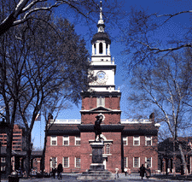
The Call for a Constitutional Convention
Twelve states sent delegates to the Convention held in Philadelphia. Only Rhode Island had declined.
There were 55 delegates. Thirty-four of them were lawyers.
The Convention began in Philadelphia on May 25, 1787.

Slide 6
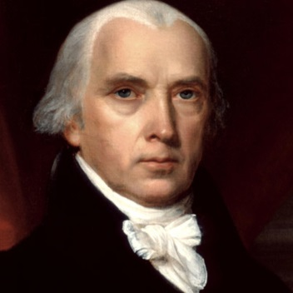
The Call for a Constitutional Convention
President of Convention- George Washington.
The delegates did not want to be pressured by the politics of the day, so they met in secret.
What we know about the convention is thanks to James Madison from Virginia.
He took detailed notes on the proceedings.

Slide 7
The Call for a Constitutional Convention
Who Was There?
The delegates at the Constitutional Convention (the convention where the Constitution was created) became known as the Founders of the United States.
Included was James Wilson, a delegate from
Pennsylvania. He worked with James Madison in pushing for a system of popular sovereignty, which is a government system where the people rule.

Slide 8
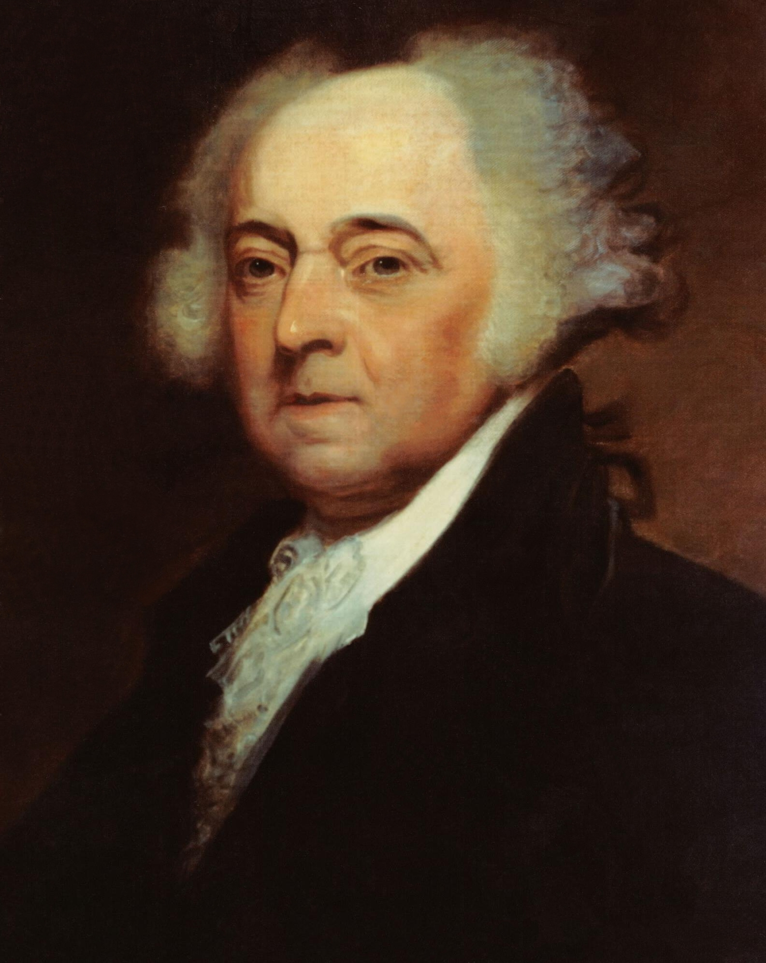
The Call for a Constitutional Convention
Who was not there:
Thomas Jefferson
John Adams
Both were overseas at their diplomatic posts.
Patrick Henry, who had been elected as a delegate from Virginia, refused to go. He said he “smelled a rat…tending toward monarchy.”

Slide 9
Some Challenges of the Convention
What were some of the major challenges facing the Convention?

Slide 10
Some Challenges of the Convention
Put yourself in the shoes of a delegate.
First Question:
Should we try to reform the Articles of Confederation or drop them completely and make a new constitution?
If so, how do we make a constitution where all states agree? The states were very different in size and economics.

Slide 11
Some Challenges of the Convention
The founders decided to make a whole new document and dropped the idea of trying to fix the Articles of Confederation.
The founders did not reinvent the wheel, but used great ideas already in circulation.
What were some of these great ideas? Hint: You can find these in the lesson “Influences on the Delegates.”

Slide 12
Some Challenges of the Convention
The delegates knew that the states wanted a government that was strong enough to protect people’s rights but not so strong that it would oppress them.

Slide 13
Some Challenges of the Convention
Disagreements over Representation
How should it be decided how many representatives each state sends to Congress to make laws?
Virginia Plan, designed by James Madison & other Virginians
New Jersey Plan, presented by William Patterson

Slide 14
Disagreements over Representation
Virginia Plan
Proposed a government with three branches
Executive branch= enforce the laws (President)
Judicial branch= interpret the laws (Supreme Court/ Judges)
Legislative branch= create the laws (Congress). This branch would have two sections, an Upper House (Senate) and a Lower House (House of Representatives). Both of these Houses would be filled with representatives based on a state’s population or it’s wealth.
Each branch could check the powers of the other branches in certain circumstances. This system of “checks and balances” is a way of controlling the power of the government.

Slide 15
Disagreements over Representation
Small states strongly opposed the Virginia Plan because it gave more power to states with larger populations.
In response, the New Jersey Plan was created as an alternative.
The New Jersey Plan called for
single chamber Congress
each state has an equal vote, as in the Articles of Confederation

Slide 16
Disagreements over Representation
 | Virginia Plan | New Jersey Plan
Legislative branch | -Two (branches) houses: representation determined by state population or wealth -Lower House: elected by the people -Upper House: elected by lower house (This plan gives the four largest states a majority in both houses). | -One house: one vote for each state, regardless of size -Elected by state legislators (This plan gives the 7 smallest states, which included just 25% of Americans, control of Congress).
Executive branch | Appointed by Legislature | Appointed by Legislature
Judicial branch | Appointed by Legislature | Appointed by Executive

Slide 17
Disagreements over Representation
By July 2 the convention was at a halt because of this dilemma.
To try to find a resolution, the delegates assigned a member from each state to the “grand committee” dedicated to compromise
What do you think happened? Virginia Plan? New Jersey Plan? Compromise? Something completely different and new?

Slide 18
Disagreements over Representation
The delegates compromised and agreed on a plan proposed by Roger Sherman
& the Connecticut delegation, known as the
Great Compromise. It was an agreement to
establish a two-house legislature, with all
states having equal representation in one
house and each state having representation
based on its population in the other house.

Slide 19
Disagreements over Representation
The Great Compromise:
Congress
House of Representatives
Representation determined by Population.
Large states were happy with this!
Senate
Every state has an equal number of Representatives.
Small states were happy with this!

Slide 20
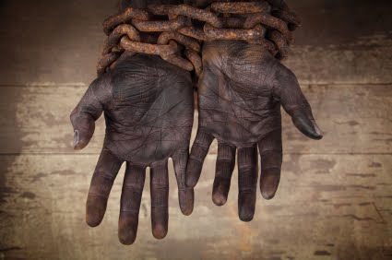
Challenges Over Slavery
How did the Constitutional Convention compromise over slavery?

Slide 21
Disagreement on Slavery
Southerners regarded slaves as “property” yet for political reasons they wanted slaves to be counted as people so that the slave owners would then have more representation in Congress. They did not want slaves counted when deciding how much tax they would have to pay.
Northerners knew the Southerners trick and did not want the slaves to be counted for representation, but did want the Southerners to be taxed for their slaves.

Slide 22
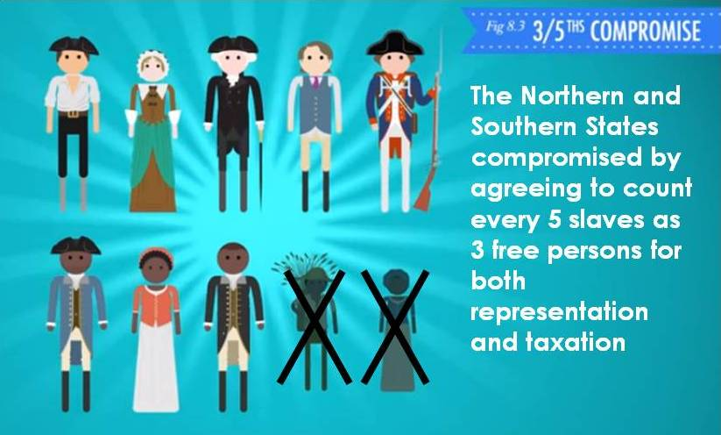
Disagreement on Slavery
Three-Fifths Compromise- agreement that three-fifths of a state’s slave population would be counted for representation in the legislature and taxation.

Slide 23
Disagreement on Slavery
Outlaw Slavery?
Slavery had already been outlawed in several Northern states and many Northerners wanted it outlawed throughout the U.S.
Southern slaveholders disagreed.
Georgia & South Carolina threatened to never accept a plan if their demands were not met.

Slide 24
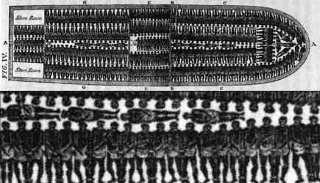
Disagreement on Slavery
Compromise: Slave trade could not be banned until 1808.

Slide 25
Compromise at Constitutional Convention
On September 17, 1787, the delegates passed the new Constitution.
Out of the 43 delegates presents, only three decided not to sign it.
Next Step: The Constitution had to be approved by the states.

Slide 26
Reflection:
Within the context of the late 18th century, were the compromises reached by the delegates reasonable? Were these compromises necessary in order to obtain approval of the Constitution?
Can you think of any issues in today’s society where compromise has or has not taken place?

Slide 27
Vocabulary
Constitutional Convention- 1787 meeting at which the U.S. Constitution was created
Founders- people who helped create the U.S. Constitution
James Madison- prominent adviser to the Constitutional Convention
Great Compromise- agreement to establish a two-house national legislature, with all states having equal representation in one house and each state having representation based on its population in the other house.

Slide 28
Vocabulary Continued
Three-Fifths Compromise- agreement that three-fifths of a state’s slave population would be counted for representation and taxation
Executive branch- government department that enforces laws
Judicial branch- government department that interprets laws
Legislative branch- government department that makes laws
Checks and balances- the ability of each branch of government to exercise checks, or controls, over the other branches

