Slide 2
8.6 Cytokinesis differs for plant and animal cells
In animal cells, cytokinesis occurs as
A cleavage furrow forms
-from a contracting ring of microfilaments
The cleavage furrow deepens to separate the contents into two cells.
Notes:
Teaching Tips
• Many students think of mitosis and cytokinesis as one process. In some situations, mitosis occurs without subsequent cytokinesis. Challenge your students to predict the outcome of mitosis without cytokinesis (multinuclear cells called a syncytium). This occurs in human development during the formation of the placenta.
• The authors make an analogy between a drawstring on a hooded sweatshirt and the mechanism of cytokinesis in animal cells. Students seem to appreciate this association. Have your students think of a person tightening the drawstring of sweatpants so tight that they pinch themselves in two, or perhaps nearly so! The analogy is especially good because, like the drawstring just beneath the surface of the sweatpants, the microfilaments are just beneath the surface of the cell’s plasma membrane.

Slide 3
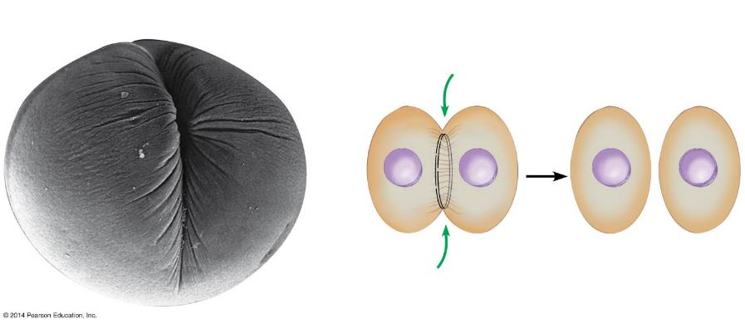
Figure 8.6a-0
Cytokinesis
Cleavage furrow
Contracting ring of microfilaments
Daughter cells
Notes:
Figure 8.6a-0 Cleavage of an animal cell

Slide 4
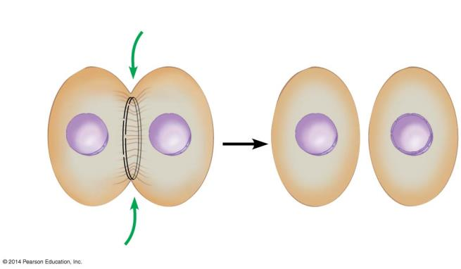
Figure 8.6a-2
Cleavage
furrow
Contracting ring of microfilaments
Daughter cells
Notes:
Figure 8.6a-2 Cleavage of an animal cell (part 2)

Slide 5
8.6 Cytokinesis differs for plant and animal cells
In plant cells, cytokinesis occurs as
A cell plate forms in the middle
-from vesicles containing cell wall material
The cell plate grows outward to reach the edges
-dividing the contents into two cells
Each cell now possesses a plasma membrane and cell wall.
Notes:
Teaching Tips
• Many students think of mitosis and cytokinesis as one process. In some situations, mitosis occurs without subsequent cytokinesis. Challenge your students to predict the outcome of mitosis without cytokinesis (multinuclear cells called a syncytium). This occurs in human development during the formation of the placenta.
• The authors make an analogy between a drawstring on a hooded sweatshirt and the mechanism of cytokinesis in animal cells. Students seem to appreciate this association. Have your students think of a person tightening the drawstring of sweatpants so tight that they pinch themselves in two, or perhaps nearly so! The analogy is especially good because, like the drawstring just beneath the surface of the sweatpants, the microfilaments are just beneath the surface of the cell’s plasma membrane.

Slide 6
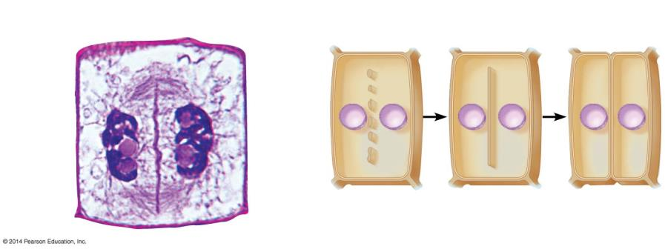
Figure 8.6b-0
Cytokinesis
New cell wall
Cell wall of the parent cell
Cell wall
Daughter nucleus
Cell plate forming
Vesicles containing cell wall material
Cell plate
Daughter cells
Notes:
Figure 8.6b-0 Cell plate formation in a plant cell

Slide 7
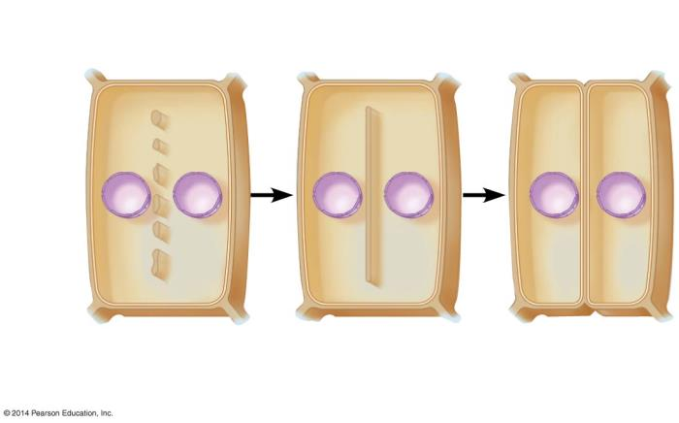
Figure 8.6b-2
New cell wall
Cell wall
Vesicles containing cell wall material
Cell plate
Daughter cells
Notes:
Figure 8.6b-2 Cell plate formation in a plant cell (part 2)

Slide 8
Animation: Cytokinesis

Slide 9
Answer in Notebooks
#8. Differentiate between cleavage furrow and cell plate.

Slide 10
8.7 Anchorage, cell density, and chemical growth factors affect cell division
Cell division is controlled by
anchorage dependence -the need for cells to be in contact with a solid surface to divide
density-dependent inhibition -crowded cells stop dividing
the presence of essential nutrients
growth factors -proteins that stimulate division.

Slide 11
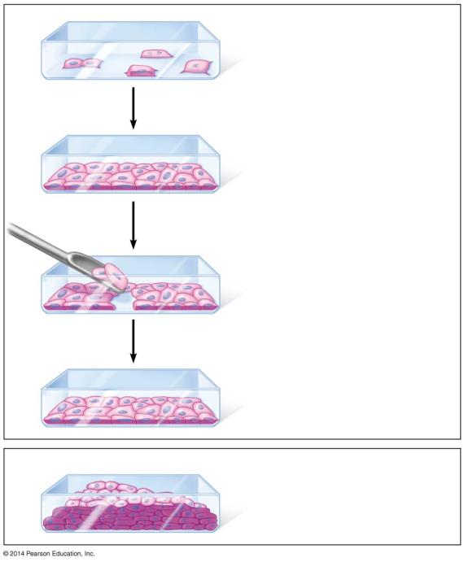
Figure 8.7a
Anchorage
Single layer of cells
Removal of cells
Restoration of single layer by cell division
Cancer cells forming clump of overlapping cells
Notes:
Figure 8.7a An experiment demonstrating density-dependent inhibition, using animal cells grown in culture

Slide 12
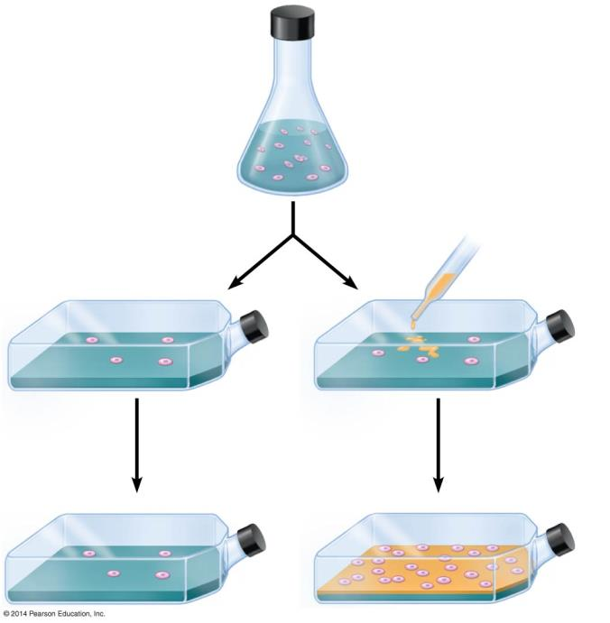
Figure 8.7b
Cultured cells suspended in liquid
The addition of growth factor
Cells fail to divide
Cells divide in presence of growth factor
Notes:
Figure 8.7b An experiment demonstrating the effect of growth factors on the division of cultured animal cells

Slide 13
Answer in Notebooks
#9. What are the 4 things that control cell division?

Slide 14
8.8 Growth factors signal the cell cycle control system
Cell cycle control system -cycling set of molecules in the cell that triggers and coordinates key events in the cell cycle.
Checkpoints in the cell cycle can
stop an event
signal an event to proceed
Notes:
Teaching Tips
• The cell cycle control system depicted in Figure 8.8A is like the control device of an automatic washing machine (which uses a turning dial). Each has a control system that triggers and coordinates key events in the cycle. However, unlike a washing machine, the components of the control system of a cell cycle are not all located in one place.

Slide 15
8.8 Growth factors signal the cell cycle control system
There are three major checkpoints in the cell cycle.
G₁ checkpoint: allows entry into the S phase or causes the cell to leave the cycle, entering a nondividing G₀ phase.
G₂ checkpoint
M checkpoint
Research on the control of the cell cycle is one of the hottest areas in biology today.
Notes:
Teaching Tips
• The cell cycle control system depicted in Figure 8.8A is like the control device of an automatic washing machine (which uses a turning dial). Each has a control system that triggers and coordinates key events in the cycle. However, unlike a washing machine, the components of the control system of a cell cycle are not all located in one place.

Slide 16
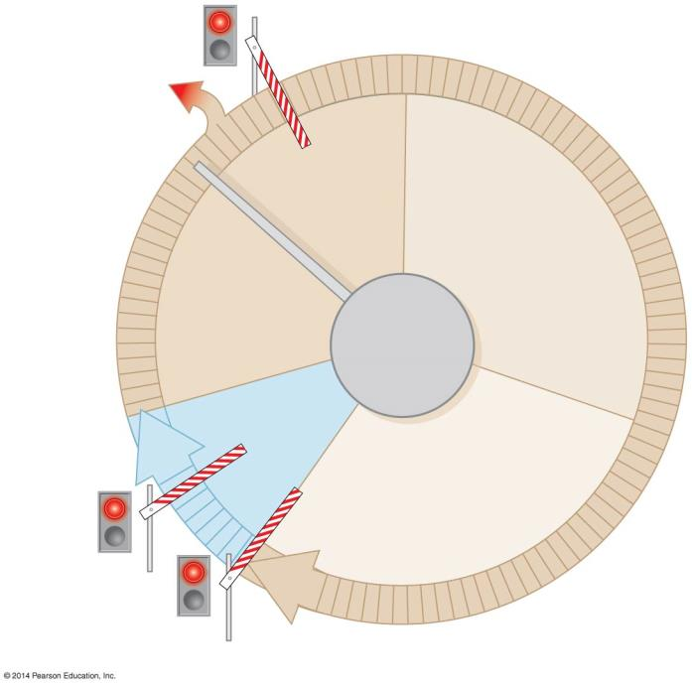
Figure 8.8a
G₁ checkpoint
G₀
G₁
S
Control system
M
G₂
M checkpoint
G₂ checkpoint
Notes:
Figure 8.8a A schematic model for the cell cycle control system

Slide 17
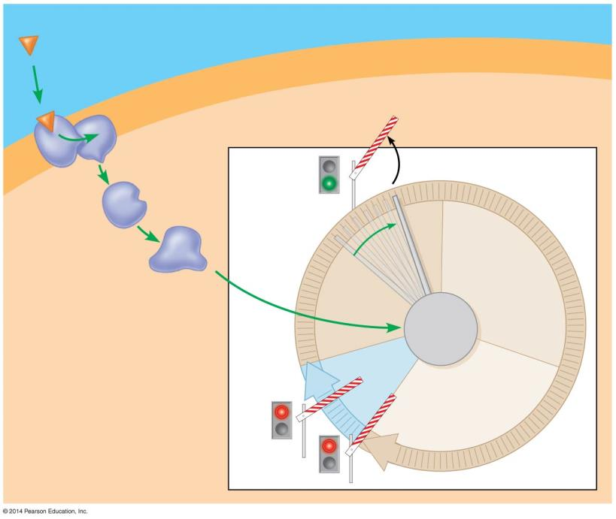
Figure 8.8b
Plasma membrane
Extracellular fluid
Growth factor
Relay proteins
G₁ checkpoint
Receptor protein
Signal transduction pathway
G₁
S
Control system
M
G₂
Cytoplasm
Notes:
Figure 8.8b How a growth factor signals the cell cycle control system

Slide 18
Answer in Notebooks
#10. What is the purpose of checkpoints in the cell cycle?

Slide 19
Cell Cycle
Cancer

Slide 20
8.9 CONNECTION: Growing out of control, cancer cells produce malignant tumors
Cancer currently claims the lives of 20% of the people in the United States.
Cancer cells escape controls on the cell cycle.
Cancer cells divide excessively and invade other tissues of the body.
Notes:
Student Misconceptions and Concerns
• Students do not typically know that not all cancers are genetically based. Consider making this clear early in your discussions. Challenge your students to explain how certain viruses can lead to cancer.
Teaching Tips
• Chemotherapy has some disastrous side effects. The drugs used to fight cancer may attack rapidly dividing cells. Unfortunately for men, the cells that make sperm are also rapidly dividing. In some circumstances, chemotherapy can leave a man infertile (unable to produce viable sperm) but still able to produce an erection. Many other approaches to attack cancers are under consideration. You may wish to explore these as sidelights to your lecture. Good resources include cell biology and development textbooks.
Active Lecture Tips
• See the Activity Losing Control of a Car Relates to Unregulated Cell Division on the Instructor Exchange. Visit the Instructor Exchange in the MasteringBiology instructor resource area for a description of this activity.

Slide 21
8.9 CONNECTION: Growing out of control, cancer cells produce malignant tumors
A tumor is a mass of abnormally growing cells within otherwise normal tissue.
Benign tumors remain at the original site but may disrupt certain organs if they grow in size.
Malignant tumors can spread to other locations in a process called metastasis.
An individual with a malignant tumor is said to have cancer.
Notes:
Student Misconceptions and Concerns
• Students do not typically know that not all cancers are genetically based. Consider making this clear early in your discussions. Challenge your students to explain how certain viruses can lead to cancer.
Teaching Tips
• Chemotherapy has some disastrous side effects. The drugs used to fight cancer may attack rapidly dividing cells. Unfortunately for men, the cells that make sperm are also rapidly dividing. In some circumstances, chemotherapy can leave a man infertile (unable to produce viable sperm) but still able to produce an erection. Many other approaches to attack cancers are under consideration. You may wish to explore these as sidelights to your lecture. Good resources include cell biology and development textbooks.
Active Lecture Tips
• See the Activity Losing Control of a Car Relates to Unregulated Cell Division on the Instructor Exchange. Visit the Instructor Exchange in the MasteringBiology instructor resource area for a description of this activity.

Slide 22
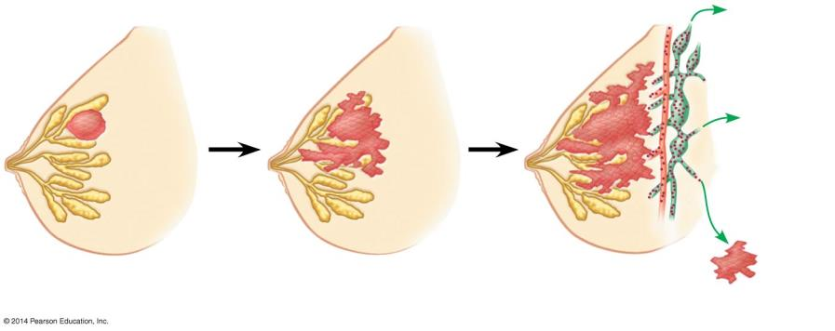
Figure 8.9
Lymph vessels
Blood vessel
Tumor
Tumor in
another part of the body
Glandular
tissue
Tumor growth
Invasion
Metastasis
Notes:
Figure 8.9 Growth and metastasis of a malignant (cancerous) tumor of the breast

Slide 23
8.9 CONNECTION: Growing out of control, cancer cells produce malignant tumors
Cancers are named according to the organ or tissue in which they originate.
Carcinomas originate in external or internal body coverings.
Leukemia originates from immature white blood cells within the blood or bone marrow.
Notes:
Student Misconceptions and Concerns
• Students do not typically know that not all cancers are genetically based. Consider making this clear early in your discussions. Challenge your students to explain how certain viruses can lead to cancer.
Teaching Tips
• Chemotherapy has some disastrous side effects. The drugs used to fight cancer may attack rapidly dividing cells. Unfortunately for men, the cells that make sperm are also rapidly dividing. In some circumstances, chemotherapy can leave a man infertile (unable to produce viable sperm) but still able to produce an erection. Many other approaches to attack cancers are under consideration. You may wish to explore these as sidelights to your lecture. Good resources include cell biology and development textbooks.
Active Lecture Tips
• See the Activity Losing Control of a Car Relates to Unregulated Cell Division on the Instructor Exchange. Visit the Instructor Exchange in the MasteringBiology instructor resource area for a description of this activity.

Slide 24
8.9 CONNECTION: Growing out of control, cancer cells produce malignant tumors
Localized tumors can be
removed surgically
treated with concentrated beams of high-energy radiation.
Metastatic tumors are treated with chemotherapy.
Notes:
Student Misconceptions and Concerns
• Students do not typically know that not all cancers are genetically based. Consider making this clear early in your discussions. Challenge your students to explain how certain viruses can lead to cancer.
Teaching Tips
• Chemotherapy has some disastrous side effects. The drugs used to fight cancer may attack rapidly dividing cells. Unfortunately for men, the cells that make sperm are also rapidly dividing. In some circumstances, chemotherapy can leave a man infertile (unable to produce viable sperm) but still able to produce an erection. Many other approaches to attack cancers are under consideration. You may wish to explore these as sidelights to your lecture. Good resources include cell biology and development textbooks.
Active Lecture Tips
• See the Activity Losing Control of a Car Relates to Unregulated Cell Division on the Instructor Exchange. Visit the Instructor Exchange in the MasteringBiology instructor resource area for a description of this activity.

Slide 25
8.10 Scientific Thinking: Tailoring treatment to each patient may improve cancer therapy
It is increasingly possible to personalize cancer treatment by
sequencing the genome of tumor cells and
tailoring treatment based upon the tumor’s specific genetic profile.
Notes:
Teaching Tips
• The following website describing Personalized Cancer Therapy at Vanderbilt-Ingram Cancer Center is a good introduction to the resources becoming available for genetically based, personal cancer treatments: www.vicc.org/personalized/.

Slide 26
Table 8.10
Notes:
Table 8.10 Numbers of cancer patients responding to the drug Everolimus

Slide 27
Cancer
How does cancer begin?
What can occurs when a cell does not follow the signals to stop dividing? (*hint the answer is NOT cancer)
Individual units of information are called what?

Slide 28
What happens to the cell if both copies of the tumor suppressor gene are damaged?
What is angiogenesis?
The movement of tumor cells to other parts of the body is known as what?
What is apoptosis?

Slide 29
http://www.cbsnews.com/news/billionaire-doctor-fights-cancer-in-unconventional-way/

