Slide 1
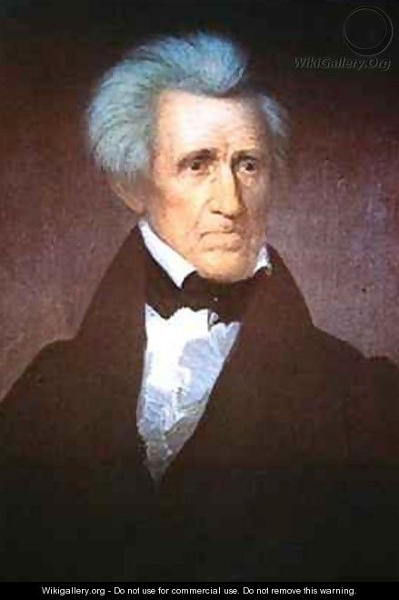
Chapter 12 Sec 2 Jackson’s Policy Towards NATAMS
Essential Question: How has Jackson impacted the United States?

Slide 2
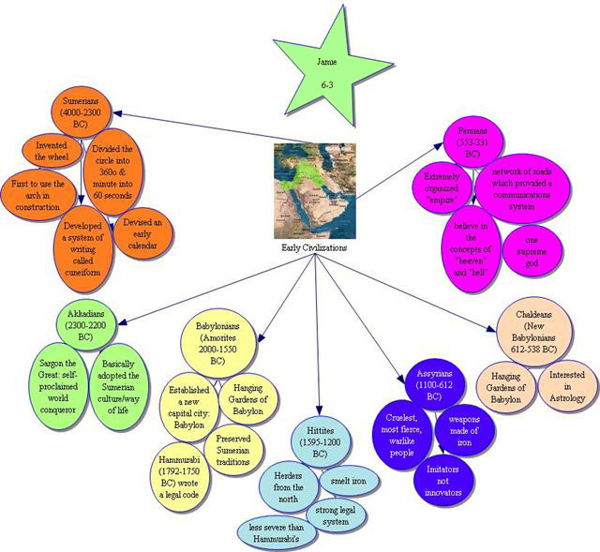
What are some characteristics of a civilization?
Think about it!

Slide 3
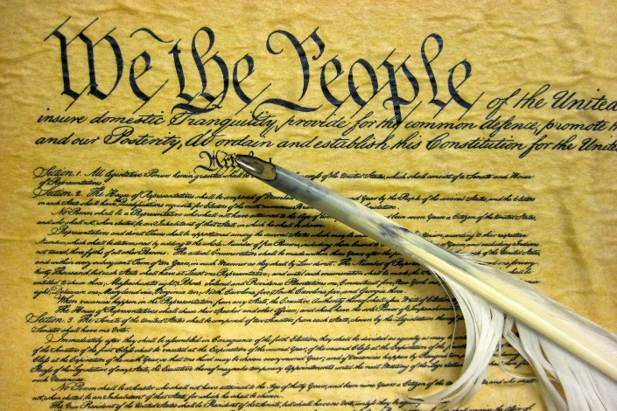
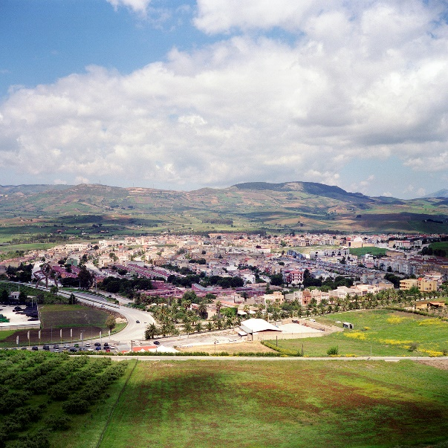
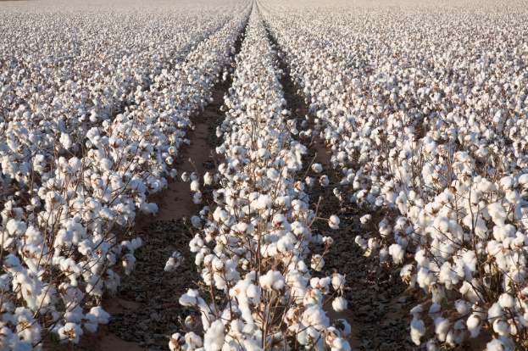
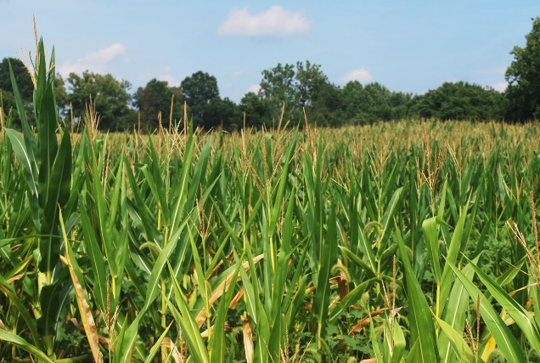
What are some characteristics of a civilization?
+
+

Slide 4
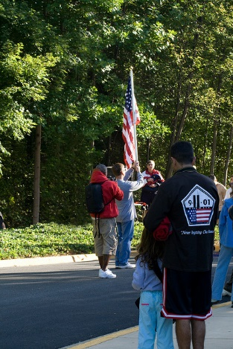
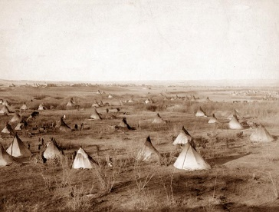
Two U.S. Policies Towards NATAMS
Assimilation
Removal/Reservation
Become like white man with same civilization ideas – same language, same religious ideas, etc.
Become a U.S. citizen
G. Washington’s Policy
Whites did not like NATAMS on “their” land - thought better for both races
Move to land west of Mississippi River
Started with T. Jefferson

Slide 5
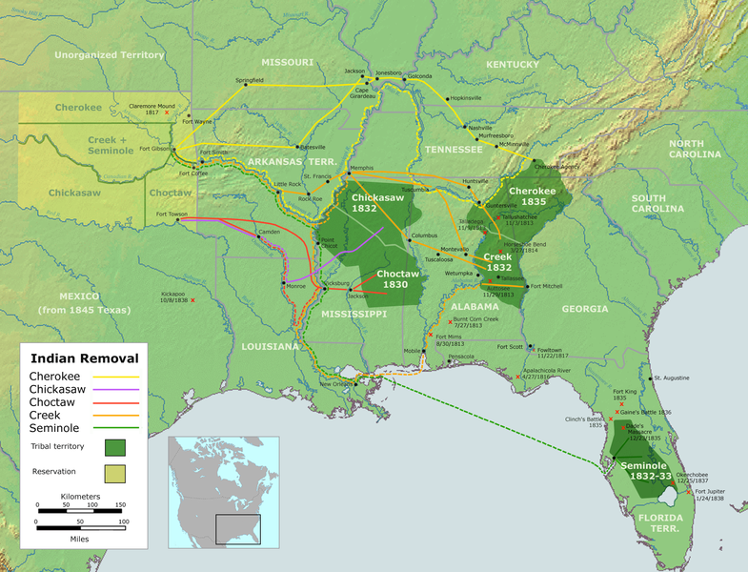
Five Civilized Tribes of the Southeast
Four “C”s and an “S” – Cherokee, Chickasaw, Choctaw, Creek & Seminole
Cherokee
Creek
Chickasaw
Choctaw
Seminole

Slide 6
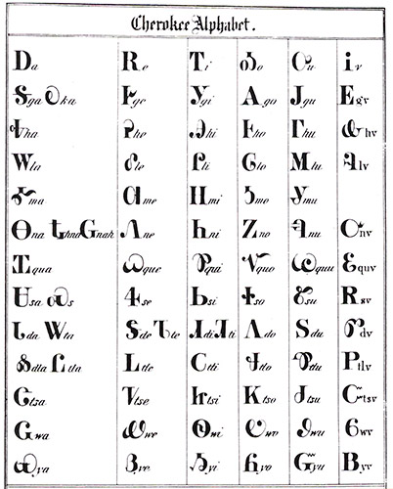
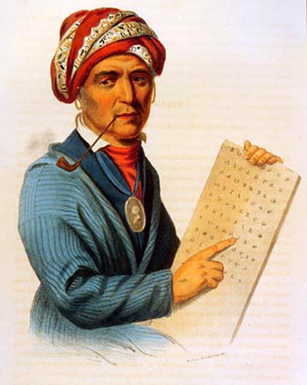
Why “Civilized Tribes”?
CHEROKEES had ALPHABET developed by SEQUOYA

Slide 7
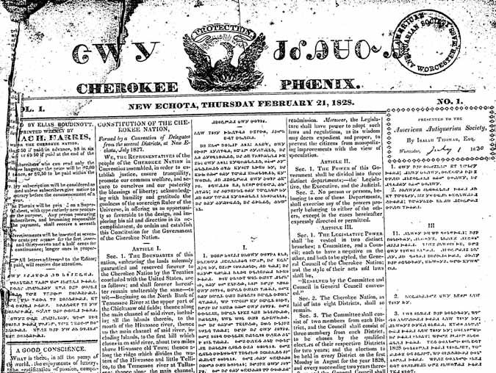
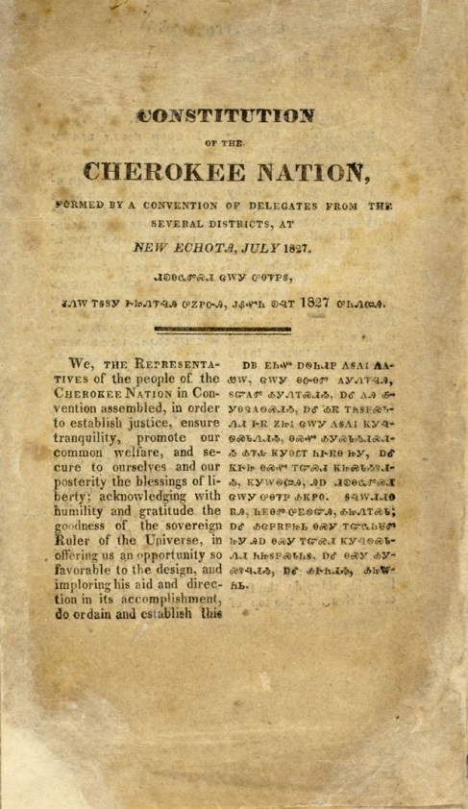
Why “Civilized Tribes”?
CHEROKEES had a CONSTITUTION similar to the U.S
CHEROKEES had a NEWSPAPER called the CHEROKEE PHOENIX

Slide 8
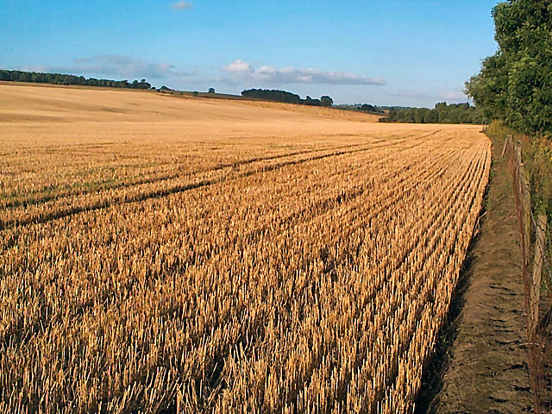
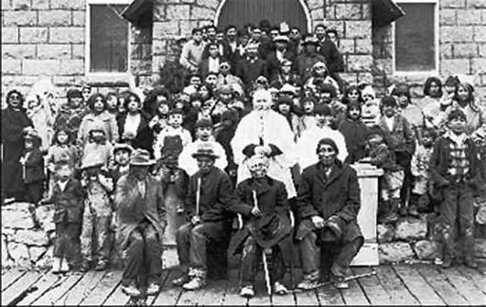
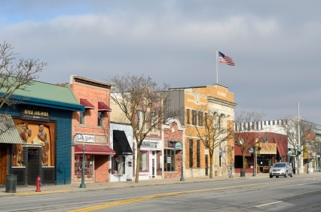
Why “Civilized Tribes”?
Many CHEROKEES had FARMS and PLANTATIONS – SOME owned SLAVES!
Or lived in TOWNS!
Many CHEROKEES had adopted CHRISTIANITY.

Slide 9
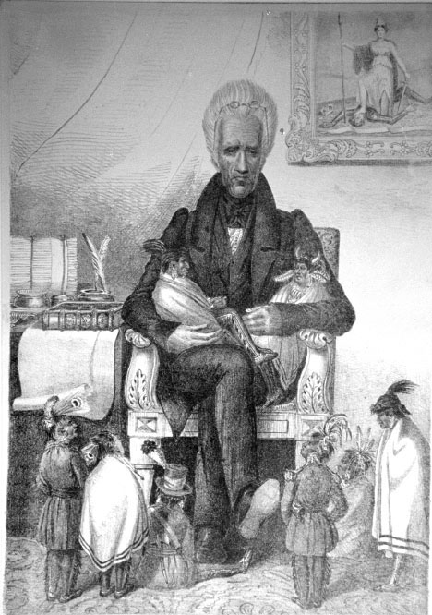
WHAT IS PRESIDENT JACKSON’S VIEW?
OBSERVATIONS – What do you see?
- Answer the four questions on WS # _____

