Slide 1
The Declaration of Independence

Slide 2
Do we need government?
What might life look like in a “state of nature”?
State of nature- a condition in which no government or laws existed at all.
People who are stronger or more skilled may abuse those who are weaker or less skilled
People would use their own skill to protect their natural rights
No one’s life, liberty, or property would be safe
No one would have the right to govern you

Slide 3
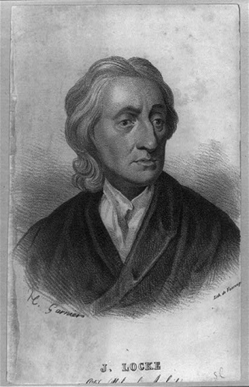
Philosopher: John Locke
Life: People want to survive. People want to be as safe as possible from threats to their lives.
Liberty: People want to be as free as possible. People want to be able to make their own decisions and to live as they please.
Property: People want to own the things that are necessary to survive, such as food, houses, tools, or land. People want the freedom to work and to gain economic benefits.

Slide 4
Are these Rights Man-made?
The Founders believed that such rights as those to life, liberty, and property are not manmade.
They believed our rights are based on the laws of nature which were made by God.
The Declaration of Independence speaks of “the Laws of Nature and of Nature’s God.”
It says people are “endowed by their Creator” with certain basic rights and that no one may take away these rights.

Slide 5
Purpose of Government
The main purpose of government is to protect those natural rights that the individual cannot effectively protect in a state of nature.
Social Contract- each person agrees with others to create and live under a government and give that government the power to make and enforce laws.
Each person agrees to give up the right to do whatever they want, in exchange for a government that will protect their natural rights.

Slide 6
Is the British king protecting the colonies natural rights?
The Founders believed that if the government did not protect these natural rights, then they have the right to change the government.
The Founders did not think Great Britain was protecting their natural rights, therefore they decided to break away and start their own government.

Slide 7
Declaration of Independence Parts
Ideals
Arguments
Complaints
Conclusion

Slide 8
Introduction
The colonists feel that they must explain to the world the reasons why they are separating from Britain.
It sets forth their beliefs about the purposes of government and how government is created.

Slide 9
When, in the course of human events, it becomes necessary for one people to dissolve the political bonds which have connected them with another, and to assume among the powers of the earth, the separate and equal station to which the laws of nature and of nature's God entitle them, a decent respect to the opinions of mankind requires that they should declare the causes which impel them to the separation.
We hold these truths to be self-evident [easy for anyone to see], that all men are created equal, that they are endowed [given] by their Creator [God] with certain unalienable rights [rights that cannot be taken away], that among these are life, liberty and the pursuit of happiness. That to secure these rights, governments are instituted [established] among men, deriving [receiving] their just powers from the consent [agreement] of the governed. That whenever any form of government becomes destructive to these ends [purposes], it is the right of the people to alter or to abolish[overthrow or put an end to] it, and to institute new government, laying its foundation on such principles and organizing its powers in such form, as to them shall seem most likely to effect their safety and happiness.

Slide 10
Arguments & Complaints
The Declaration gives the reasons why the colonies thought they were justified in breaking away from Great Britain.
The Declaration includes a list of complaints against the British king.
They show how the British government violated the rights of the colonists.

Slide 11
Conclusion
The colonies declare that the bond between Great Britain and the colonies is dissolved.
“…that these United Colonies are, and of Right ought to be, Free and Independent States.”

Slide 12
Declaration of Independence Facts
Committee of Five:
Thomas Jefferson
Benjamin Franklin
Robert Livingston
Roger Sherman
John Adams
July 2nd: Voted to be independent
July 4th: Adopted the document (DOI)
https://www.youtube.com/watch?v=nrvpZxMfKaU

