Slide 1
Chapter 20 THE CARDIOVASCULAR SYSTEM: THE HEART
Lecture Outline

Slide 2
INTRODUCTION
The cardiovascular system consists of the blood, heart, and blood vessels.
The heart is the pump that circulates the blood through an estimated 60,000 miles of blood vessels.
The study of the normal heart and diseases associated with it is known as cardiology.

Slide 3
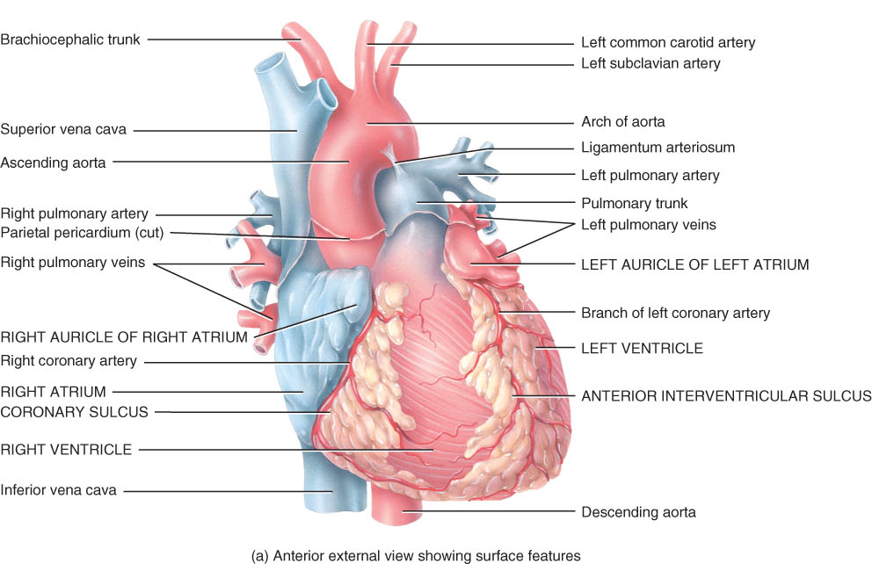
Chapter 20 The Cardiovascular System: The Heart
Heart pumps over 1 million gallons per year.
Over 60,000 miles of blood vessels

Slide 4
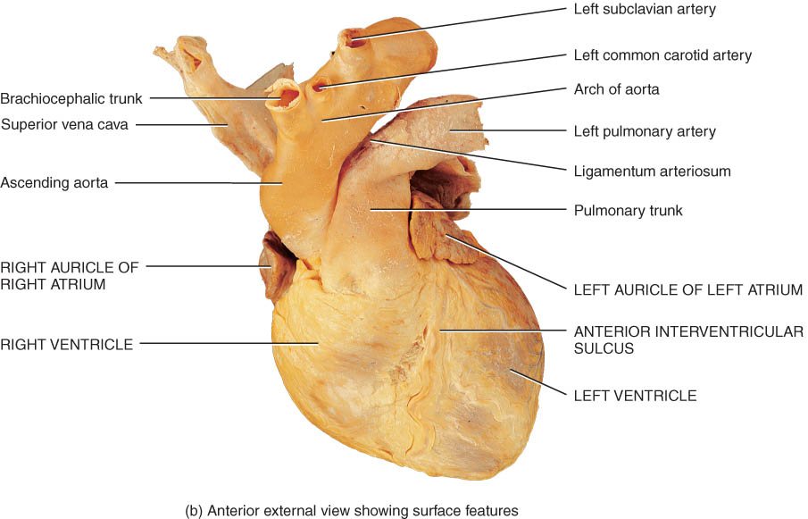
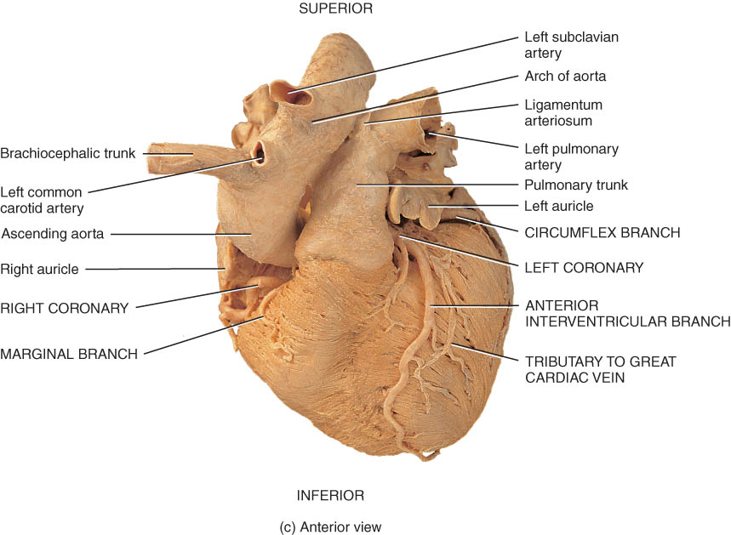
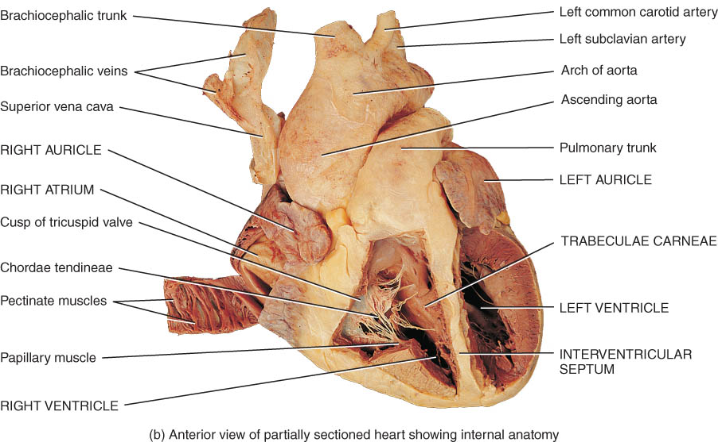
ANATOMY OF THE HEART

Slide 5
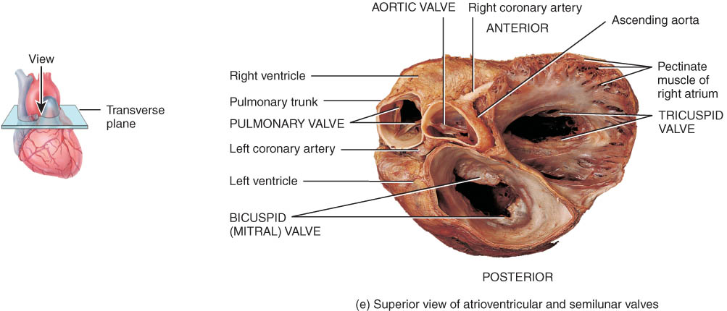
ANATOMY OF THE HEART

Slide 7
Rt. Atrium
Rt. Ventricle
Lt. Atrium
Lt. Ventricle

Slide 8
Location of the heart
The heart is situated between the lungs in the mediastinum with about two-thirds of its mass to the left of the midline (Figure 20.1).
Because the heart lies between two rigid structures, the vertebral column and the sternum, external compression on the chest can be used to force blood out of the heart and into the circulation. (Clinical Application)

Slide 9
Heart Location
Heart is located in the mediastinum
area from the sternum to the vertebral column and between the lungs

Slide 10
Heart Orientation
Apex - directed anteriorly, inferiorly and to the left
Base - directed posteriorly, superiorly and to the right
Anterior surface - deep to the sternum and ribs
Inferior surface - rests on the diaphragm
Right border - faces right lung
Left border (pulmonary border) - faces left lung

Slide 11
Heart Orientation
Heart has 2 surfaces: anterior and inferior, and 2 borders: right and left

Slide 12
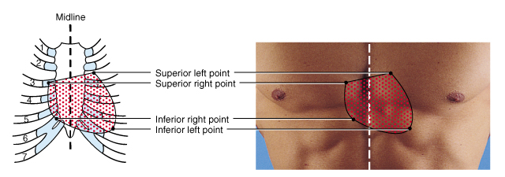
Surface Projection of the Heart
Superior right point at the superior border of the 3rd right costal cartilage
Superior left point at the inferior border of the 2nd left costal cartilage 3cm to the left of midline
Inferior left point at the 5th intercostal space, 9 cm from the midline
Inferior right point at superior border of the 6th right costal cartilage, 3 cm from the midline

Slide 13
Pericardium
The heart is enclosed and held in place by the pericardium.
The pericardium consists of an outer fibrous pericardium and an inner serous pericardium (epicardium). (Figure 20.2a).
The serous pericardium is composed of a parietal layer and a visceral layer.
Between the parietal and visceral layers of the serous pericardium is the pericardial cavity, a potential space filled with pericardial fluid that reduces friction between the two membranes.
An inflammation of the pericardium is known as pericarditis. Associated bleeding into the pericardial cavity compresses the heart (cardiac tamponade) and is potentially lethal (Clinical Application).

