Slide 1
Taxonomy

Slide 2
Phylum: Chordata
- chordates have:
1. notochords – a longitudinal, flexible rod located b/w the digestive tube and the nerve cord.
~ provides skeletal support
~ most adult vertebrates only retain remnants of the embryo notochord
Notes:
There are 2 subphyla of invertebrates (lancelets and tunicates), hagfishes and chordates

Slide 3
2. dorsal, hollow nerve cord
~ develops into central nerve system (brain and spinal cord)
3. pharyngeal slits/clefts – pouches separated by grooves along the sides of the pharynx. In most these grooves (clefts) open to the outside of body and are called slits.
~ can become gill slits in some animals
~ in tetrapods they play a role in the development of ear and parts of head and neck.
Notes:
Tetrapods = limbed animals

Slide 4
4. muscular, post-anal tail
~ in many species it is diminished during embryonic development.

Slide 5
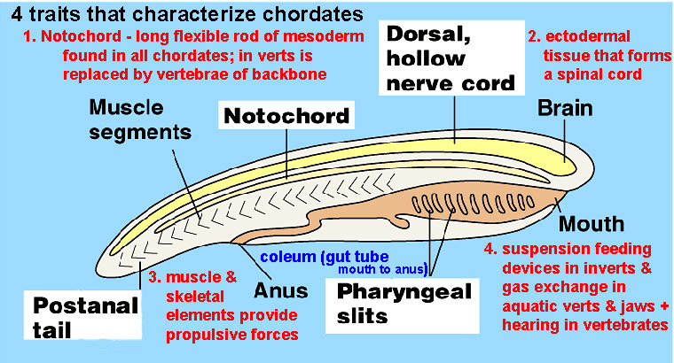

Slide 6
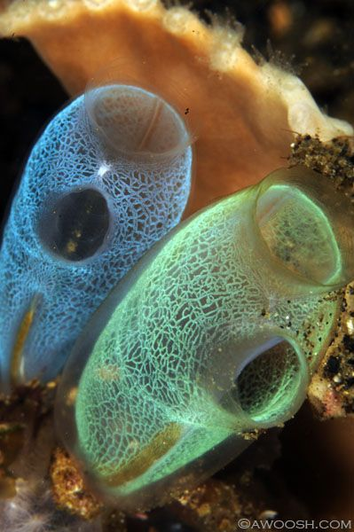
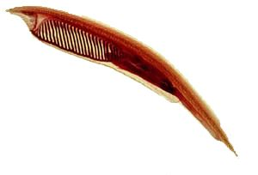
Invertebrate Chordates
Tunicates (aka sea squirts)
-siphons
-suspension feeders
-chordate features in larval form
Lancelets
-bladelike
-filter feed using mucus on the pharyngeal slits to trap food

Slide 7
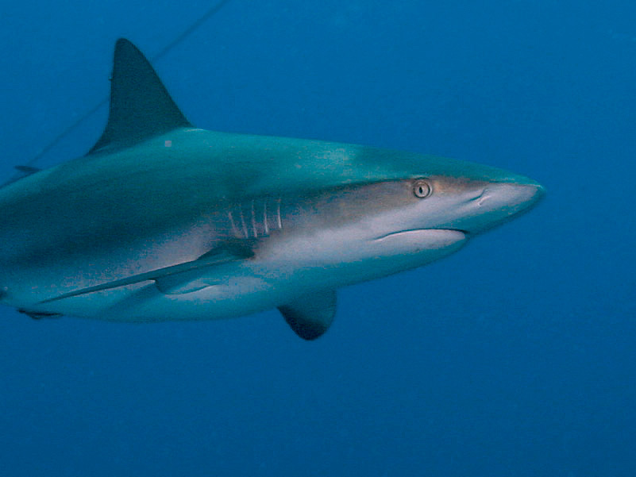
chordates with a head = craniates
Craniates with a backbone = vertebrates
1. gnathostomes = having jaws
a. chondrichthyes – cartilaginous fish (rays, skates and sharks)

Slide 8
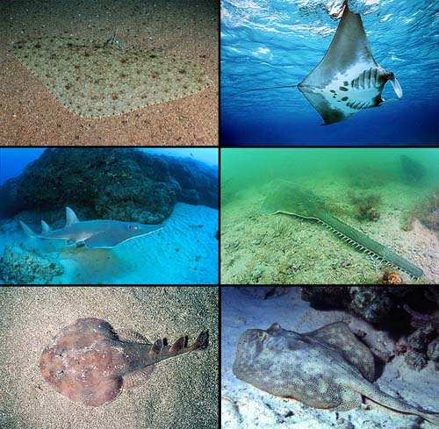

Slide 9
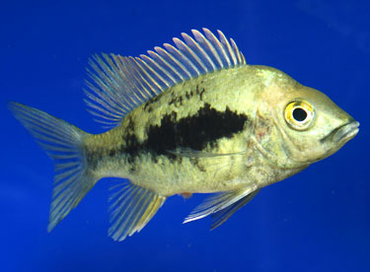
b. osteichthyes – bony fish originally, though now encompasses much, much more (including us)
i. ray-finned fishes (perch, bass, clown fish, salmon, etc.)

Slide 10
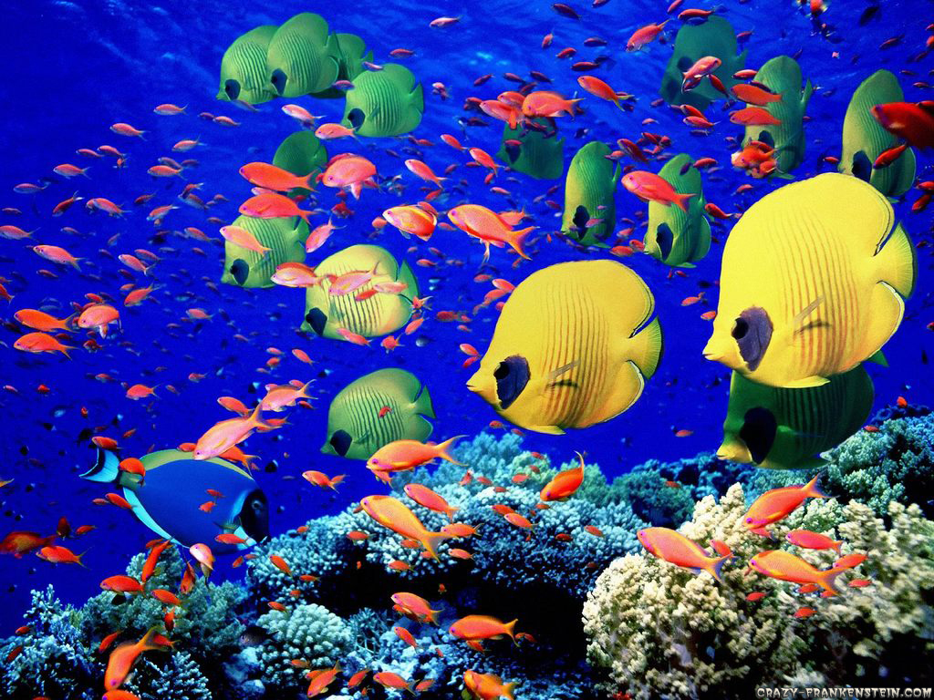

Slide 11
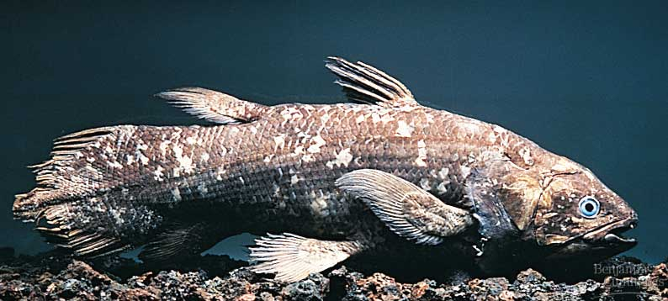
ii. Lobe-fins – have rod-shaped bones surrounded by a thick layer of muscle in their pectoral and pelvic fins
- coelacanth – thought extinct
Notes:
Coelacanth – thought to have been extinct 75 mya, but discovered in 1938 in Western Indian Ocean

Slide 12
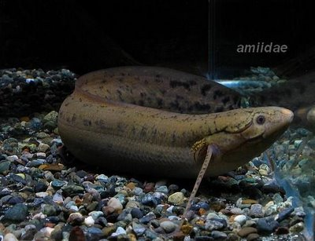
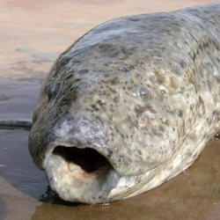
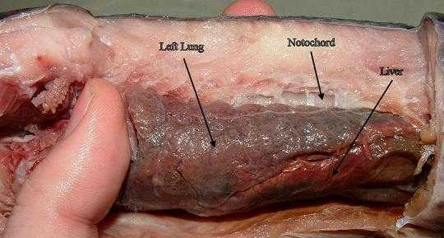
- lungfishes – gills and lungs

Slide 13
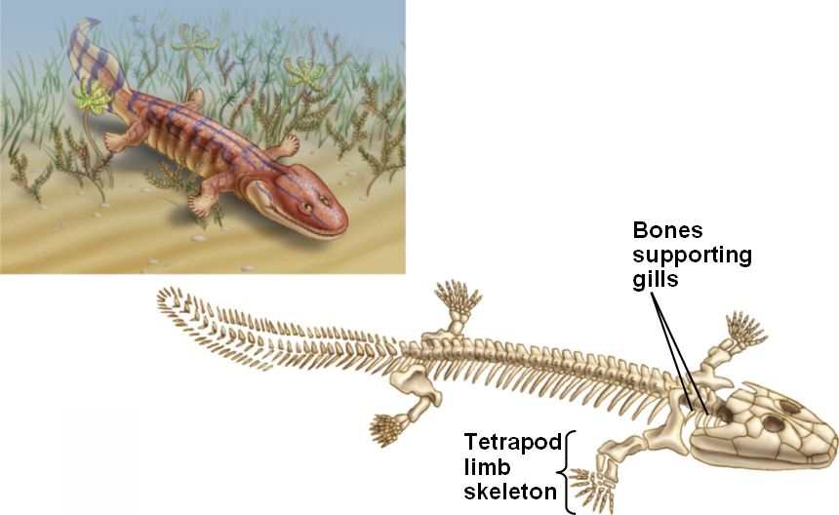
- tetrapods – in place of pelvic and pectoral fins, they have limbs that can support their weight on land
Acanthostega, Devonian relative of tetrapods

Slide 14
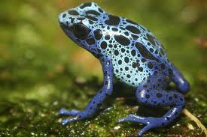
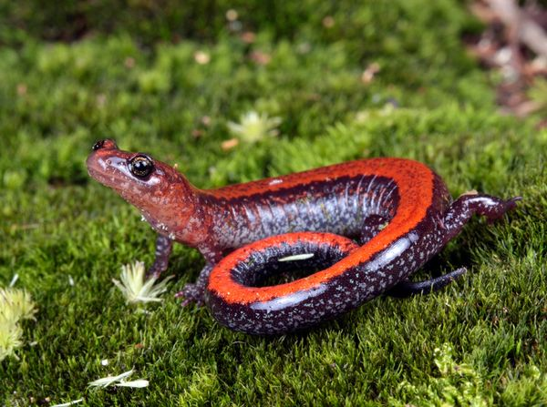
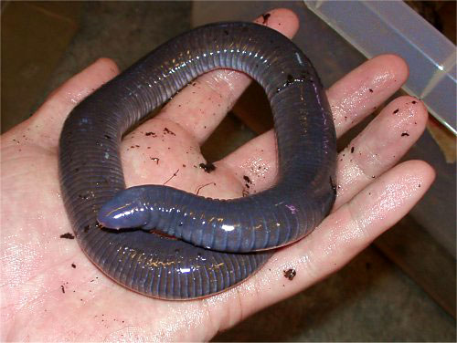
Tetrapods
A. amphibians (frogs, salamanders)
1. 2 life stages – tadpole (aquatic with gills ) metamorphoses into adult with limbs (may be terrestrial with lungs and gas exchange through skin)
2. unshelled eggs
Frog
Salamander
Caecillian
Notes:
Caecillian ancestor had legs,

Slide 15
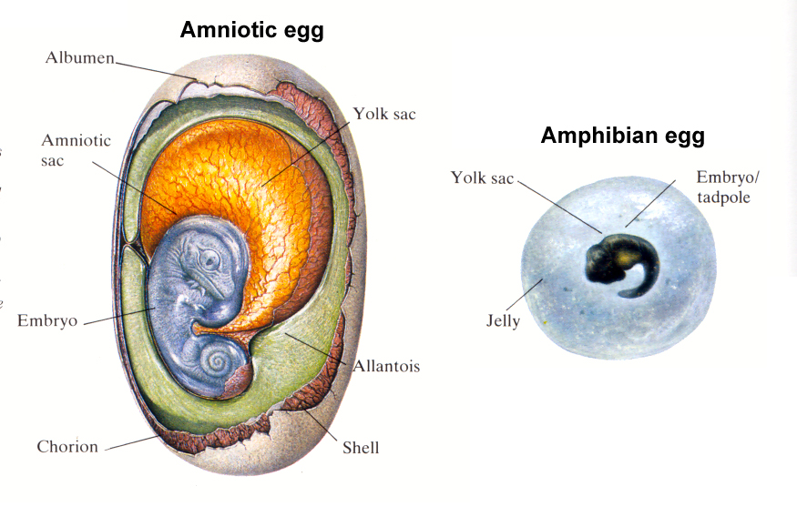
Notes:
The amniotic egg contains several membranes that allowed animals to live a fully terrestrial life style.The amnion protects the embryo in a fluid-filled cavity that serves as a cushion.
The allantois holds metabolic wastes produced by the embryo.
The chorion exchanges gases between the embryo and the air.
The yolk sac provides nutrients; other nutrients are stored in the albumen (egg white).

Slide 16
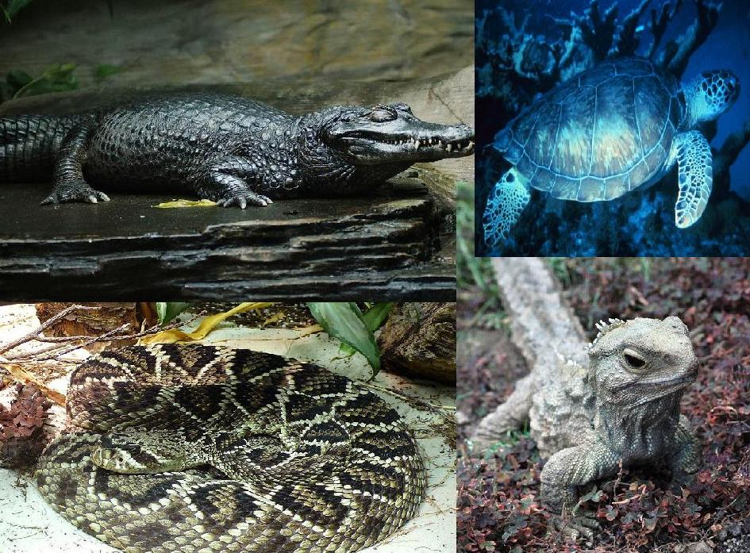
B. amniotes – form amniote eggs
1. reptiles (lizards, snakes, turtles, crocodilians, bird)
a. many are ectothermic = cannot regulate body temp internally
- scales, shelled eggs (some hard, some leathery)
Notes:
Amniote eggs allowed organisms to move reproduction out of the water
All of extant reptiles, except turtles, are diapsids – have 2 holes on side of skull behind eye sockets

Slide 17
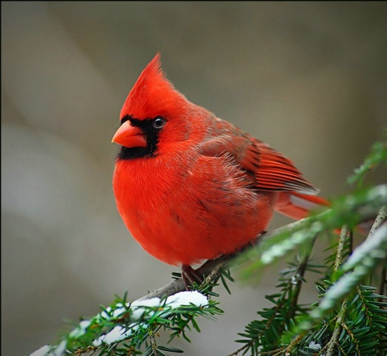
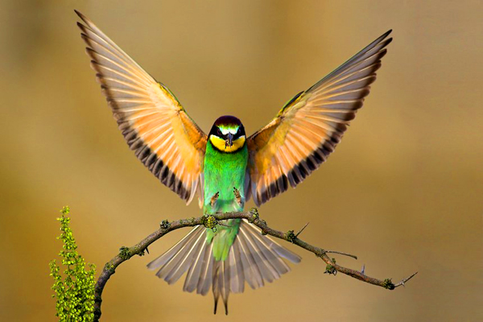
b. birds (aves) are endothermic which means they are capable of maintaining internal temps through metabolism
i. hard shelled eggs, hollow bones, feathers (made of keratin like scales of other reptiles)

Slide 18
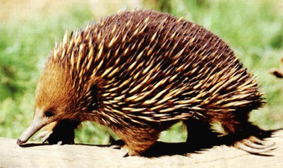
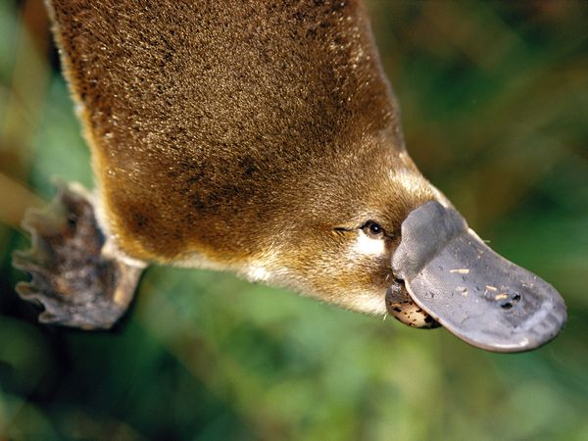
2. Mammals – amniotes with hair and produce milk.
a. monotremes – platypus & echidna
- lay eggs
- no nipples, milk is secreted by glands on mother’s belly and is sucked off of fur by baby
Notes:
Mammal = synapsids, a single temporal fenestra, hole behind the eye socket on each side of skull

Slide 19
b. marsupials – opossums, kangaroos, koalas, etc.
- live young, with nipples for providing milk
- higher metabolic rates
- have a placenta to diffuse nutrients into embryo from mother’s blood.
- infants are born very immaturely, crawl from reprod tract to pouch on mother for remainder of development

Slide 20
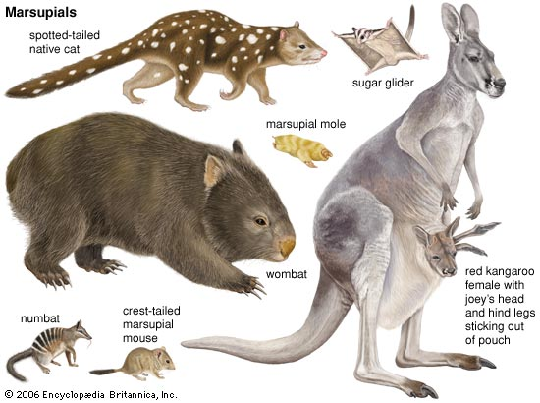
marsupials

Slide 21
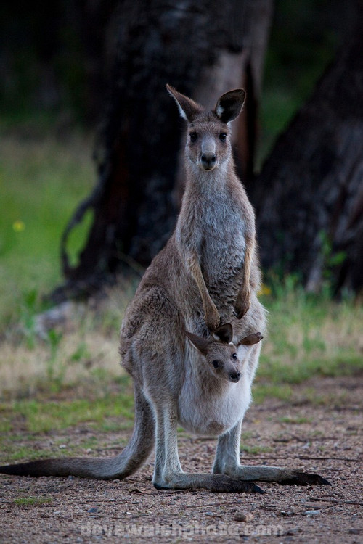
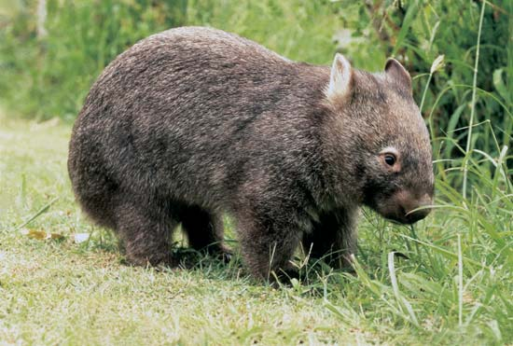
Notes:
Kanaroo with joey and wombat

Slide 22
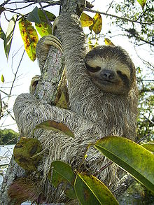
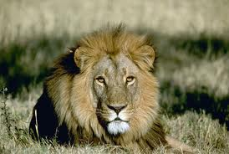
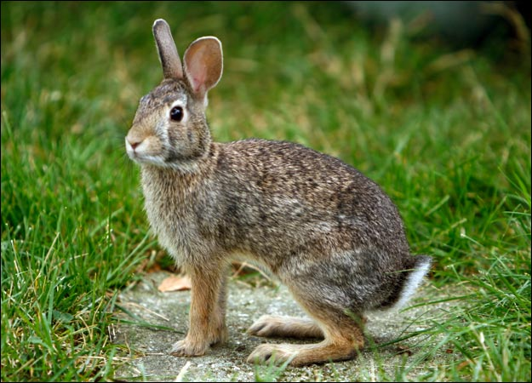
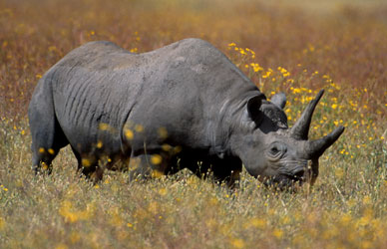
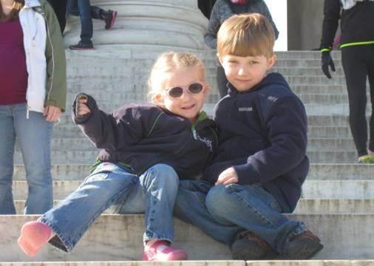
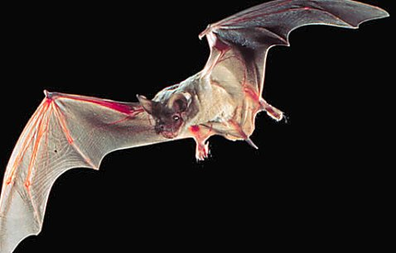
c. eutherians (placental mammals)
- more complex placenta
- longer pregnancy

Slide 23
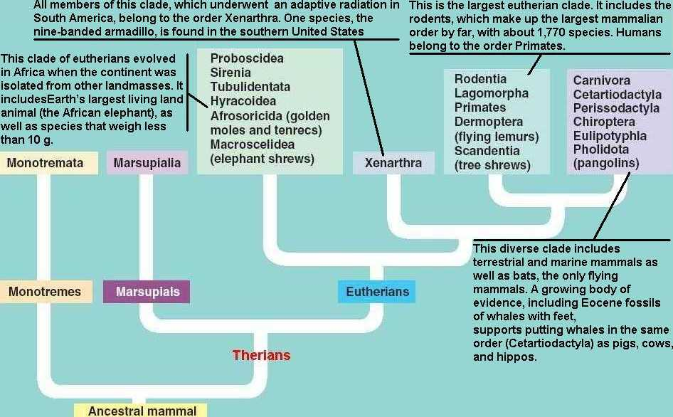

Slide 24
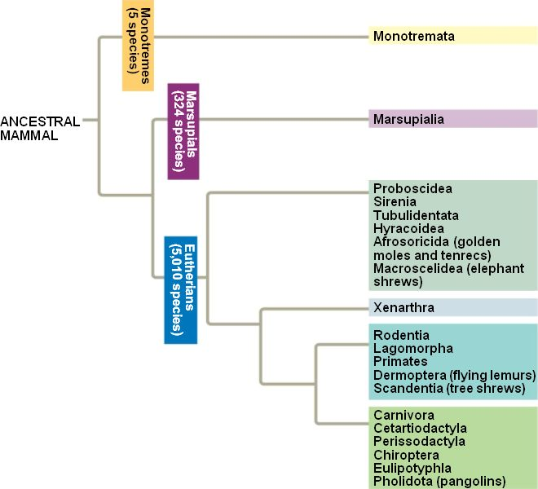

Slide 25
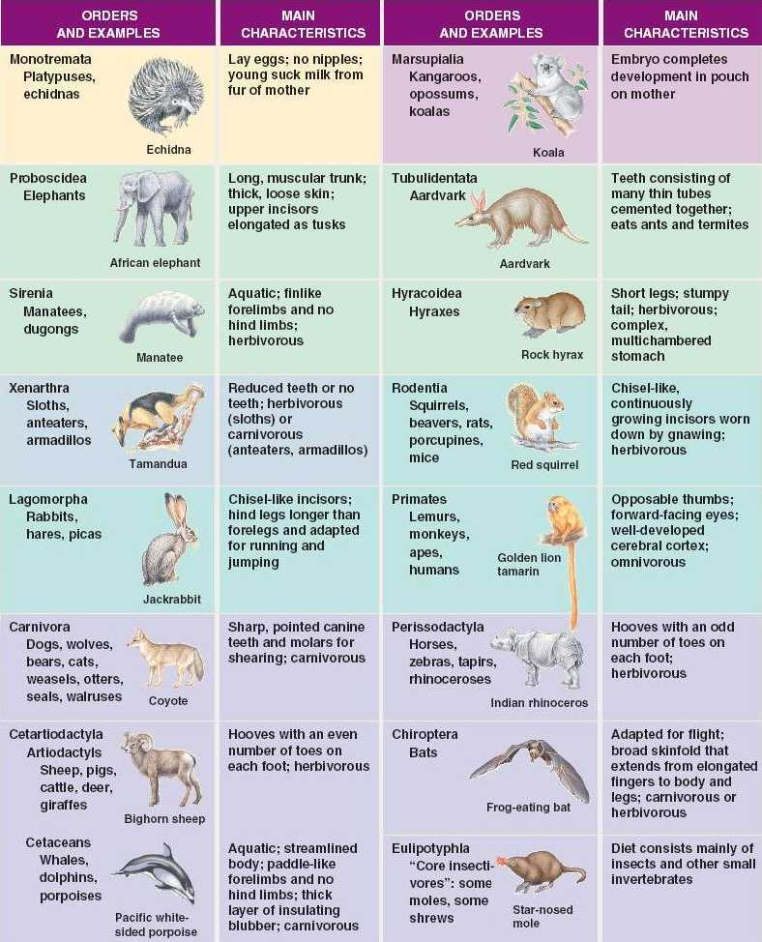
Notes:
Colors match tree on previous slide

