Slide 1
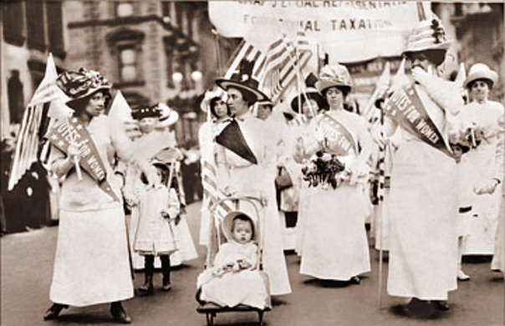
Lesson 4: Women In Public Life
The Big Idea: As a result of social and economic change, may women entered public life as workers and reformers.
Why It Matters Now: Women won new opportunities in labor and education that are enjoyed today.
Key Terms and People: NACW / Susan B. Anthony / Suffrage / Elizabeth Cady Stanton / NAWSA

Slide 2
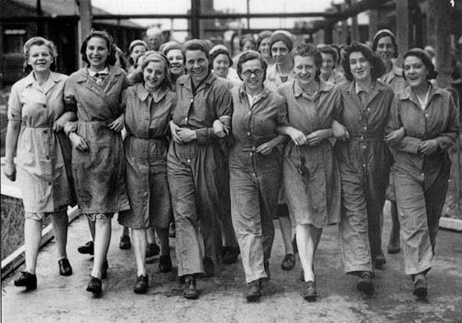
LESSON 4
Women and Public Life
Women in the Work Force
Only middle-, upper-class women can devote selves to home, family
Poor women usually have to work for wages outside home
Farm Women
On Southern, Midwestern farms, women’s roles same as before
Perform household tasks, raise livestock, help with crops
Women in Industry
After 1900, 1 in 5 women hold jobs; 25% in manufacturing
50% industrial workers in garment trade; earn half of men’s wages
Jobs in offices, stores, classrooms require high school education
Business schools train bookkeepers, stenographers, typists
Continued…

Slide 3
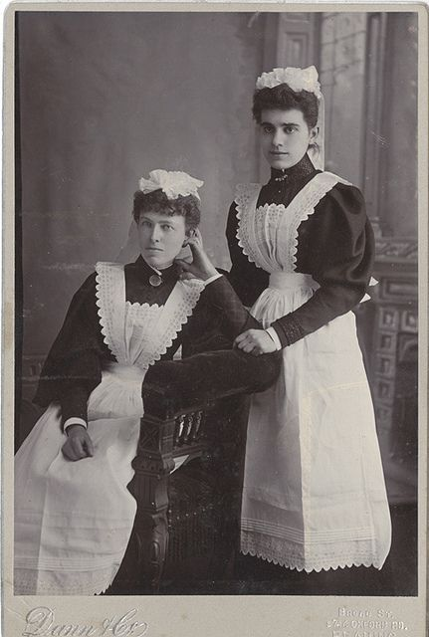
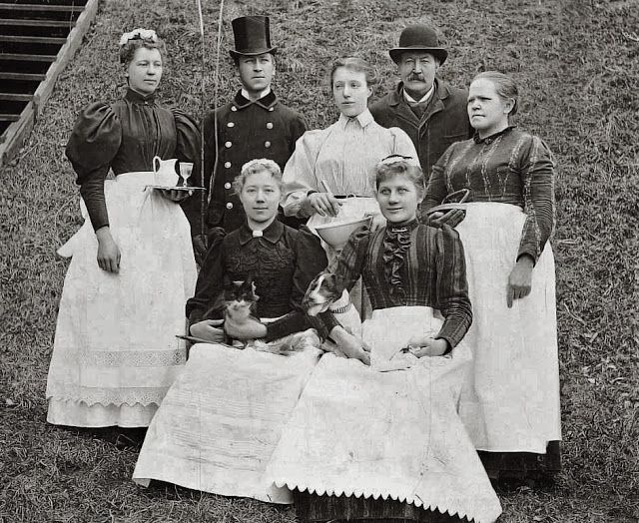
Lesson 4
Women in the Work Force (continued)
Domestic Workers
In 1870, 70% of employed women do domestic work
Many African-American, immigrant women do domestic labor
married immigrants take in piecework, boarders
Property Rights
Until mid-1800s, wages of women property of husband
1839, Mississippi passes Married Women’s Property Act

Slide 4
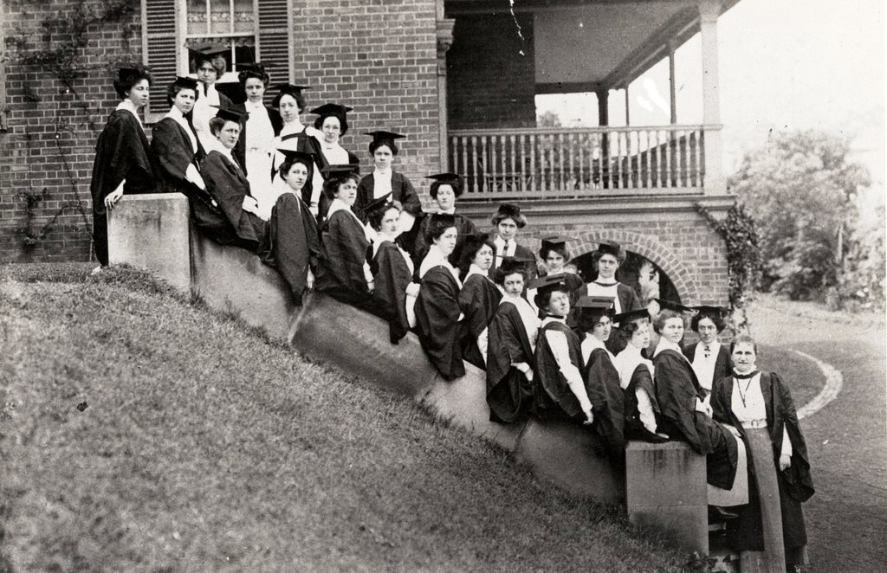
LESSON 4
Women and Public Life
Women Lead Reform
Many female industrial workers seek to reform working conditions
Women form cultural clubs, sometimes become reform groups
Women in Higher Education
Many women active in public life have attended new women’s colleges
50% college-educated women never marry; many work on social reforms
Women and Reform
Women reformers target workplace, housing, education, food and drugs laws
National Association of Colored Women (NACW)—child care, education
Susan B. Anthony and Elizabeth Cady Stanton found National American Woman Suffrage Association (NAWSA)
works for woman suffrage, or right to vote
Continued…

Slide 5
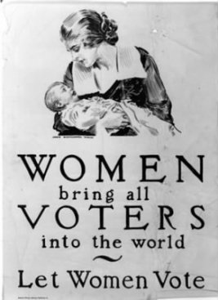
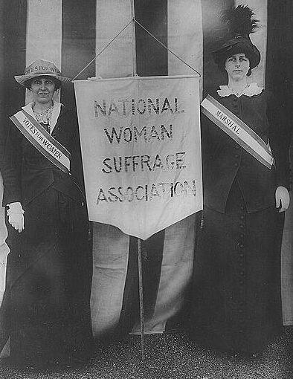
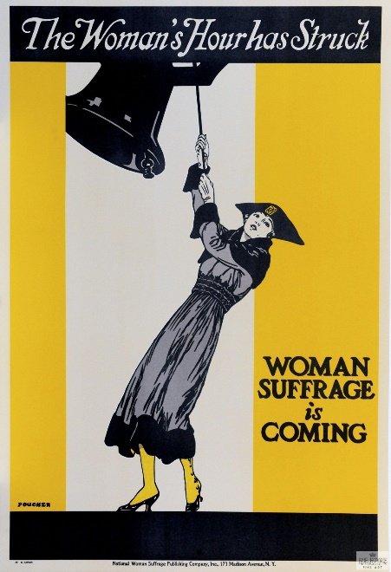
Lesson 4
Women Lead Reform (continued)
A Three-Part Strategy for Suffrage
Convince state legislatures to give women right to vote
Test 14th Amendment, states lose representation if deny men vote
Push for constitutional amendment to give women the vote

