Slide 1
Jay v. Pinckney Treaties
A Review:
Decide if the slide pertains to the Jay or Pinckney Treaty

Slide 2
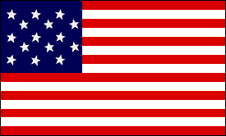
It was an agreement between Spain and the United States

Slide 3
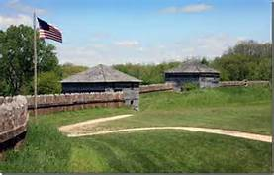
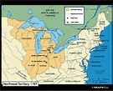
The British agreed to leave their forts in the Northwest Territory.

Slide 4
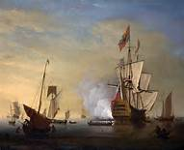
England agreeed to pay for ships and cargoes captured at sea.

Slide 5
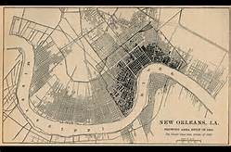
Western farmers can store their trade goods in New Orleans without paying taxes.

Slide 6
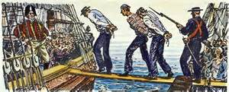
It did not open Caribbean trade; English ships still raided American merchant ships; did not stop impressment.

Slide 7
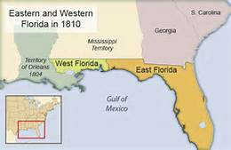
Border with Florida (a Spanish colony at the time) was settled at 31º N.

Slide 8
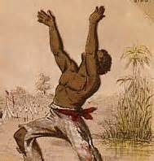
Southern slave owners did not like it because it did not pay for slaves freed by the British during the American Revolution.

Slide 9
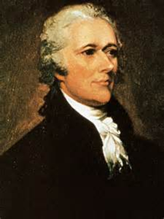
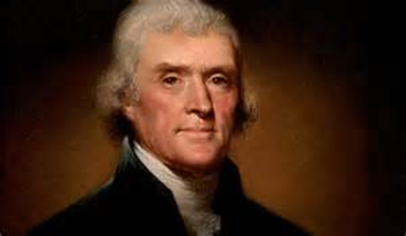
Both Jefferson and Hamilton liked this treaty.
Jefferson because it helped the western farmer with river trade.
Hamilton because it opened up trade.

Slide 10
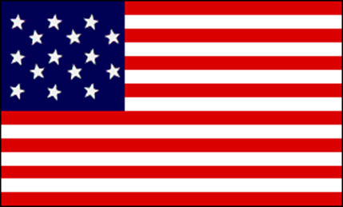
Agreement between the United States and England

Slide 11
Controversial Treaty
Narrowly passes the Senate with Hamilton’s support.
Jefferson fought against this treaty.

